Slide 1

Cybersecurity Fundamentals: Hands-On Labs
A practical guide to identifying and mitigating security risks through four comprehensive lab exercises.

Slide 2
Lab Overview
01
02
Asset-Threat-Vulnerability Mapping
CIA Triad Implementation
Identify risks in a business environment by mapping critical assets, potential threats, and existing vulnerabilities
Protect files using encryption (Confidentiality), checksums (Integrity), and backup systems (Availability)
03
04
Network Security with Firewall Rules
Password Policy Enforcement
Block unwanted network traffic using firewall configurations to prevent unauthorized access
Prevent weak passwords from being compromised through policy implementation and testing
Each lab provides hands-on experience with essential cybersecurity concepts and tools that form the foundation of effective security practices.

Slide 3
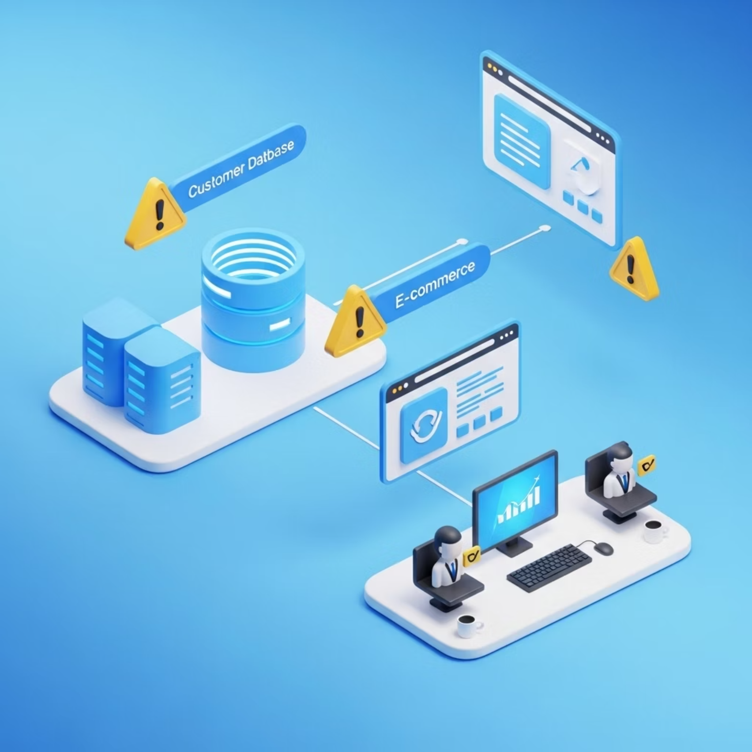
Lab 1: Asset-Threat-Vulnerability Mapping
Objective: Identify risks by mapping assets, threats, and vulnerabilities
For this lab, imagine you own a small online retail store with these key assets:
Customer database (names, emails, payment info)
E-commerce website (where customers buy products)
Employee workstations (computers used by staff)
We'll create a risk assessment table to identify threats, vulnerabilities, risk levels, and appropriate mitigations for each asset.

Slide 4
Lab 1: Risk Assessment Table
Asset
Threat
Vulnerability
Risk Level
Mitigation
Customer Database
Data Breach
Weak encryption
High
Use AES-256 encryption
E-commerce Website
DDoS Attack
No Web Application Firewall
Medium
Deploy Cloudflare WAF
Employee Workstations
Ransomware
No antivirus
High
Install EDR (e.g., Wazuh)
Risk Level = Threat Likelihood × Impact
Technical Controls
Administrative Controls
Physical Controls
Firewalls, encryption, antivirus
Training, policies, procedures
Locks, security cameras, secure rooms

Slide 5






Lab 2: Implementing the CIA Triad
Objective: Protect files using encryption, checksums, and backups
Integrity
Detect if files were changed using checksums (SHA-256)
Confidentiality
Keep data secret from unauthorized people using encryption (AES-256)
Availability
Ensure files are not lost using automated backups

Slide 6
Lab 2: Hands-On Implementation
Confidentiality (Encryption)
Integrity (Checksum)
Steps:
Steps (PowerShell):
Create a file secret_data.txt with sensitive info
#Step1: This is done by the sender(Get-FileHash .\secret_data.txt -Algorithm SHA256).Hash | Out-File -Encoding ASCII -NoNewline checksum.sha256#Step2: what attackers can do to you file.Add-Content .\secret_data.txt "`nAdded line"#Step3: The Receiver Verification(Get-Content .\checksum.sha256) -eq (Get-FileHash .\secret_data.txt -Algorithm SHA256).Hash
Right-click → 7-Zip → Add to Archive
Set a password and choose AES-256 encryption
Why? If hackers steal the file, they can't open it without the password.
Why? Ensures no one tampered with the file.
Availability (Backups)
Create automated backups using Task Scheduler (Windows) or crontab (Linux) to run robocopy or rsync commands daily.
$source = "C:\Users\uwajo\Documents"
$destination = "D:\Backup"
# Ensure destination exists
New-Item -ItemType Directory -Path $destination -Force
# Run robocopy
robocopy $source $destination /MIR
Why? If files are deleted or encrypted by ransomware, you can restore from backup.

Slide 7
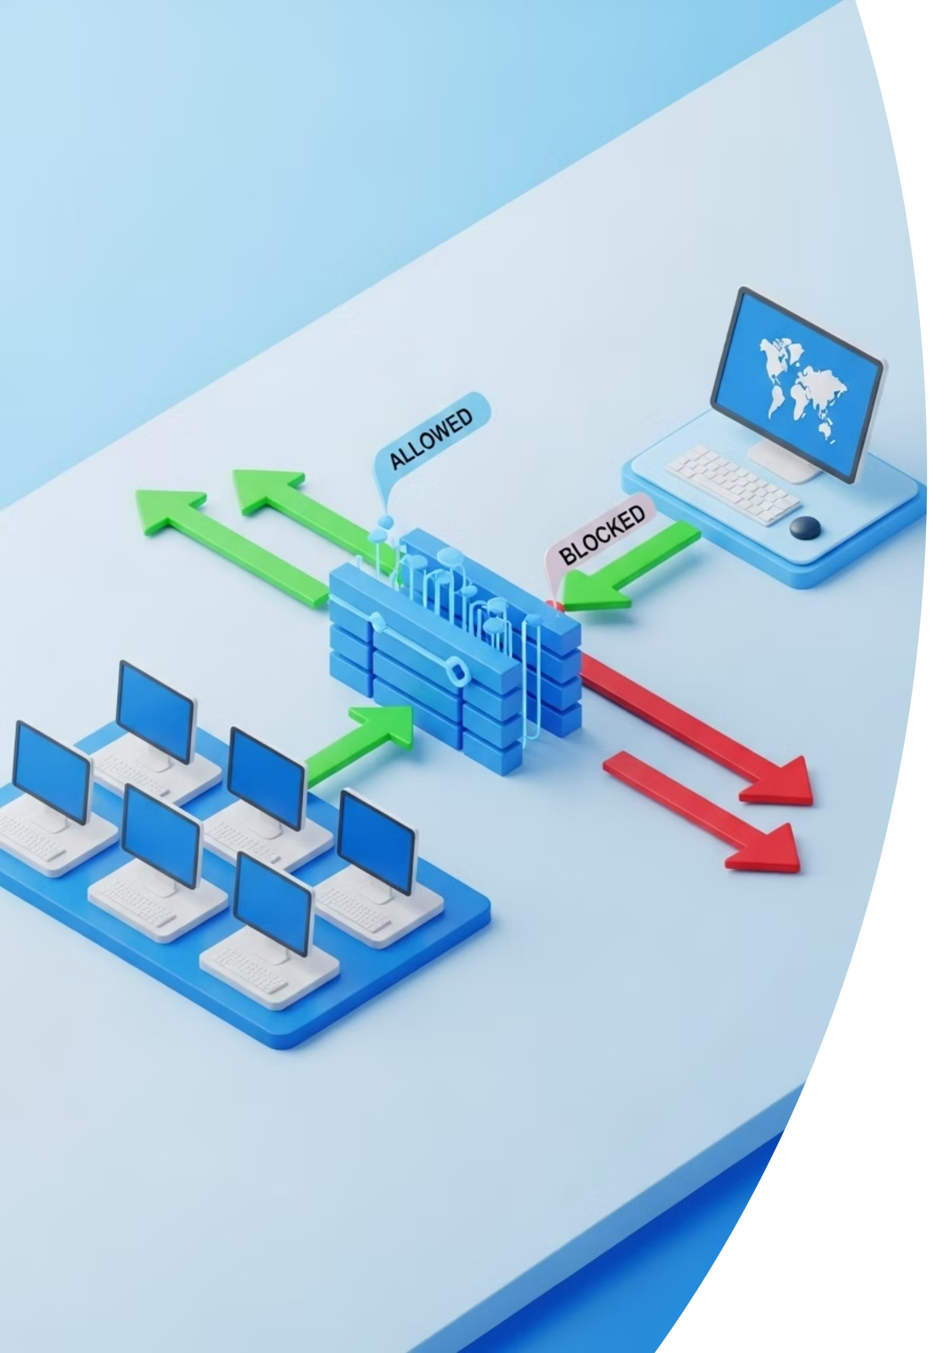

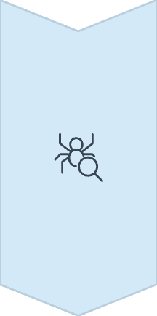

Lab 3: Network Security with Firewall Rules
Objective: Block unwanted network traffic using firewalls
Block ICMP (Ping)
Stop hackers from discovering your computer using ping requests
New-NetFirewallRule -DisplayName "Block ICMP" -Direction Inbound -Protocol ICMPv4 -Action Block
Test with Nmap
Verify your firewall is working by scanning from another computer
nmap -Pn
Allow Only Secure Access
Permit only SSH/RDP for authorized remote connections
New-NetFirewallRule -DisplayName "Allow RDP" -Direction Inbound -Protocol TCP -LocalPort 3389 -Action Allow

Slide 8
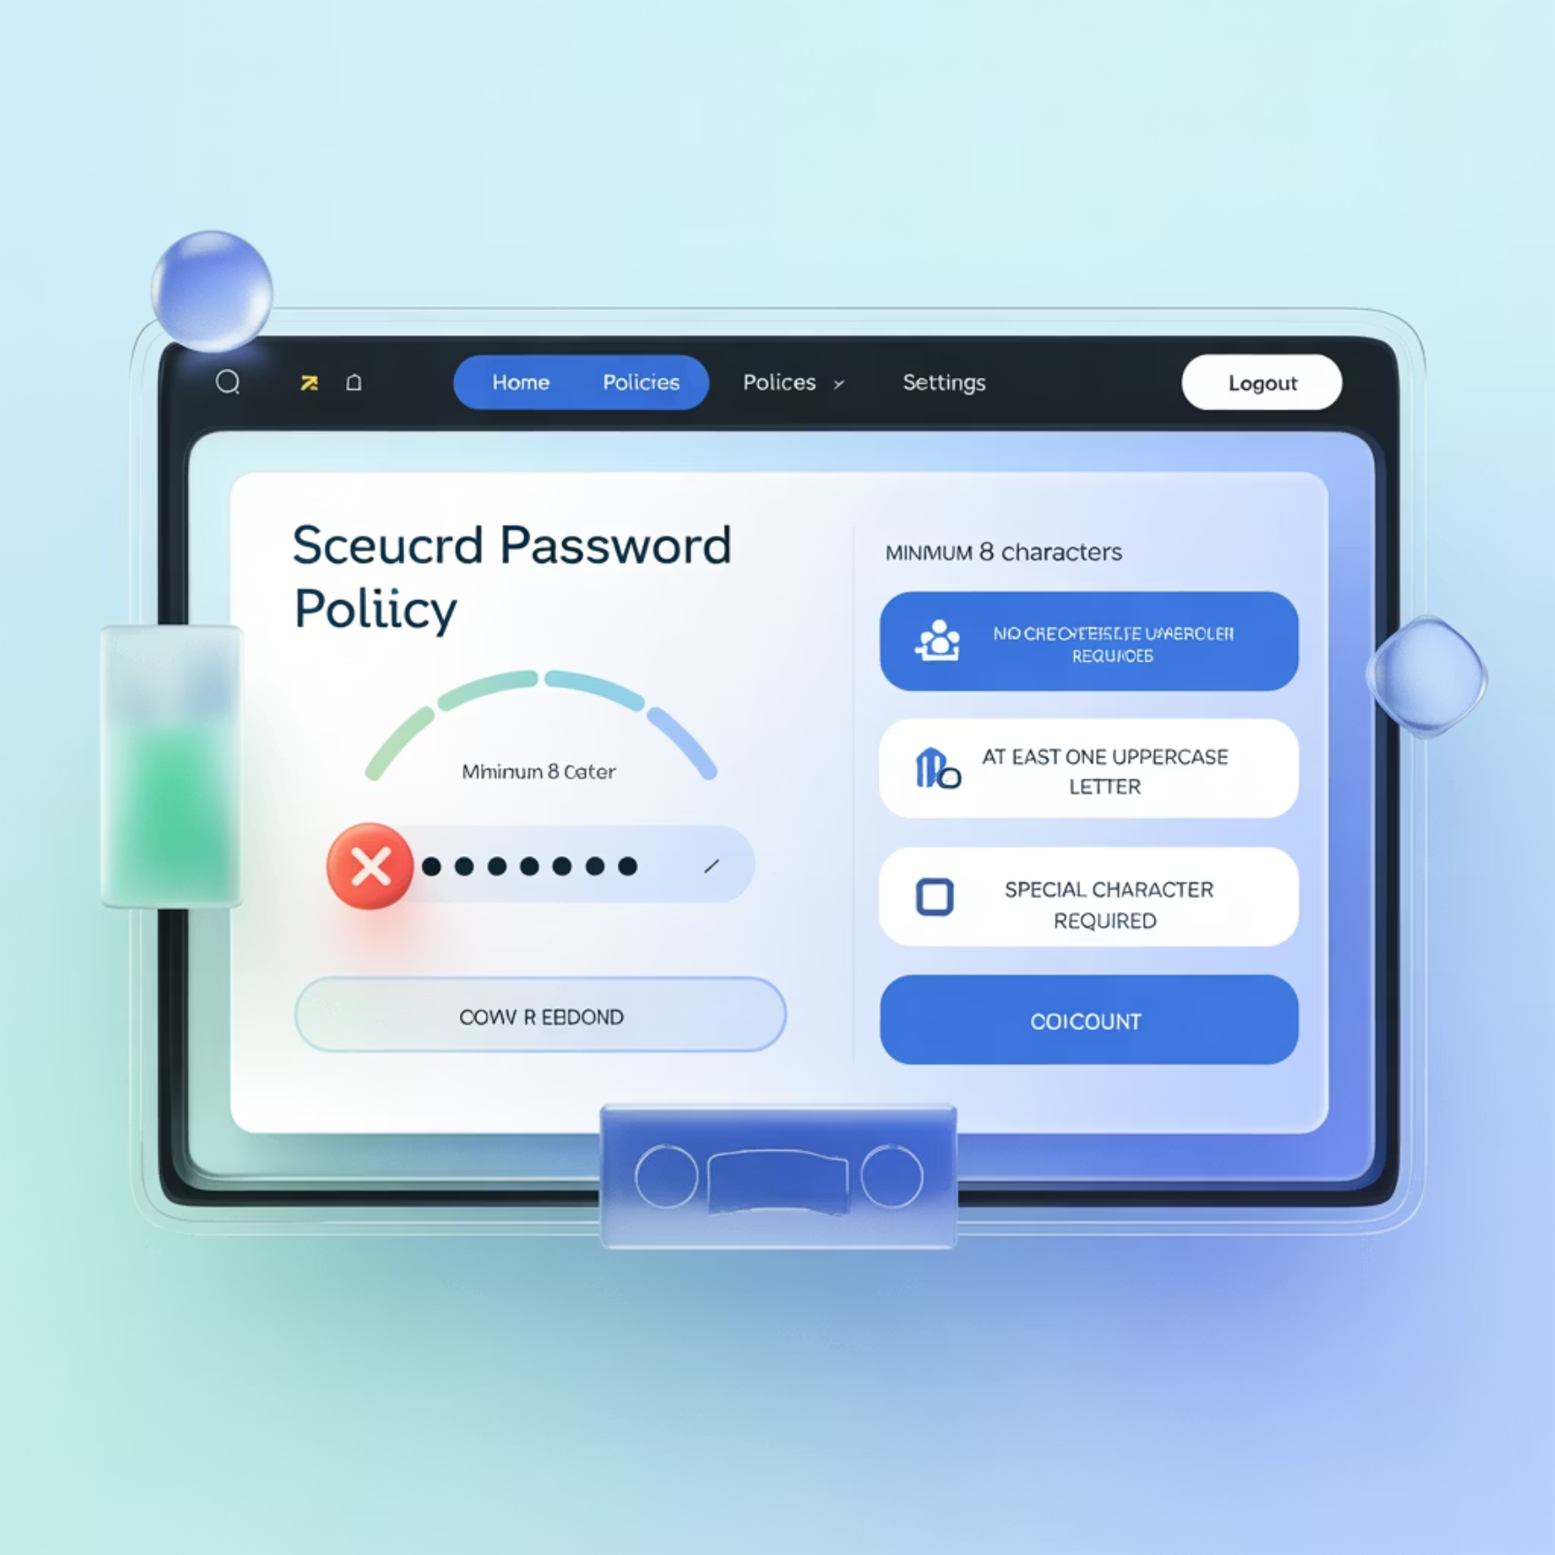
Lab 4: Password Policy Enforcement
Objective: Prevent weak passwords from being hacked
Set Strong Password Policies
Windows (Group Policy Editor):
Open gpedit.msc
Navigate to: Computer Config → Windows Settings → Security Settings → Account Policies
Set minimum length: 12
Enable complexity requirements
Set maximum age: 90 days
Linux (/etc/pam.d/common-password):
password requisite pam_pwquality.so retry=3 minlen=12 difok=3 ucredit=-1 lcredit=-1 dcredit=-1
Test with John the Ripper
Demonstrate how easily weak passwords are cracked:
Create a user with password "password123"
Extract password hashes
Run John the Ripper against the hashes
Watch as weak passwords are quickly cracked

Slide 9
Key Takeaways
Risk Assessment
CIA Triad
Identify assets, threats, and vulnerabilities to understand your security posture
Protect information through Confidentiality (encryption), Integrity (checksums), and Availability (backups)
Defense in Depth
Password Security
Layer security controls (firewalls, policies, encryption) for comprehensive protection
Enforce strong password policies to prevent unauthorized access
Effective cybersecurity requires a balanced approach of preventing, detecting, and responding to security threats.

Slide 10
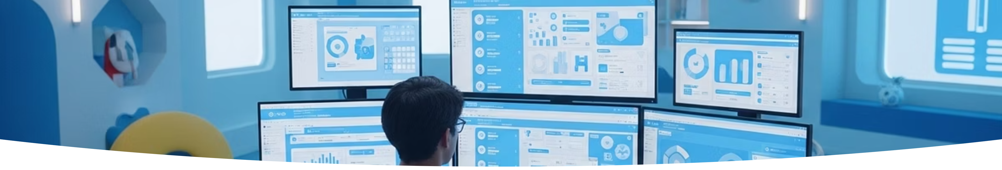
Next Steps
Practice These Labs
Explore Additional Tools
Build a Home Lab
Apply the techniques you've learned in your own environment to reinforce understanding
Expand your skills with Wireshark (network analysis) and Metasploit (ethical hacking)
Create a virtual environment to safely practice security techniques
Remember: Cybersecurity is a continuous learning process. Stay updated on the latest threats and countermeasures to maintain effective protection.

