Slide 1

Endpoint Protection: Securing the Frontline of Cybersecurity
Welcome to the world of endpoint protection - your guide to building a super-strong, high-tech shield for every device. In our digital lives, these devices are the front doors to our homes, and we need the best locks and alarms to keep the bad guys out.

Slide 2





What Is an Endpoint?
Imagine a giant castle. This castle is your company's entire network, all its computers, servers, and data. The entry points to this castle are called endpoints.
An endpoint is any device that can connect to that central network. It's where the network "ends" and a user "begins."
Computers
Mobile Devices
Laptops and desktop computers
Smartphones and tablets
Servers
IoT Devices
Powerful computers that run websites and apps
Smart thermostats, fridges, security cameras

Slide 3
Why Endpoint Protection Matters
The short answer: Because people use them.
Most attacks start here
We humans are curious, we get busy, and we make mistakes. A single moment like clicking a suspicious link or downloading from a shady website can open the door to trouble.
Hackers know it's easier to fool a person than to break through a super-strong firewall.
Endpoint protection is like a digital bodyguard for your device, standing beside you and ready to block threats.
Remote work expands risk
With BYOD and remote work, there are millions more "front doors" to protect that aren't physically in the office.
Evolving threats
The bad guys are getting smarter. Old-fashioned antivirus can't always catch new, clever tricks.

Slide 4

The Endpoint Protection Toolkit
Modern endpoint protection isn't just one thing. It's a whole toolbox of different security gadgets that work together. Let's open the toolbox and look at each tool.

Slide 5

1. Antivirus Software: The Trusty Guard Dog
This is the classic, well-known protector. Think of it as a guard dog trained to recognize the scent of known criminals.
Has a database of "bad guy" signatures (patterns of known viruses and malware)
Quarantines bad files when detected
Reliable for known threats
Limited against new, unknown threats
A clever criminal can wear a new disguise (a new virus) that the dog doesn't recognize yet.

Slide 6







2. Endpoint Detection and Response (EDR)
The Detective
Behavior Analysis
EDR is like having a detective with a surveillance camera inside your house.
Watches the behavior of programs, not just looking for known signatures.
The SWAT Team
Provides tools for security analysts to investigate incidents and remove threats.
If EDR sees a program acting strangely like trying to access unusual files or make unauthorized connections, it alerts security teams who can investigate and respond.

Slide 7

3. Extended Detection and Response (XDR)
XDR takes EDR and makes it even bigger. If EDR is a detective in your house, XDR is the entire police department, complete with:
It connects clues from multiple sources:
Endpoints (devices)
Email systems
Traffic cops
Network traffic
Helicopter surveillance
Cloud services
Detectives on every beat
This helps stop complex attacks that might start with a phishing email and then move to your network.

Slide 8

4. Host-Based Firewall: The Bouncer at the Club
Every device has doors where data comes in and out (called "ports"). A firewall is like a bouncer at each of these doors.
Has a guest list of programs allowed to send and receive data
Stops unknown programs from connecting to the internet
Asks for permission when new programs try to connect
Creates a barrier between your device and potential threats

Slide 9

5. Application Whitelisting: The Exclusive Guest List
This is a very strict security policy. Instead of trying to block every "bad" app, it only allows a pre-approved list of "good" apps to run.
It's like having an exclusive party where only people on the list can get in. No one else, no exceptions.
Very effective at preventing unauthorized software
Can be tricky to manage if you need to install new software often
Creates a highly controlled environment

Slide 10

6. USB Device Control: The Lock on Your USB Ports
The Risk
The Solution
Have you ever found a USB drive on the ground? Plugging it in is a huge risk! Hackers can load malware onto USB sticks and deliberately drop them.
USB device control lets an administrator lock down the USB ports on company devices. Only approved, company-owned USB drives can be used.
The Benefit
Prevents this sneaky attack vector and reduces the risk of malware entering through physical means.

Slide 11


7. Patch Management: The Repair Crew
Software isn't perfect. Sometimes, programmers make mistakes that create tiny holes (vulnerabilities) in their code. Hackers love to find these holes.
An unpatched device is like leaving a window wide open in your house with a sign that says "Come on in!"
Software companies release fixes, called "patches," to seal these holes. Patch management ensures every device gets these repairs as soon as possible.

Slide 12
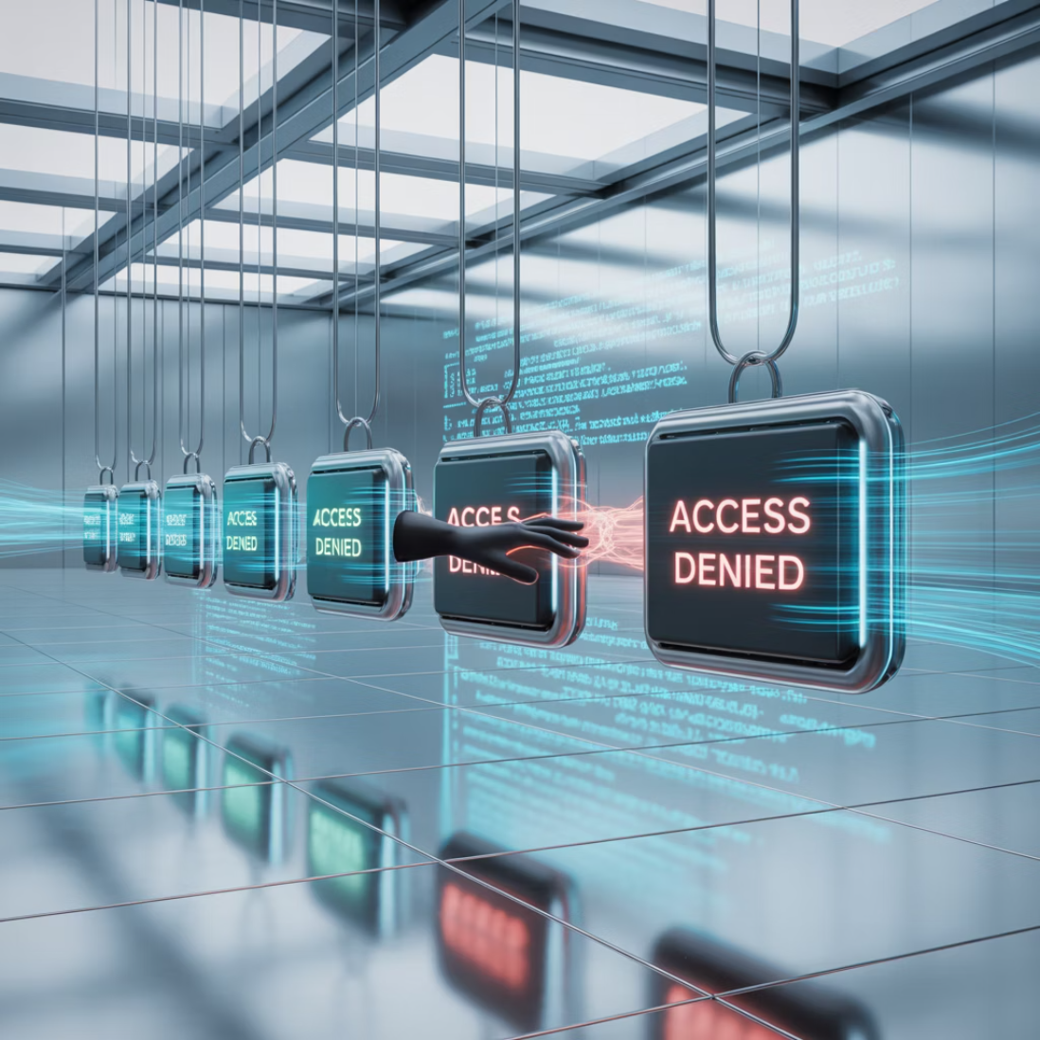
Learning from Mistakes: The Target Breach (2013)
What Happened
The Lesson
Hackers didn't attack Target's main computers first. They attacked a small HVAC company that did work for Target.
Every endpoint connected to your network is a potential doorway, even ones that belong to other companies you work with.
The HVAC company had weak endpoint protection
Strong endpoint protection for everyone is crucial.
Hackers got into their system and stole their Target login credentials
They slipped inside Target's network
Installed malware on cash registers (endpoints!)
Stole 40 million credit card numbers

Slide 13

Learning from Mistakes: The SolarWinds Attack (2020)
The Attack
Hackers secretly slipped malicious code into a regular software update for SolarWinds' network management tool.
The Spread
When companies and government agencies installed the update, they were actually installing the hacker's backdoor.
The Result
Hackers used this access to spy on numerous organizations, including U.S. government agencies.
The Lesson
Even trusted software can be used against you. You need endpoint protection that can spot unusual behavior after a program is installed, because you can't always prevent the initial infection.

Slide 14

A Helpful Metaphor: The Digital Immune System
Antivirus = White Blood Cells
EDR = Specialist Doctor
They fight off common germs (known viruses) they've seen before.
The white blood cells might not recognize a new, rare disease. The doctor runs tests, analyzes your symptoms (behavior), and diagnoses the new problem.
XDR = Full Hospital Team
The doctor talks to specialists to understand how an illness is affecting your entire body, not just one part.
This holistic approach is what keeps the digital body healthy.

Slide 15

Why This Matters for Your Career
Understanding endpoint protection isn't just theory; it's your ticket to exciting cybersecurity jobs!
1
2
SOC Analyst
IT Support Specialist
You'd sit in a security operations center, watching monitors that show alerts from EDR tools. You'd be the first line of defense, investigating potential threats.
You'd ensure everyone's laptops have the latest patches and that the firewall is turned on. You help build the first layer of defense.
3
4
Cybersecurity Analyst
Threat Hunter
You'd look at the big picture after an attack and figure out how to prevent it next time by choosing better tools or policies.
Instead of waiting for alerts, you'd proactively dig through endpoint data to find hidden hackers who are trying to stay quiet.

Slide 16

Your Simple Action Plan: Best Practices
Use Good Software
Be Careful with Power
Install a reputable antivirus or EDR tool. There are great free options for personal use, like Windows Defender.
Don't use an "Administrator" account for your daily web browsing. Use a standard user account. It makes it harder for malware to install itself.
UPDATE, UPDATE, UPDATE
Think Before You Click
Seriously. When your phone or computer says an update is available, do it. Those updates are those critical "patches" we talked about.
Be suspicious of weird emails and links. If an offer seems too good to be true, it probably is.

Slide 17

Lock Your USB Doors
For Companies:
Implement USB device control policies
Only allow approved devices to connect
Consider disabling USB ports on high-security systems
Train employees on USB security risks
Provide secure, company-approved USB devices
This simple step can prevent a major attack vector that bypasses network security entirely.

Slide 18




Professional Tools to Know About
Cisco Secure Endpoint
Microsoft Defender for Endpoint
Enterprise-grade endpoint protection with advanced threat detection and response capabilities.
Integrated protection for Windows environments with cloud-powered security features.
CrowdStrike Falcon
Bitdefender
Cloud-native endpoint protection platform with AI-powered threat detection.
Comprehensive security suite with multi-layered protection for various endpoints.
These are the professional-grade "digital bodyguards" used by organizations worldwide to protect their endpoints.

Slide 19

The Evolving Landscape of Endpoint Protection
Current Trends
Future Challenges
Integration of AI and machine learning for better threat detection
Protecting an ever-expanding attack surface
Balancing security with user experience
Cloud-based management for remote workforces
Defending against AI-powered attacks
Zero-trust security models becoming standard
Managing security across hybrid work environments
Increased focus on IoT device security

Slide 20

Final Thought
Endpoint protection is where cybersecurity begins.
It's about protecting the devices we touch every day. By understanding how these tools work together like a security team, you're not just protecting yourself—you're learning the essential skills to become a guardian of the digital world.
You are building the foundation for a strong and exciting career in cybersecurity. Keep learning!

