Slide 1

Governance, Risk & Compliance + Certification Review
In the dynamic digital landscape, technical controls like firewalls are necessary but insufficient. Governance, Risk, and Compliance (GRC) constitute the command structure that ensures cybersecurity activities align with business objectives and demonstrate due care to stakeholders.
This chapter deconstructs these critical concepts, providing foundational knowledge to understand, implement, and manage the principles that form the backbone of any mature security program.

Slide 2
Security Policies: The Organizational Constitution
Acceptable Use Policy
Password Policy
Access Control Policy
Defines boundaries for using company IT assets, explicitly stating prohibited activities and outlining monitoring practices for legal protection.
Technical standard mandating complexity requirements, history restrictions, age limits, and secure storage as salted hashes.
Enforces principle of least privilege and need-to-know, defining processes for granting, reviewing, and revoking system access.
Security policies are formal documents ratified by senior management that dictate the organization's stance on security. They serve as the constitution from which all procedures, standards, and guidelines derive their authority.

Slide 3

Policy Implementation Framework
01
02
Training and Awareness
Exceptions Process
All employees must read and acknowledge understanding of key policies during onboarding and annually thereafter.
Formal process for handling policy exceptions, requiring risk assessment and management approval.
03
Regular Review
Policies must be reviewed and updated at least annually or when significant business or threat landscape changes occur.

Slide 4










NIST Cybersecurity Framework
Protect
Implement appropriate safeguards to ensure delivery of critical services through identity management and data security.
Identify
Develop organizational understanding to manage cybersecurity risk to systems, people, assets, data, and capabilities.
Detect
Implement activities to identify cybersecurity events through continuous monitoring and anomaly detection.
Recover
Maintain plans for resilience and restore capabilities impaired due to cybersecurity incidents.
Respond
Take action regarding detected cybersecurity incidents through response planning and communications.

Slide 5
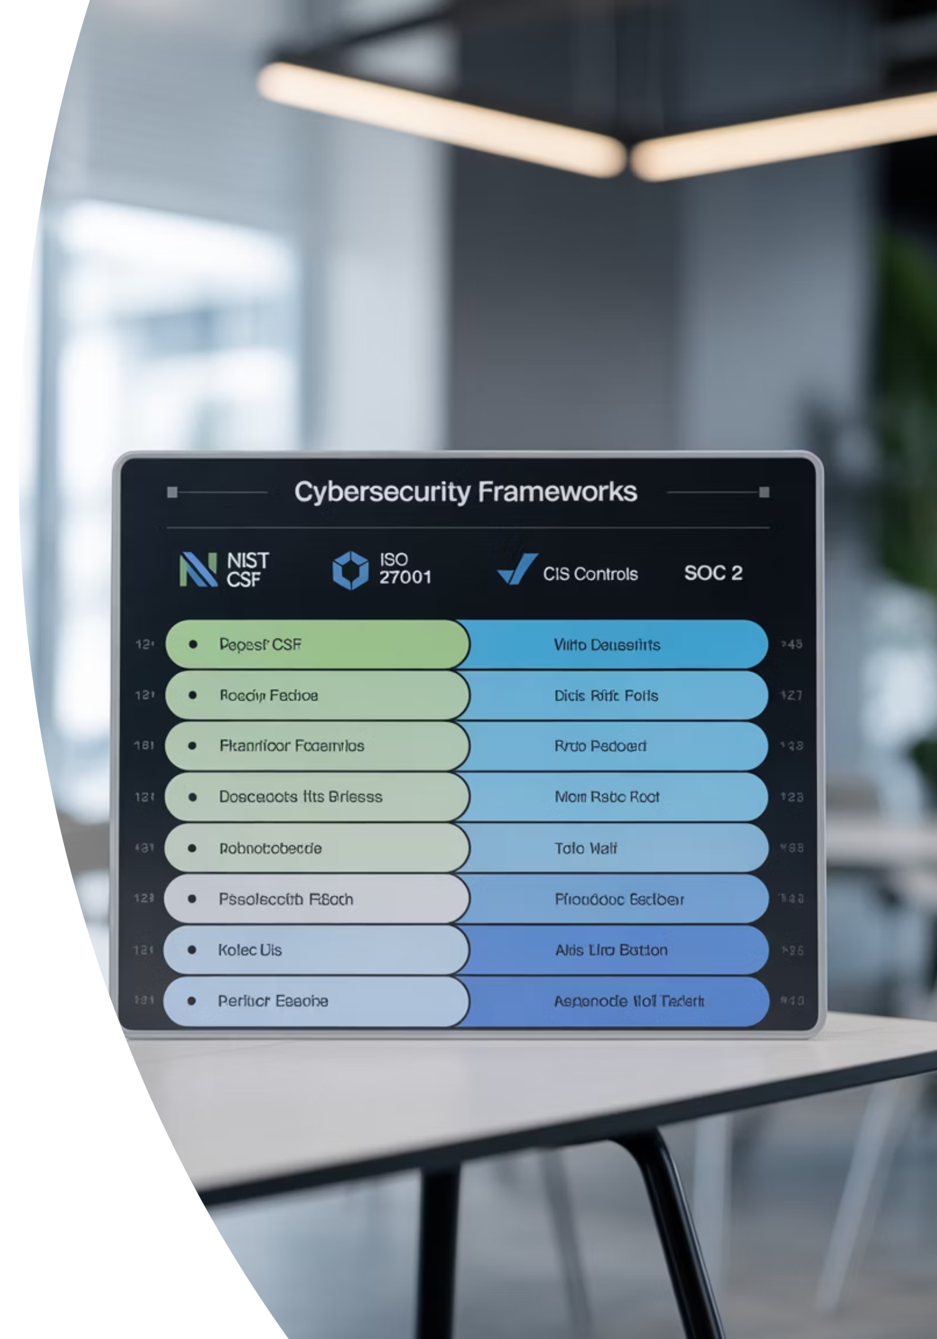
Framework Comparison
NIST CSF
ISO/IEC 27001
CIS Controls
Flexible, risk-based approach with implementation tiers. Most widely adopted globally for its adaptability to various industries.
International standard for Information Security Management System (ISMS). Certifiable through accredited auditing bodies.
Prioritized, prescriptive best practices designed to defend against common cyber attacks through three implementation groups.
Five core functions
Plan-Do-Check-Act cycle
Basic cyber hygiene
Implementation tiers
Foundational security
114 security controls
Voluntary framework
Certification available
Organizational security

Slide 6
Case Study: Equifax Breach (2017)
The breach was not due to a complex, unknown threat but a failure in basic cyber hygiene, precisely what frameworks are designed to enforce.
The Vulnerability
Framework Failures
The Lesson
Apache Struts vulnerability (CVE-2017-5638) had a patch available for months before the breach occurred.
Lack of accurate asset inventory, formalized patch management process, and vulnerability scanning to identify unpatched systems.
Frameworks are not bureaucratic exercises but essential operational blueprints for preventing catastrophic failures.

Slide 7



Risk Management: The Core Discipline
Risk = Threat × Vulnerability × Impact
Threat
Vulnerability
Impact
A potential event that can cause harm, such as phishing campaigns, malicious insiders, or natural disasters. Threat intelligence helps understand likelihood.
A weakness in systems, processes, or controls that can be exploited, like unpatched software or misconfigured cloud storage.
The magnitude of loss from successful exploitation, measured in financial, operational, or reputational terms.

Slide 8
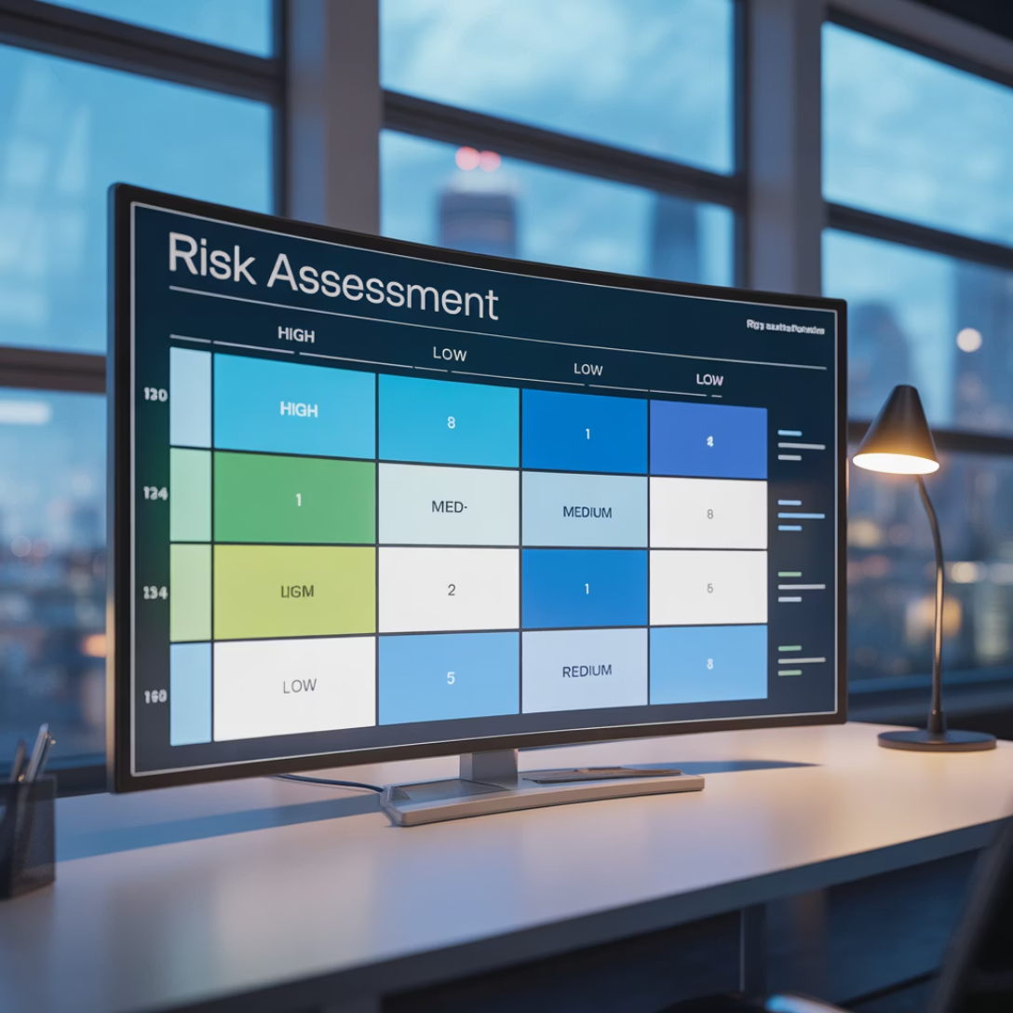
Risk Assessment Methods
Quantitative Risk Analysis
Qualitative Risk Analysis
Assigns monetary values to risk components using mathematical formulas:
Uses scales (High, Medium, Low) based on expert opinion and consensus. More practical for most organizations.
Single Loss Expectancy (SLE): Asset Value × Exposure Factor
Techniques like risk matrices plot and prioritize risks based on likelihood and impact.
Annualized Rate of Occurrence (ARO): Expected frequency per year
Annualized Loss Expectancy (ALE): SLE × ARO

Slide 9
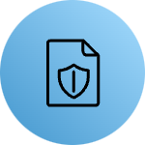







Risk Treatment Strategies
Mitigate
Accept
Implement controls to reduce likelihood or impact. Most common approach requiring active security measures.
Acknowledge risk but take no action when mitigation costs outweigh potential loss. Requires formal management approval.
Transfer
Avoid
Shift financial burden to third parties, most commonly through cybersecurity insurance policies.
Eliminate risk entirely by discontinuing risky activities, such as shutting down vulnerable services.

Slide 10

WannaCry: Risk Management in Action
The 2017 WannaCry ransomware was a live-fire exercise in risk management consequences. Organizations that had accepted the risk of unpatched systems or had ineffective patch management suffered direct impact.
Those that had properly mitigated the risk by applying the MS17-010 patch months prior were unaffected. This perfectly illustrates the practical consequence of risk decisions and the importance of proactive risk treatment.

Slide 11
Data Classification Framework
Public
1
No impact if disclosed. Press releases, marketing materials.
Internal Use
2
Low impact if disclosed. Internal memos, operational policies.
Confidential
3
Moderate to high impact. Client lists, business plans, employee records.
Restricted
4
Severe impact. PHI, credit card data, source code. Protected by strict regulations.
Data classification categorizes information based on sensitivity and value to apply appropriate protective controls. Each level requires defined handling procedures for storage, transmission, access, and disposal.

Slide 12

Privacy Regulations Overview
GDPR (General Data Protection Regulation)
HIPAA (Health Insurance Portability and Accountability Act)
Scope: Any organization processing personal data of EU individuals, regardless of location.
Scope: U.S. covered entities (healthcare providers, health plans) and business associates.
Key Principles: Lawfulness, fairness, transparency, purpose limitation, data minimization, accuracy, storage limitation.
The Rules: Privacy Rule (PHI protection), Security Rule (ePHI safeguards), Breach Notification Rule (reporting requirements).
Individual Rights: Access, rectification, erasure ("right to be forgotten"), data portability, and objection.

Slide 13

Facebook-Cambridge Analytica: Privacy Failure
1
2
3
Data Minimization Failure
Transparency Breakdown
Consent Mechanisms
Collected more data than needed for the stated purpose, violating fundamental privacy principles.
Lack of transparency in third-party data sharing arrangements with app developers.
Inadequate user consent mechanisms for data collection and sharing practices.
Result: $5 billion FTC fine and global reputational damage, proving that privacy failures have severe financial and business consequences.

Slide 14
Business Continuity vs. Disaster Recovery
Business Continuity (BC)
Disaster Recovery (DR)
Keeping the business running during disruptions. Focuses on people and processes.
Getting the technology back online. Focuses on systems and data.
Using paper forms if computers are down
Server restoration procedures
Work-from-home strategies
Data backup recovery
Alternative communication methods
Network infrastructure rebuild

Slide 15



Key BC/DR Metrics
Business Impact Analysis (BIA)
Recovery Time Objective (RTO)
Recovery Point Objective (RPO)
Foundational step identifying critical business functions, dependencies, and impacts of downtime. Establishes Maximum Tolerable Downtime (MTD).
Target time to restore business processes after disruption. Example: "CRM system must be back online within 4 hours."
Maximum acceptable data loss measured in time. Dictates backup frequency. Example: 1-hour RPO requires hourly backups.

Slide 16

BC/DR Implementation Strategies
1
Backup Strategy
Follow the 3-2-1 Rule: 3 copies of data, on 2 different media, with 1 copy stored offsite.
2
Site Selection
Hot Site: Fully operational, ready in minutes. Warm Site: Has infrastructure, needs data. Cold Site: Space and power only.
3
Testing Protocols
Plans are useless if untested. Conduct tabletop exercises and full-scale simulations for validation.

Slide 17

Delta Airlines: DR Failure Case Study
A small power outage at Delta's Atlanta data center led to cascading failure that grounded flights for days, costing over $150 million.
Root Cause
The Gap
The Lesson
Failure in uninterruptible power supply (UPS) system with inadequate redundancy and failover processes.
Difference between having a DR plan (they likely had one) and having a tested, reliable DR capability (which they lacked).
Regular testing and validation of DR procedures is essential for ensuring actual recovery capabilities match documented plans.

Slide 18




GRC Career Pathways
GRC Analyst/Auditor
Compliance Officer
Risk Management Specialist
Data Privacy Officer
Conducts internal audits against frameworks, assesses controls, and documents compliance gaps.
Subject-matter expert on specific regulations (HIPAA, PCI) ensuring legal obligations are met.
Facilitates risk assessments, maintains risk registers, and helps business owners understand and treat risks.
Mandated role under GDPR for some organizations. Oversees data privacy strategy and implementation.

Slide 19
Essential GRC Skills
Communication
Analytical Thinking
Strong written and verbal skills to translate technical issues into business risk language for stakeholders.
Ability to assess complex situations, identify patterns, and make data-driven recommendations.
Attention to Detail
Framework Knowledge
Meticulous approach to documentation, compliance requirements, and regulatory obligations.
Deep understanding of frameworks (NIST, ISO) and regulations (GDPR, HIPAA) relevant to the industry.
GRC offers stable, in-demand career paths often serving as gateways to leadership roles like CISO, bridging technical security with business strategy.

Slide 20
Key Takeaways: GRC Mastery
GRC is Strategic
Essential bridge between business objectives and technical security implementation, not just compliance checkbox.
Risk is Inevitable
Goal is intelligent risk management through identification, assessment, and treatment - not elimination.
Frameworks are Blueprints
NIST CSF and ISO 27001 provide structured, customizable approaches to building cybersecurity programs.
Privacy is Legal Right
GDPR and HIPAA have real enforcement teeth requiring transparency and accountability in personal data handling.
Resilience is Non-Negotiable
BC/DR planning with tested RTO and RPO metrics ensures organizational survival and recovery from disruptions.

