Slide 1
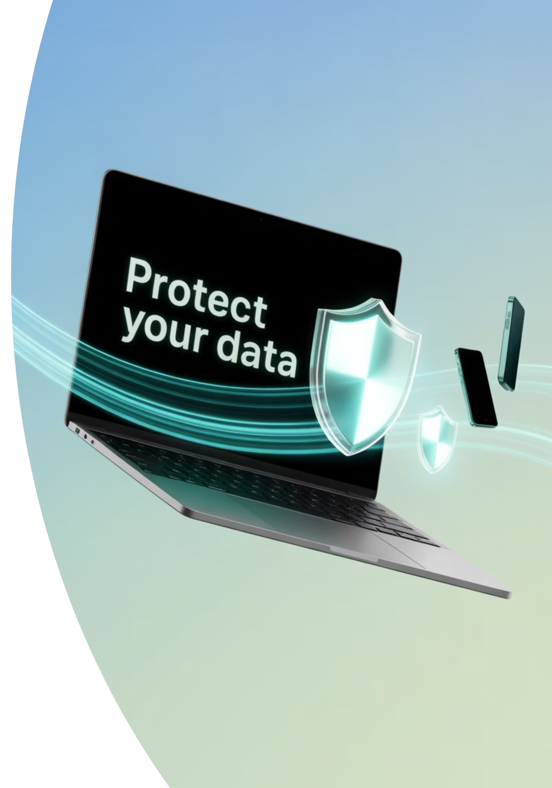
Introduction to Cybersecurity & Core Principles
Cybersecurity is no longer reserved for tech professionals or government institutions. It affects every part of modern life, from accessing bank accounts to protecting patient records. In today's digital age, understanding cybersecurity basics is as essential as knowing how to lock your front door.
Whether you're a student, business owner, or everyday internet user, cybersecurity knowledge can protect you from digital threats and give you confidence in our connected world.

Slide 2

What is Cybersecurity and Why It Matters
Cybersecurity is the practice of protecting digital systems, networks, software, and data from theft, damage, or unauthorized access. Think of it as a digital version of securing your home: locking doors, installing an alarm system, and monitoring activity through cameras.
We rely on technology every day. From using smartphones to logging into work systems remotely, our digital footprints are constantly growing. As this dependence increases, so does the potential for cyber attacks.
The consequences of cyber attacks can be devastating, both financially and emotionally. That's why cybersecurity matters — to protect your identity, privacy, finances, and the overall integrity of modern life.

Slide 3

Data is the New Gold
In today's digital economy, data is one of the most valuable assets. Organizations of all types store vast amounts of sensitive information:
Corporate Data
Customer records, intellectual property, and financial transactions
Healthcare Data
Patient records, treatment histories, and insurance information
Personal Data
Identity information, financial details, and private communications
Government Data
Citizen records, infrastructure details, and classified information
If this data falls into the wrong hands, it can be used for identity theft, fraud, corporate espionage, and more.

Slide 4
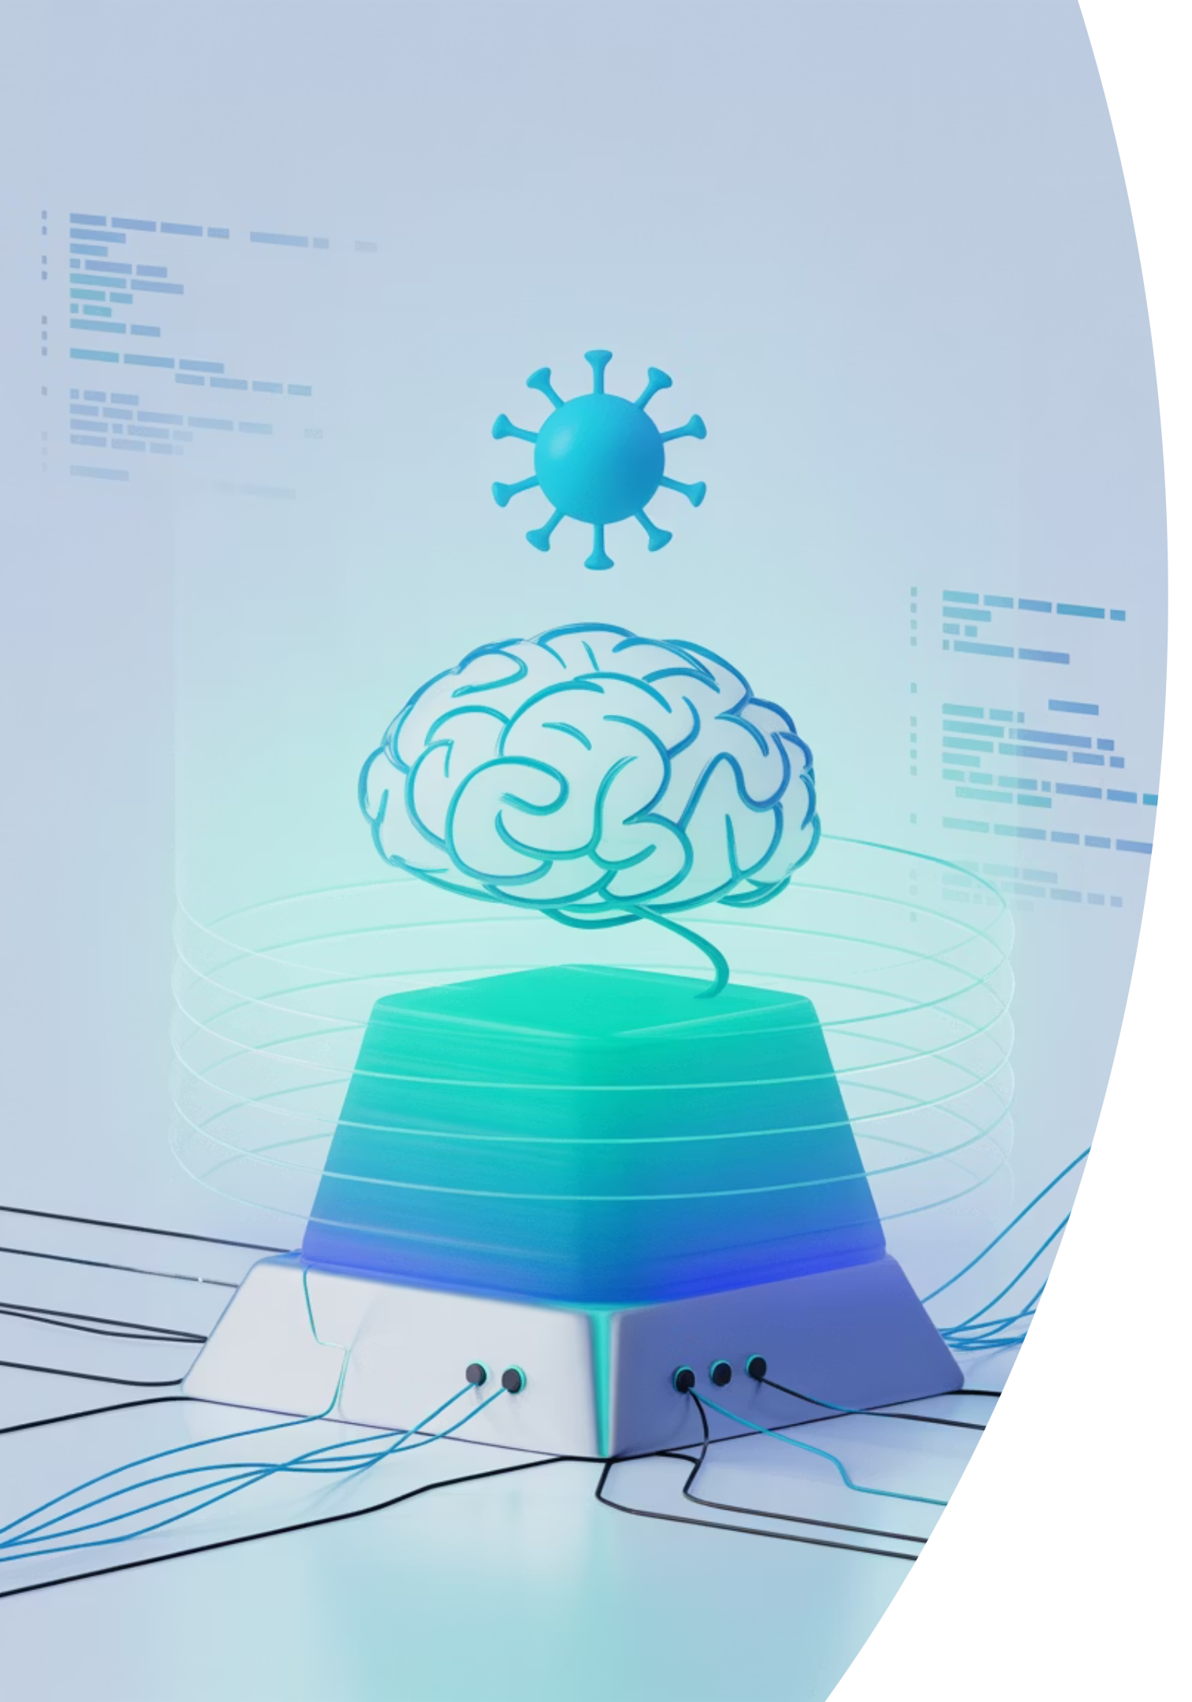
Evolving Threats in the Cyber World
Cyber threats have evolved far beyond the stereotype of a lone hacker in a basement. Modern cyber threats are sophisticated and constantly evolving:
AI-driven malware
Ransomware-as-a-Service (RaaS)
Programs that learn and adapt to bypass security controls
Ready-made ransomware tools sold on the dark web
Zero-day vulnerabilities
Flaws in software that are exploited before developers can fix them
These complex threats demand equally advanced and proactive security strategies.

Slide 5

Digital Transformation and Risk Exposure
Organizations today are increasingly adopting new technologies that expand their digital footprint:
Cloud computing services
Internet of Things (IoT) devices
Remote work technologies
Mobile applications
Artificial intelligence systems
While these advances increase efficiency and convenience, they also expand the "attack surface" — the number of entry points through which an attacker could compromise a system.

Slide 6
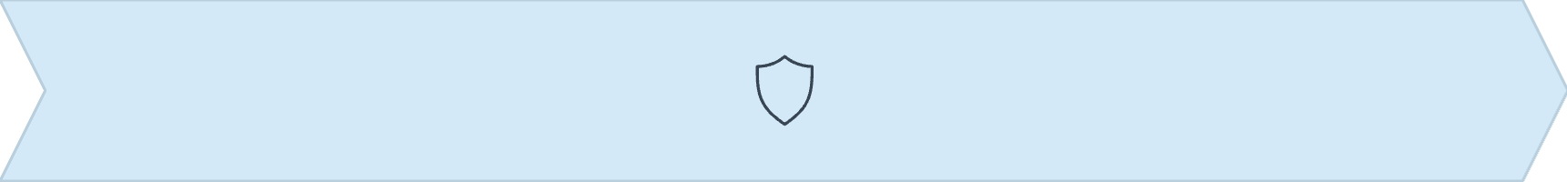
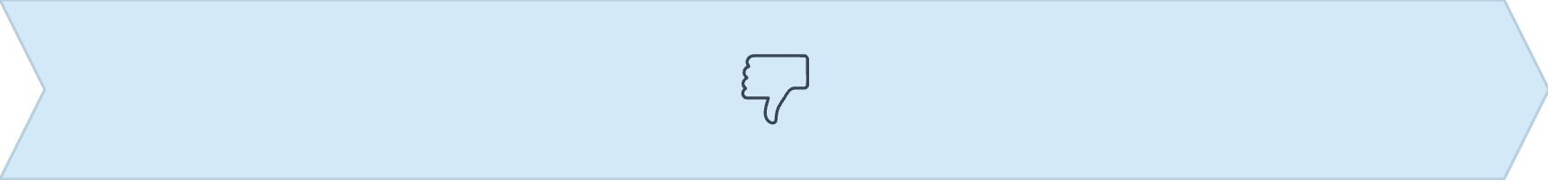
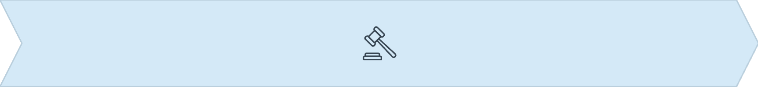
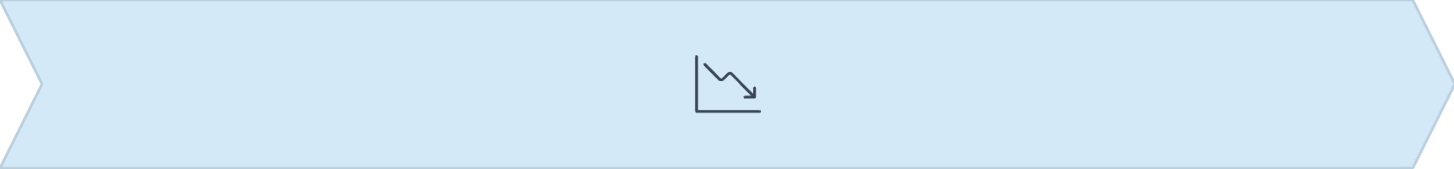
Beyond Financial Loss: Reputation and Compliance
Breach Occurs
Trust Damaged
Customer data is exposed or systems are compromised
Customers and partners lose confidence in the organization
Regulatory Penalties
Long-term Impact
Fines and sanctions from regulations like GDPR and HIPAA
Decreased business, higher costs, and operational setbacks
In sectors like healthcare and finance, where confidentiality is paramount, a single incident can destroy years of credibility and result in significant legal consequences.

Slide 7

Mapping the Threat Landscape: Who Are the Actors?
1
2
3
Nation-State Actors
Hacktivists
Cybercriminals
Governments or state-sponsored groups engaging in espionage or digital warfare (e.g., APT41 from China)
Activists who use hacking to promote political or social causes (e.g., Anonymous)
Individuals or gangs motivated by financial gain, often using ransomware or phishing
4
5
Insiders
Script Kiddies
Disgruntled or careless employees who intentionally or accidentally expose sensitive information
Inexperienced users who download hacking tools for fun or fame

Slide 8
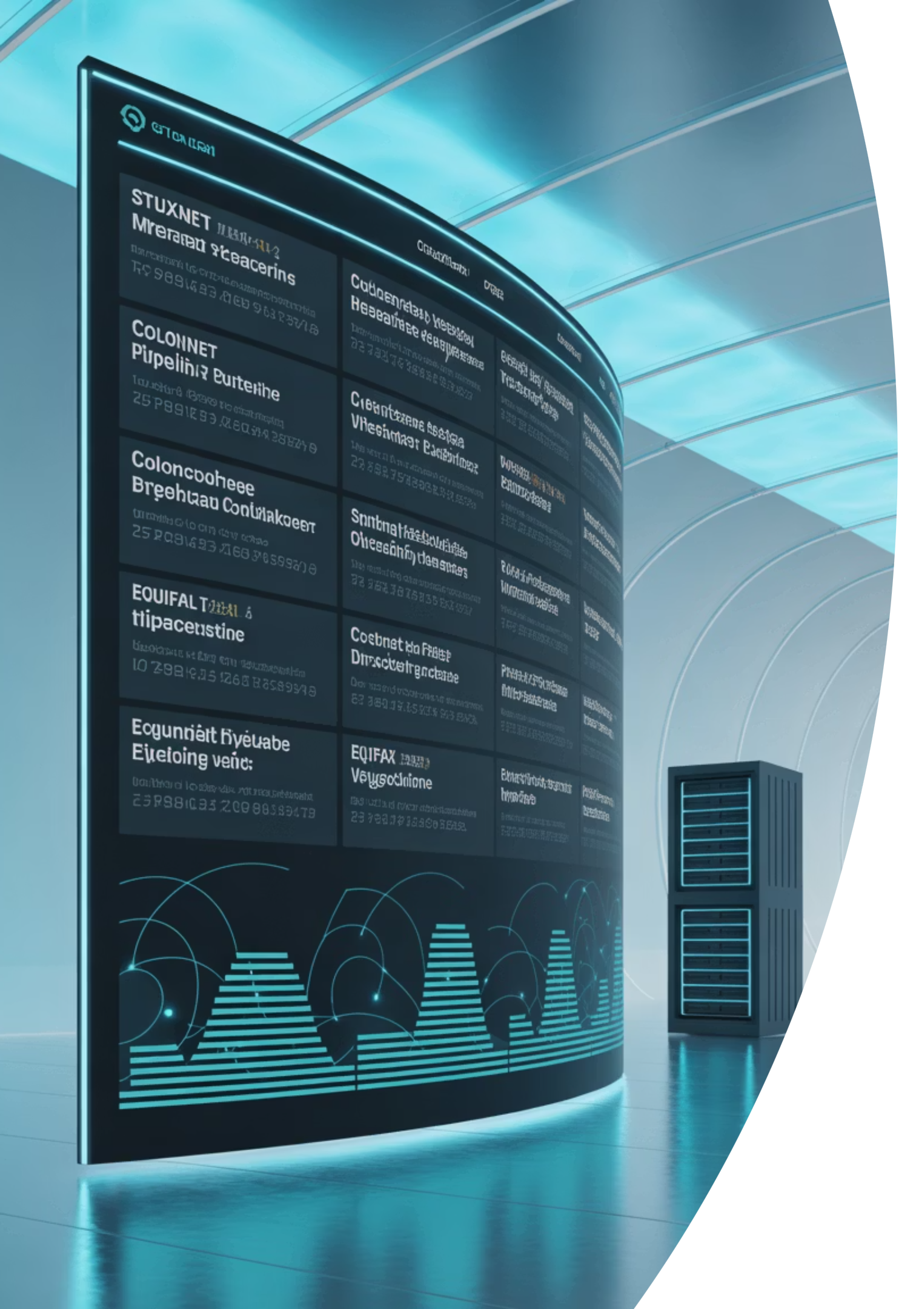
Notable Real-World Cybersecurity Cases
Stuxnet
Colonial Pipeline Attack (2021)
Equifax Data Breach (2017)
A sophisticated worm believed to have been developed by the U.S. and Israel to sabotage Iran's nuclear program. It was the first known cyberweapon to cause physical damage to industrial equipment.
A ransomware attack by the DarkSide group led to fuel shortages across the U.S. East Coast. The attackers gained access through a compromised VPN account, showing how small oversights can have massive consequences.
A failure to patch a known vulnerability led to the exposure of sensitive data belonging to over 147 million people. The breach resulted in heavy fines and long-term loss of public trust.

Slide 9
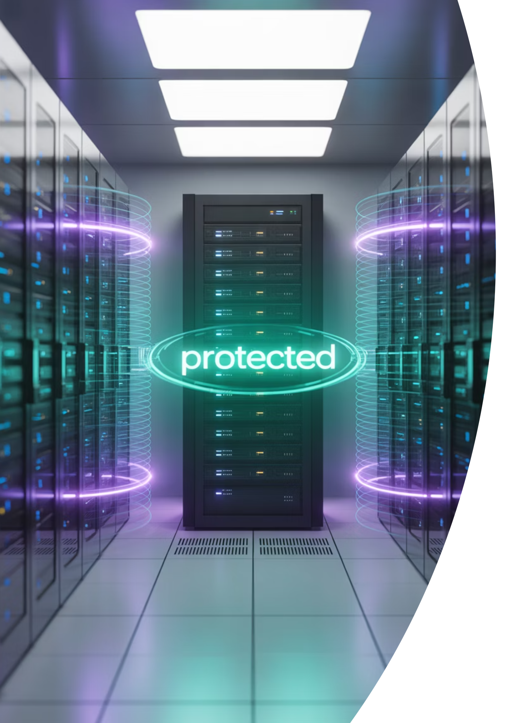
Core Cybersecurity Concepts: Assets and Attack Surface
Assets
Attack Surface
An asset in cybersecurity is anything valuable that needs protection:
The attack surface is all the points where an attacker might try to gain access:
Physical: Laptops, servers, USB drives
Open network ports
Digital: Databases, passwords, source code, personal information
Misconfigured firewalls
Weak or reused passwords
Intangible: Reputation, intellectual property, customer trust
Outdated software
Unpatched vulnerabilities

Slide 10



Core Cybersecurity Concepts: Defense Strategies
Defense in Depth
Principle of Least Privilege
Zero Trust Model
Rather than relying on a single security layer, this strategy uses multiple overlapping defenses like firewalls, antivirus software, and authentication systems.
Users should only have the minimum access necessary to perform their job. If a user account is compromised, the damage will be limited by these restrictions.
This approach assumes that threats could be both external and internal. No user or device is automatically trusted — all access requests are verified continually.
These strategies work together to create a comprehensive security posture that can adapt to evolving threats and protect against both known and unknown vulnerabilities.

Slide 11
Career Opportunities in Cybersecurity
Cybersecurity offers a wide range of careers, each with unique responsibilities and required skills:
Security Analyst
Threat Hunter
Monitors systems, responds to alerts, and analyzes incidents
Proactively searches for hidden threats within networks
Penetration Tester
SOC Analyst
Simulates attacks to identify weaknesses (Ethical Hacker)
Works in a Security Operations Center to detect and mitigate threats
Security Engineer
Compliance Officer
Designs and implements secure systems and infrastructure
Ensures the organization follows regulations and internal policies
Whether you're technically inclined or more policy-oriented, there's a place for you in cybersecurity. Many of these roles align with the ISC2 Certified in Cybersecurity (CC) certification paths.

Slide 12

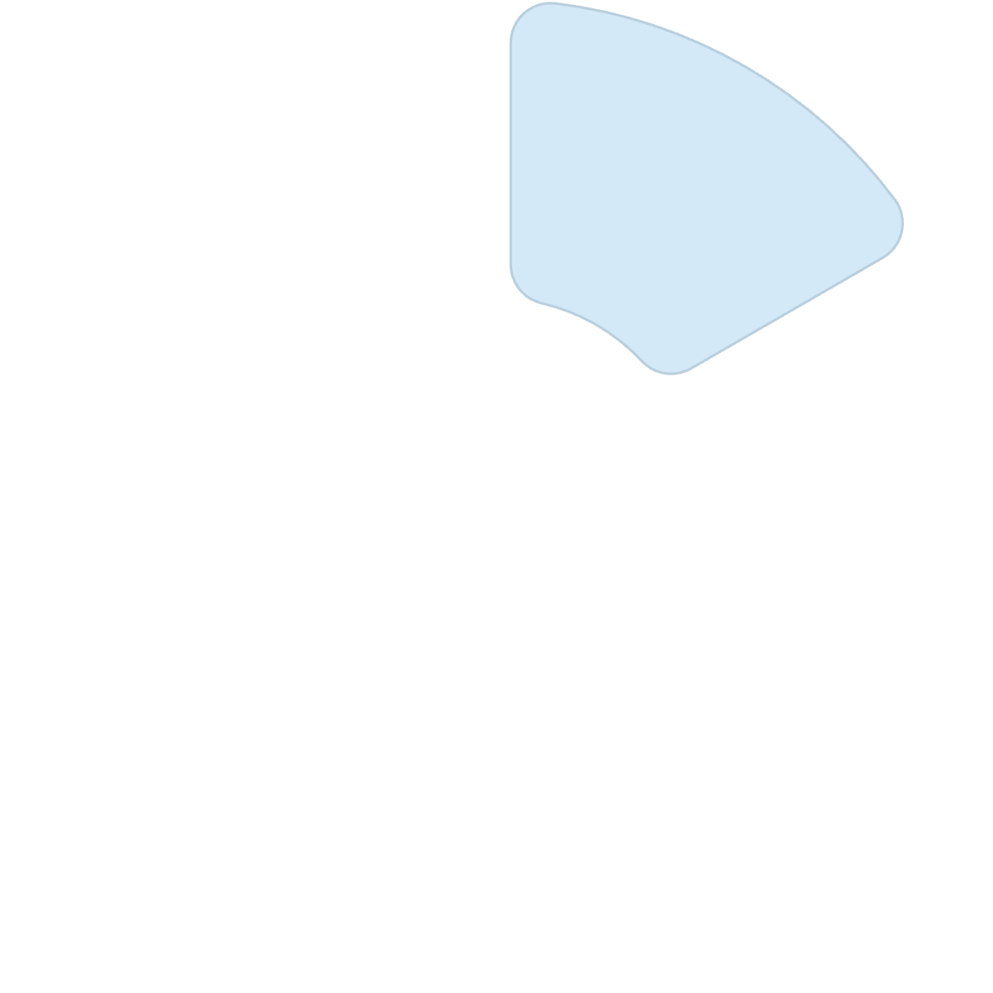
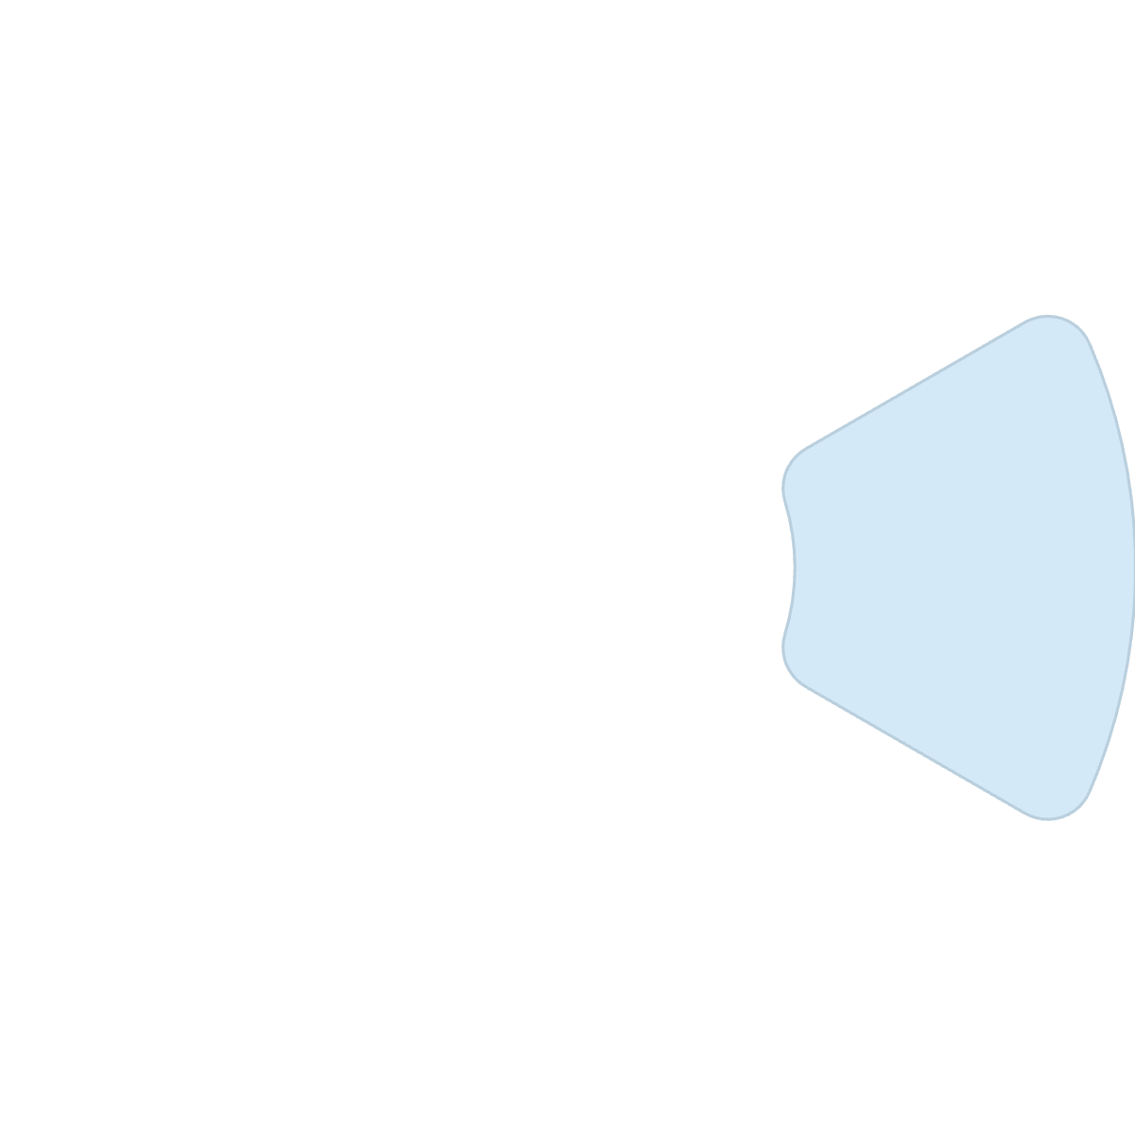









Cybersecurity Domains
The field is organized into specialized domains. Understanding these will help you navigate where your interests or skills might align:
Security Principles
Access Control
Foundational concepts like confidentiality, integrity, and availability
Ensuring only the right people can access data
Cryptography
Network Security
Securing communication and data using encryption
Firewalls, VPNs, and intrusion detection systems
Governance & Compliance
Security Operations
Policies, audits, and risk analysis
Incident response and threat management

Slide 13
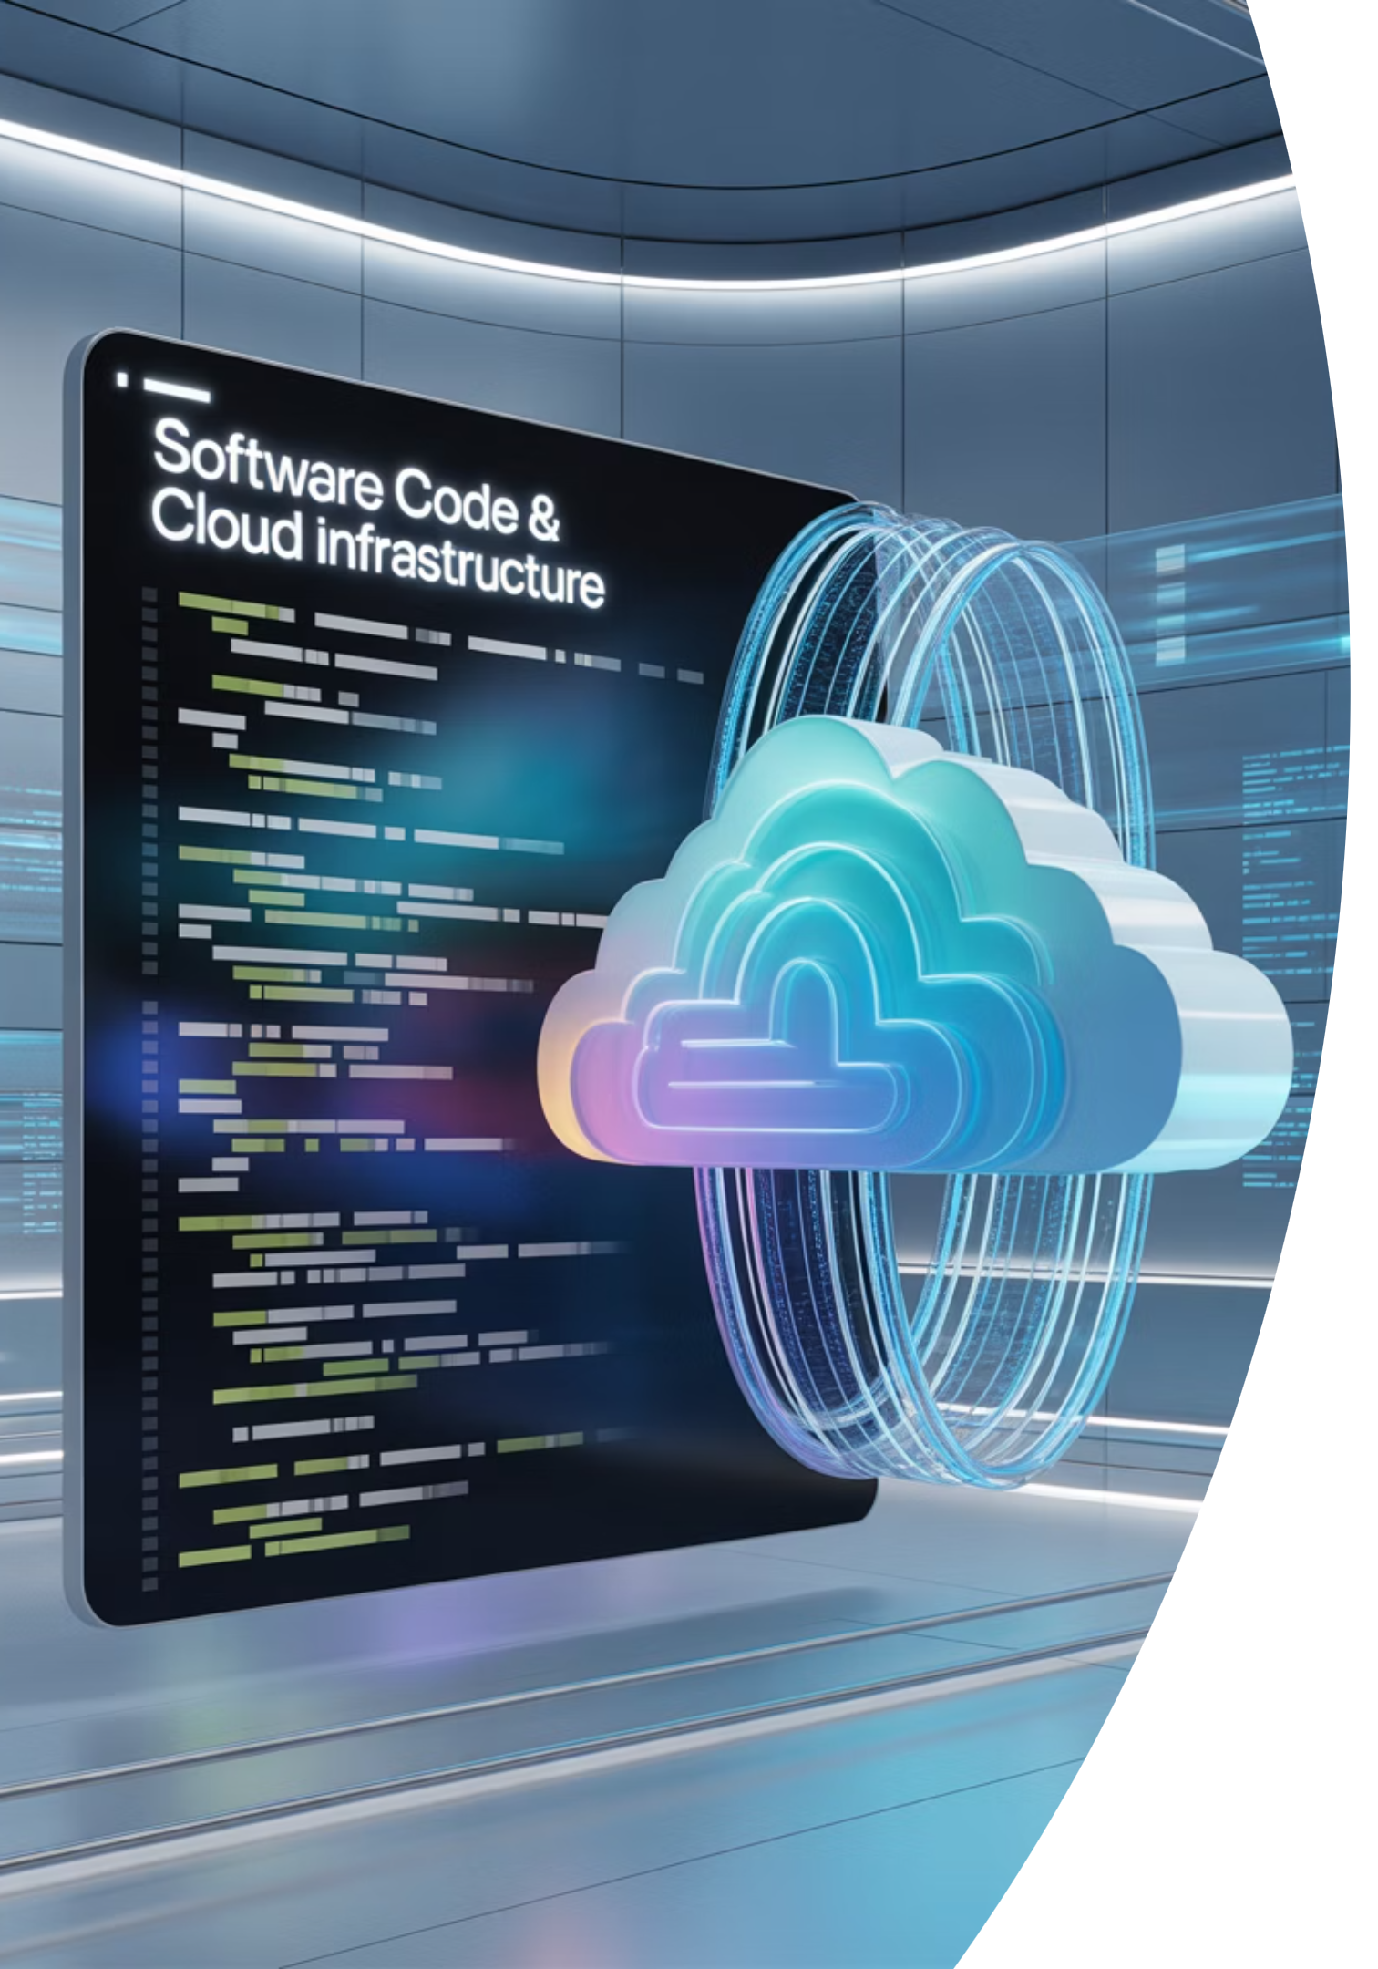
More Cybersecurity Domains
Software Security
Cloud Security
Secure coding practices
Protecting data in services like AWS, Azure, and Google Cloud
Application security testing
Software development lifecycle security
Shared responsibility models
Container security
Code review and vulnerability scanning
Identity and access management in the cloud
These domains continue to evolve as technology advances, creating new challenges and opportunities for cybersecurity professionals.

Slide 14
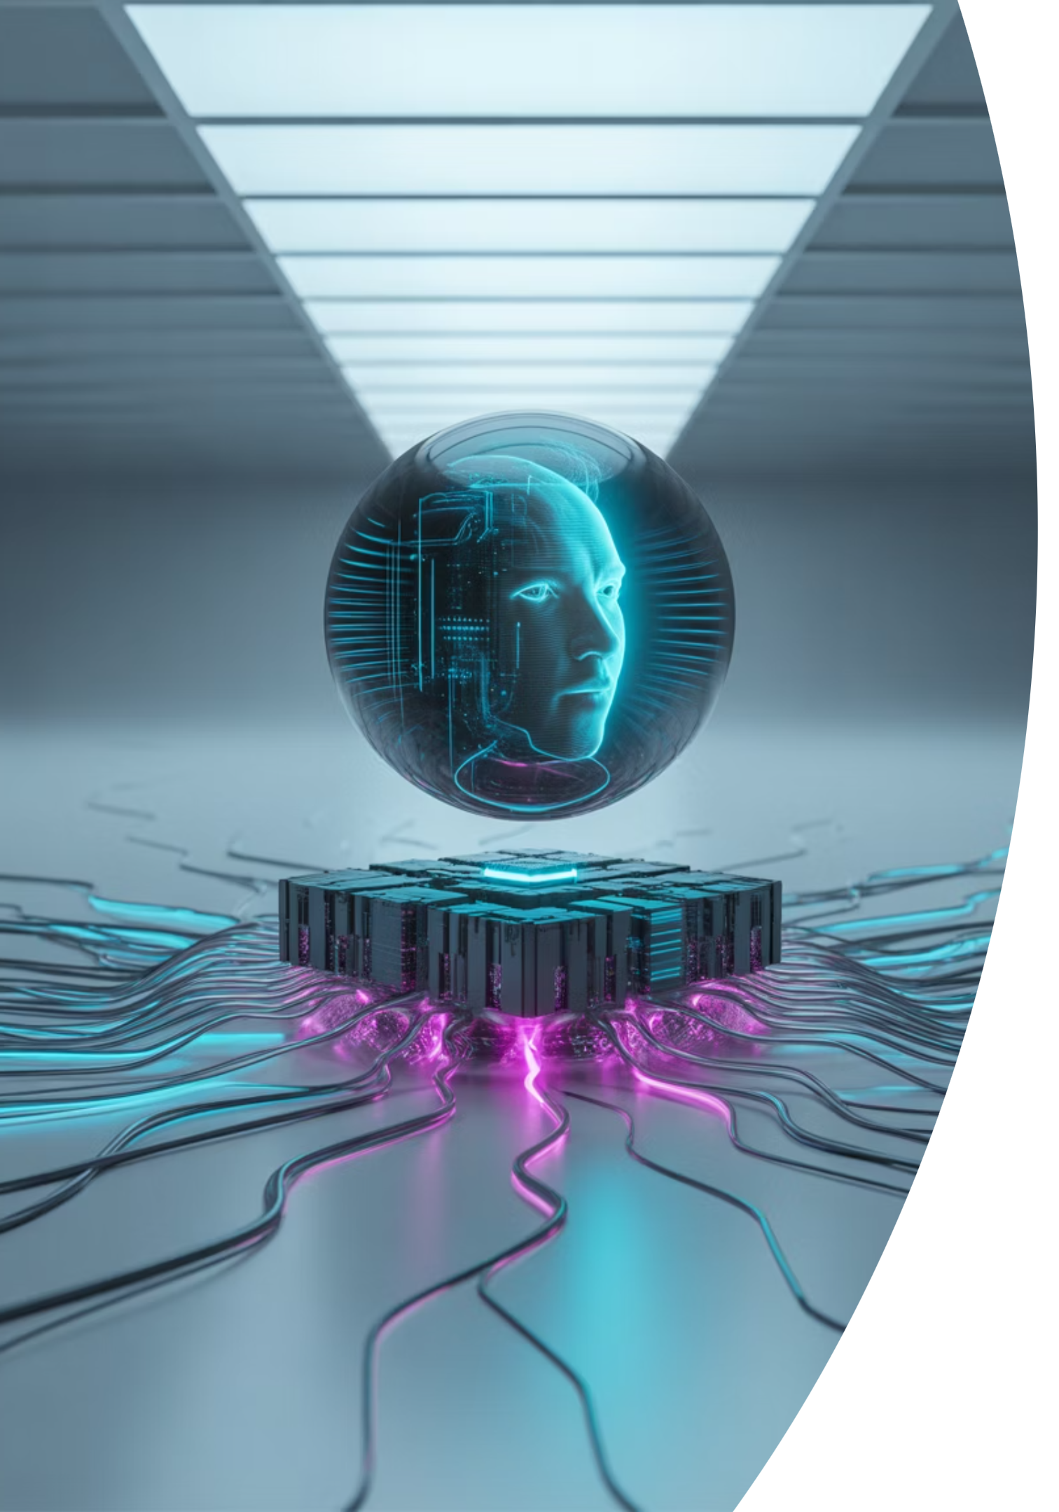
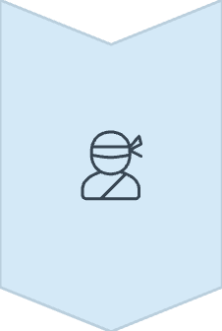
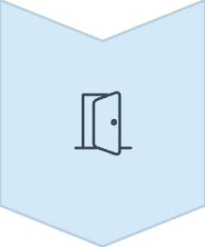
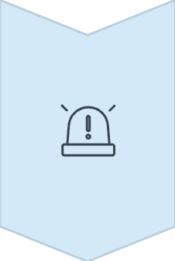
Understanding Risk, Threats, and Vulnerabilities
These three terms are often confused, but they each play a distinct role in cybersecurity:
Threat
Anything that has the potential to cause harm (e.g., hackers, malware, natural disasters)
Vulnerability
A weakness that can be exploited (e.g., unpatched software, weak passwords)
Risk
The potential impact if a threat exploits a vulnerability (e.g., data breach, financial loss)
For example, if a company stores customer credit card information (asset), but does not secure its web application (vulnerability), a hacker (threat) could use SQL injection to access the data. The risk is both reputational damage and legal consequences.

Slide 15

The CIA Triad: Confidentiality
Confidentiality
Ensures that data is accessible only to those with the proper authority.
Implemented through:
Access controls and permissions
Encryption of sensitive data
Secure communications channels
Data classification policies
Privacy controls
When confidentiality is breached, unauthorized parties gain access to protected information.

Slide 16

The CIA Triad: Integrity
Integrity
Involves making sure data is accurate and hasn't been altered inappropriately.
Implemented through:
Hashing algorithms to verify data
Checksums for file verification
Digital signatures
Version control systems
Audit logs and trails
When integrity is compromised, data can no longer be trusted to be accurate or authentic.

Slide 17
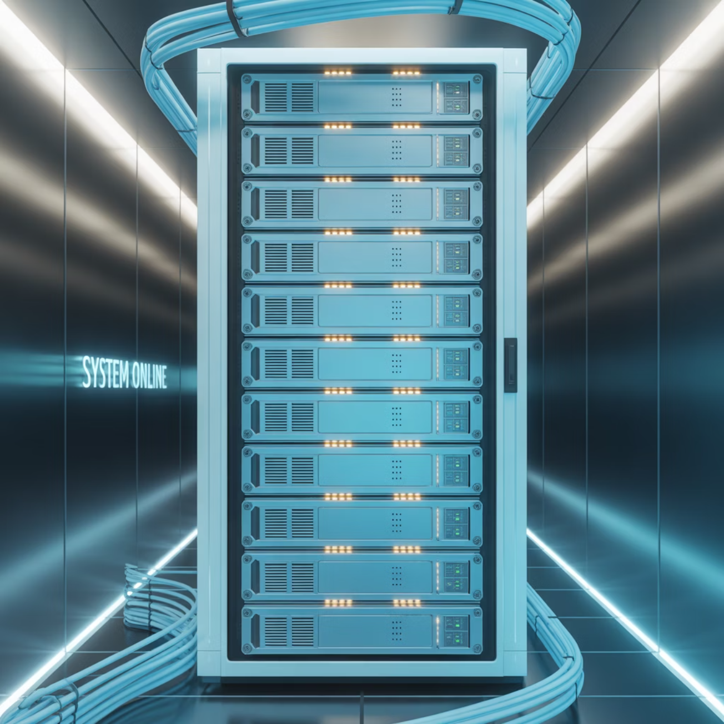
The CIA Triad: Availability
Availability
Ensures that systems and data are accessible when needed by authorized users.
Implemented through:
Backup and recovery solutions
Redundant systems and components
Disaster recovery planning
DDoS protection services
High availability architectures
When availability is compromised, legitimate users cannot access the resources they need.

Slide 18
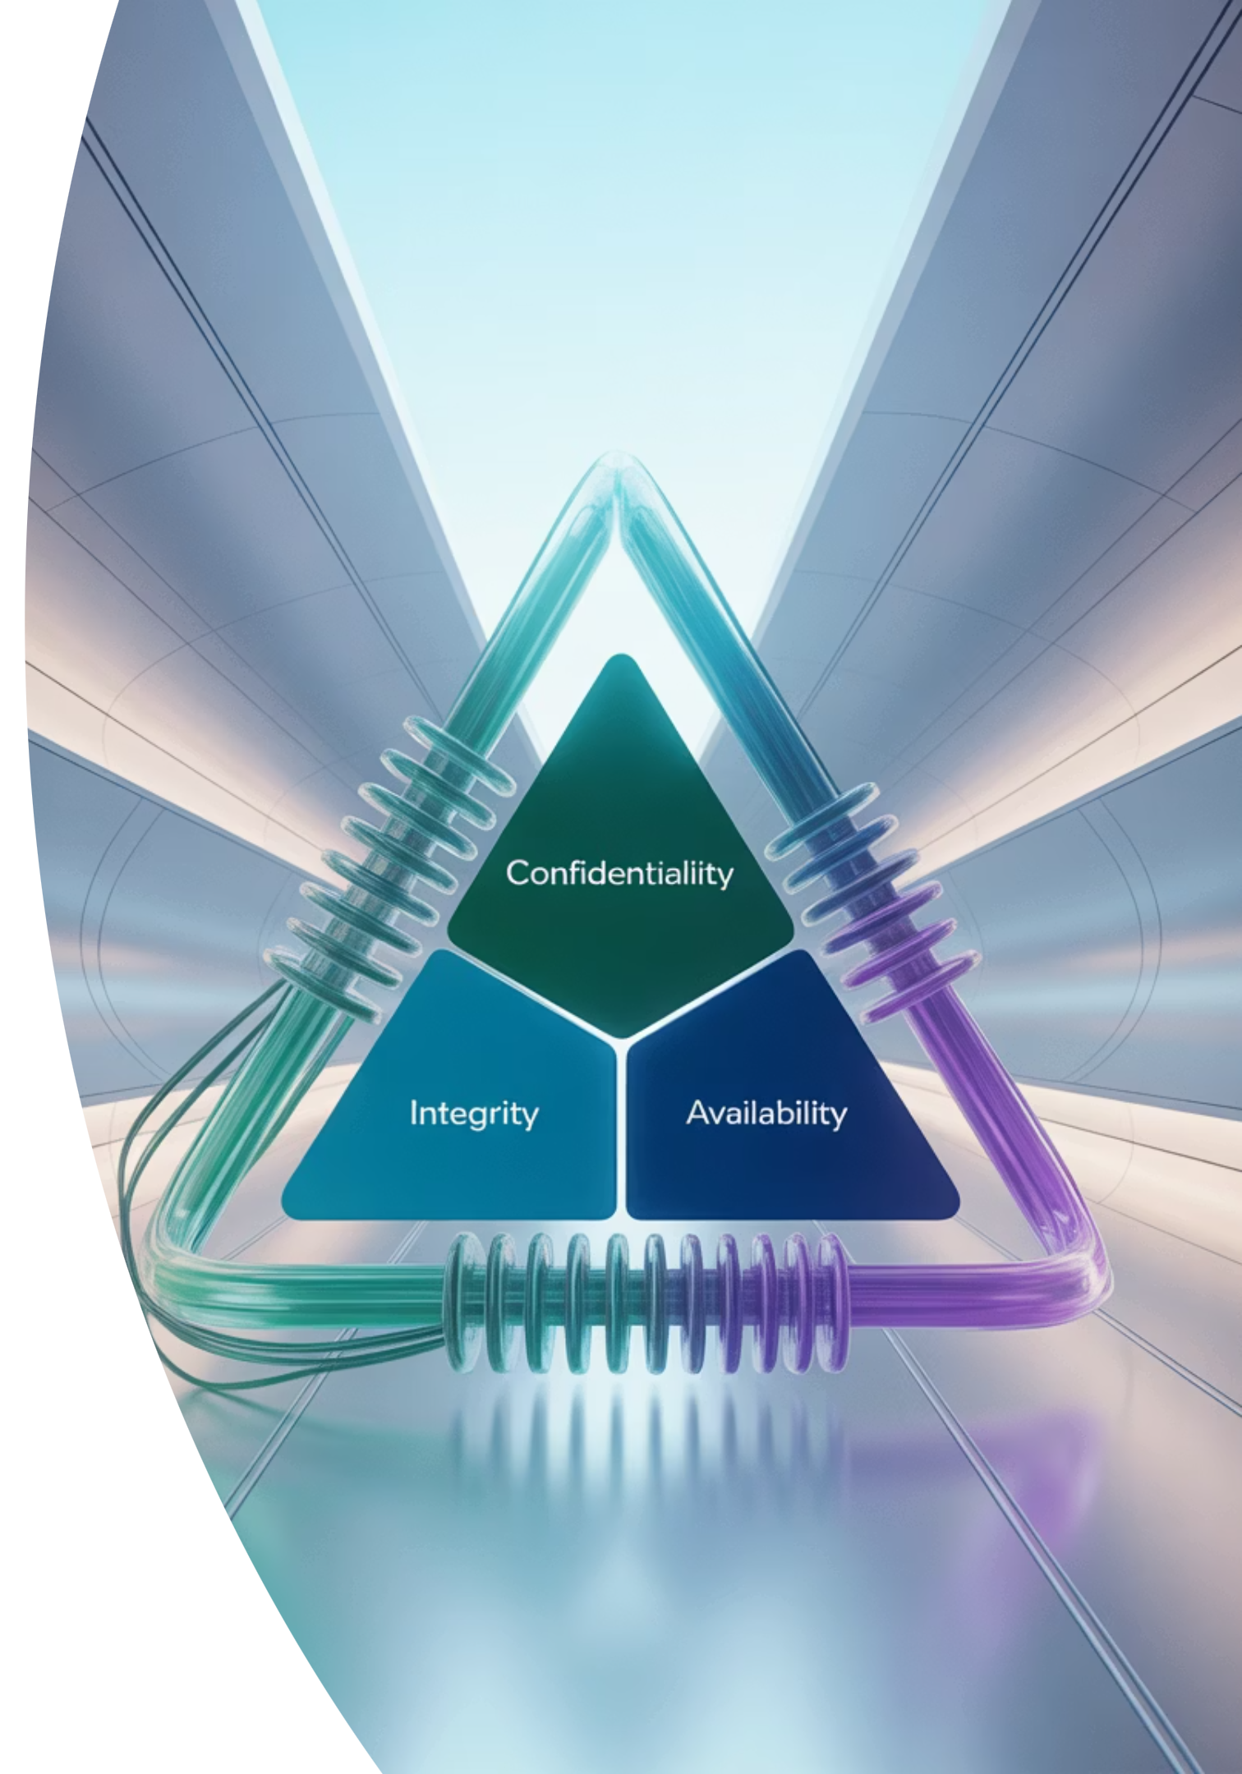
The CIA Triad: Balancing All Three
Together, these three principles form the bedrock of cybersecurity decision-making. The challenge for organizations is finding the right balance between them:
Too much focus on confidentiality
Too much focus on integrity
Can slow down processes and impact performance
Can make systems difficult to use and reduce availability
Too much focus on availability
May compromise security controls for confidentiality and integrity
The most effective security strategies find the appropriate balance based on the specific needs of the organization and the sensitivity of the data being protected.

Slide 19

Practical Application: Securing Your Digital Life
Assess Your Digital Footprint
Identify what personal information is available online and what devices and accounts you need to protect.
Implement Basic Protections
Use strong, unique passwords with a password manager, enable multi-factor authentication, and keep software updated.
Practice Safe Online Behavior
Be cautious of phishing attempts, verify before sharing information, and use secure connections for sensitive transactions.
Prepare for Incidents
Back up important data regularly and know what steps to take if your accounts or devices are compromised.
By applying cybersecurity principles to your personal digital life, you can significantly reduce your risk of becoming a victim of cyber attacks.

Slide 20
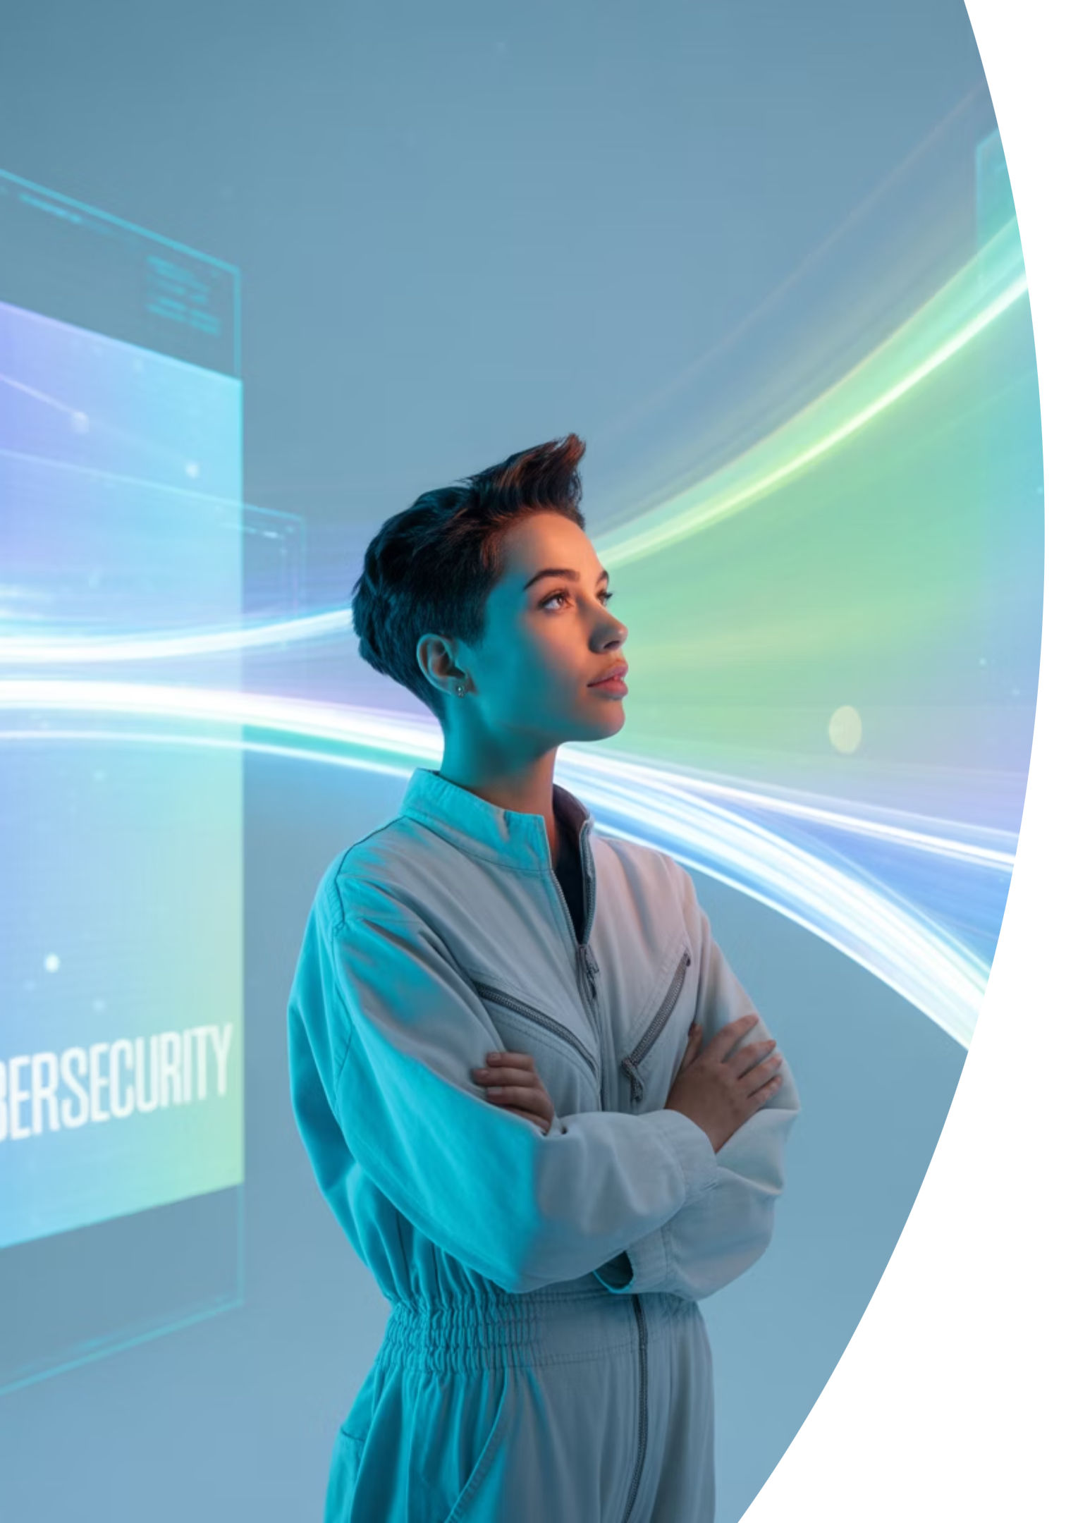
Conclusion and Next Steps
Cybersecurity is essential to the functioning of modern life. From protecting your email to securing global financial systems, it is a field with wide-reaching impact and constant evolution.
Whether your goal is to:
Enter the cybersecurity workforce
Strengthen your personal knowledge
Prepare for certifications like ISC2 CC
As you continue this journey, you will gain not only technical skills but also an appreciation for the responsibility and ethics involved in protecting the digital world.
This foundational understanding is your first step toward mastering cybersecurity concepts and practices.

