Slide 1
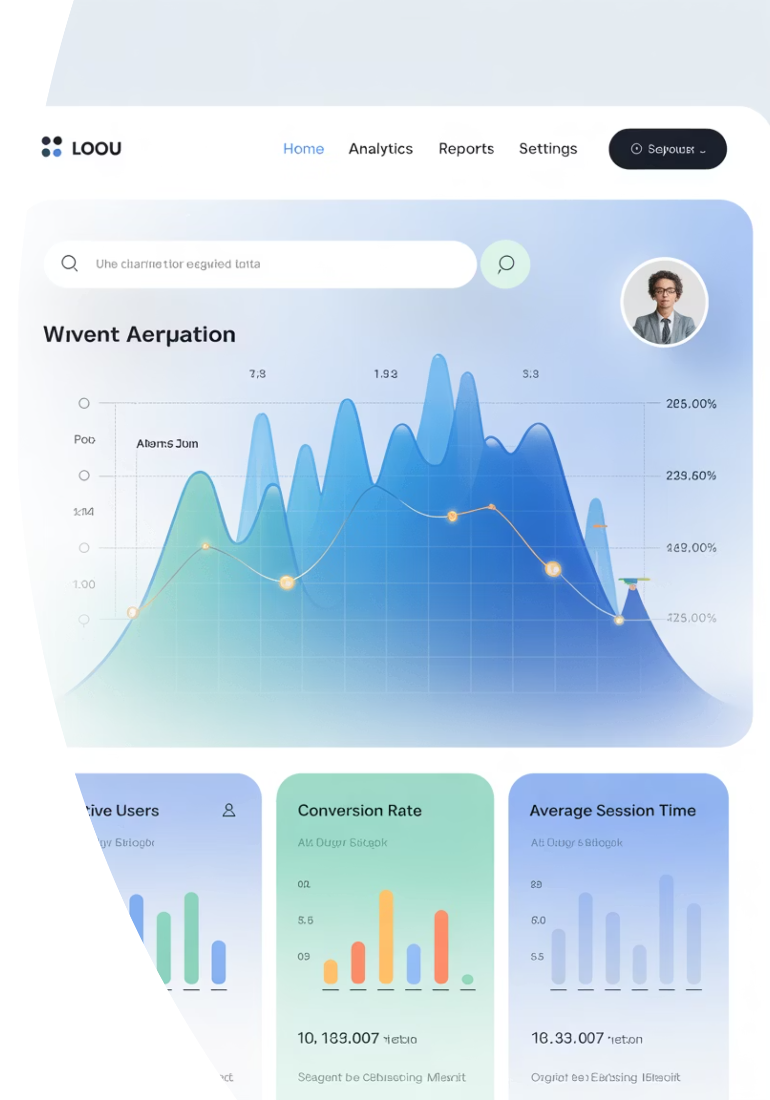
Introduction to Splunk
A comprehensive platform for searching, monitoring, and analyzing machine-generated data in real-time

Slide 2
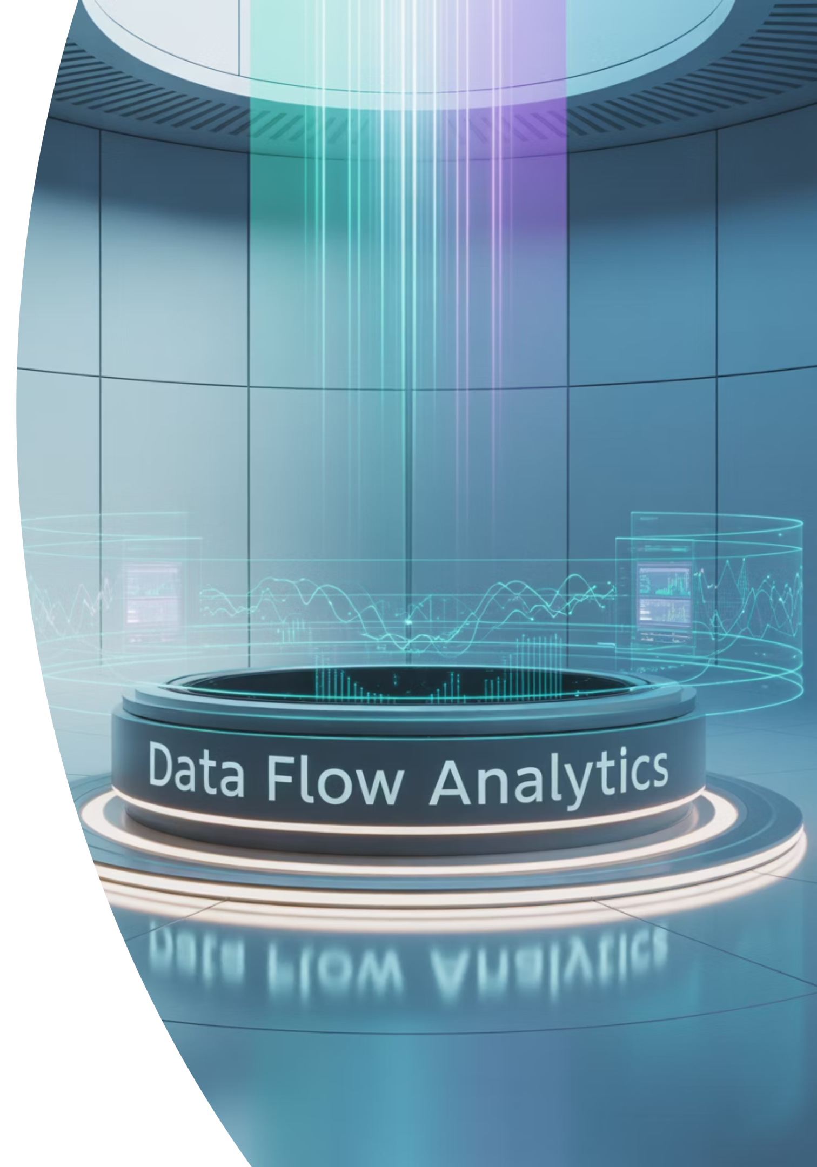
What is Splunk?
Definition
A platform for searching, monitoring, and analyzing machine-generated data (logs, metrics, events) in real-time using SPL (Search Processing Language)
Primary Uses
Security Information and Event Management (SIEM)
IT Operations Monitoring
Application Monitoring
Business Analytics

Slide 3
Splunk vs. Other Tools
Traditional SIEMs
Log Management Tools
(ArcSight, QRadar, LogRhythm)
(ELK Stack, Graylog)
Focus mainly on security event correlation
Mainly for log ingestion and storage
Compliance and alerting
Visualization capabilities
Limited analytics capabilities
Less integrated security features
Splunk Advantages:
Combines log management + SIEM + analytics in one tool
Scalable: Handles massive volumes of data
Powerful Search: SPL makes data exploration flexible
Ecosystem: Splunk Apps extend functionality
Ease of Use: GUI-based dashboards, alerts, and reports

Slide 4
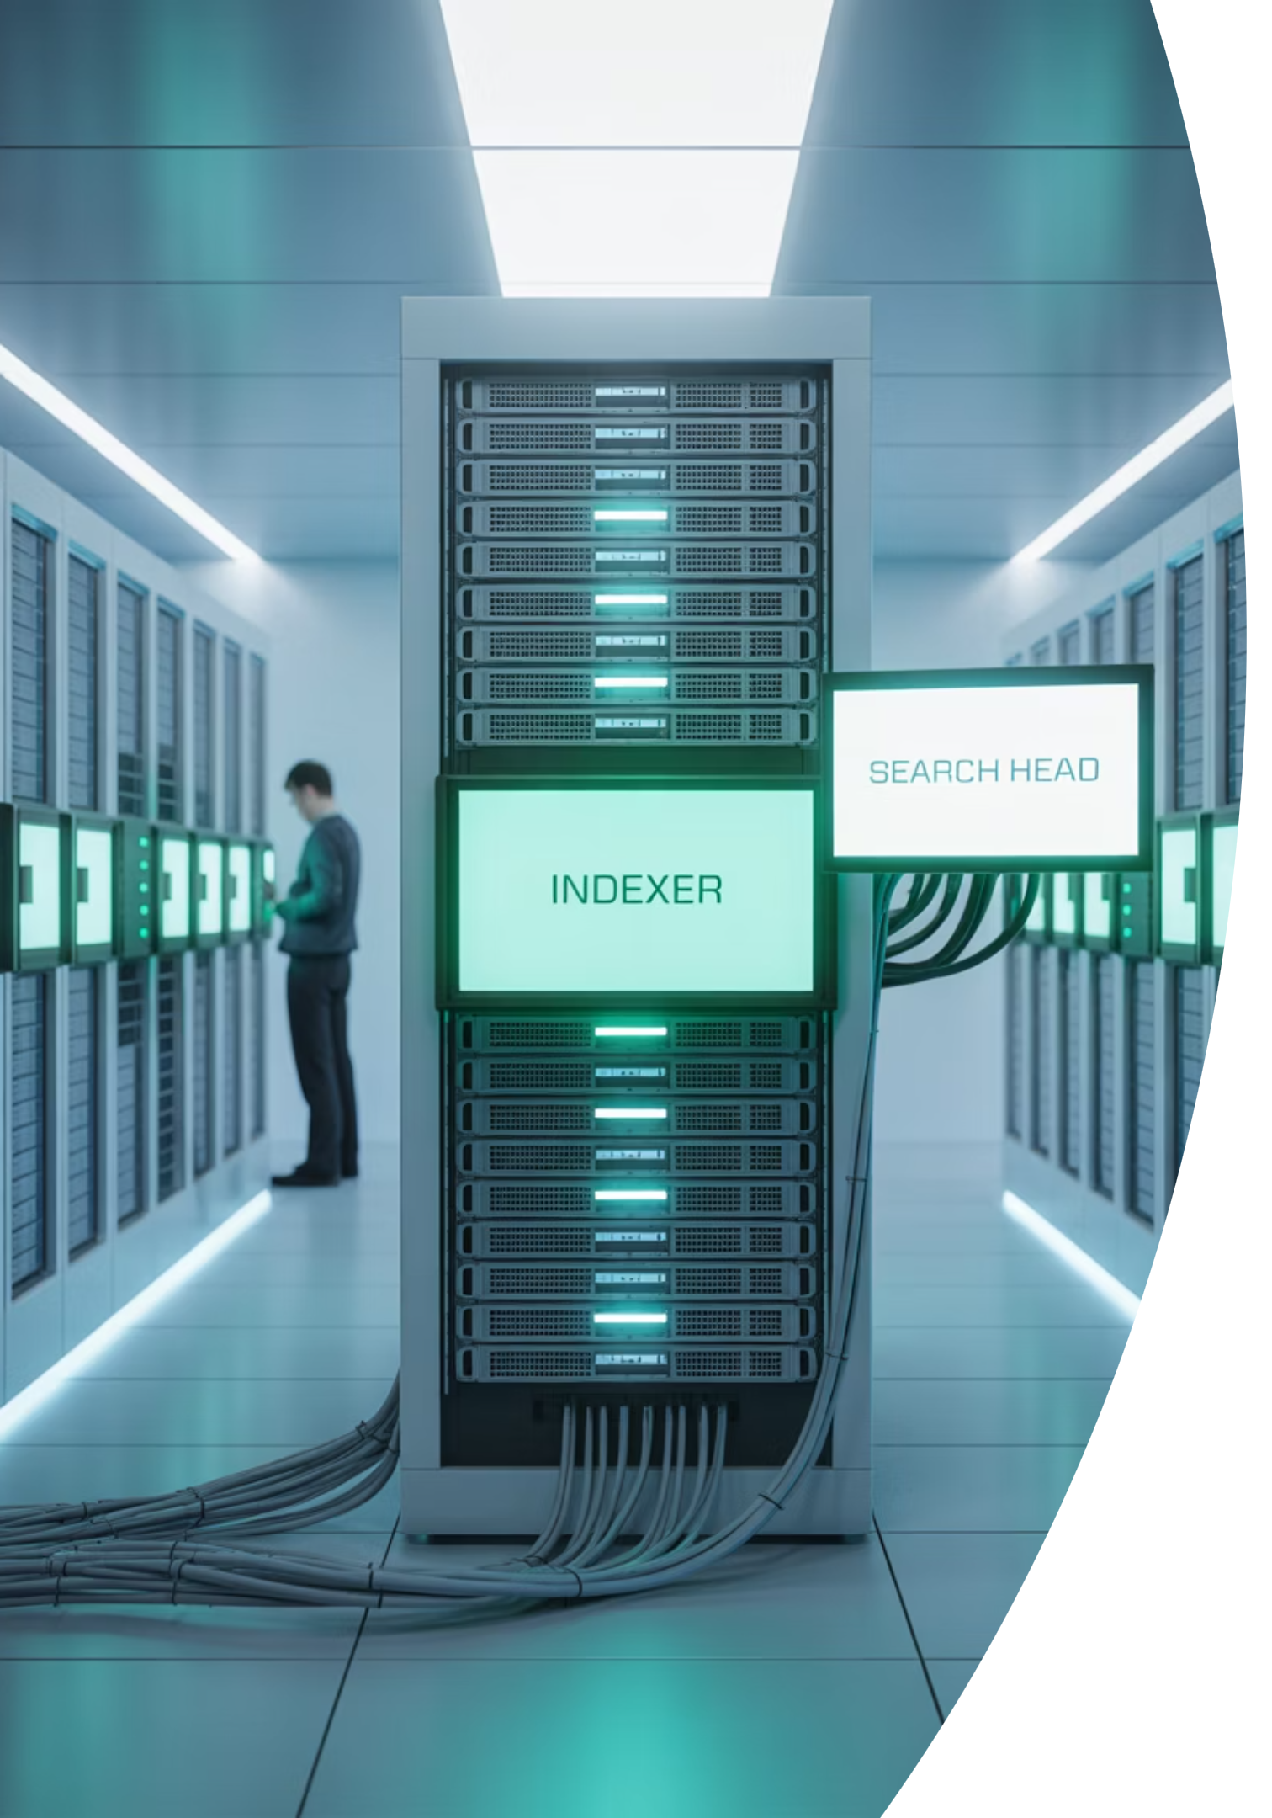
Key Concepts: Indexer & Search Head
Indexer
Core component where data is parsed, indexed, and stored
Splits data into events and saves them in indexes for searching
Manages data storage and retrieval processes
Search Head (SH)
Provides the UI and search interface
Users run queries, create dashboards, and generate alerts here
Distributes searches across Indexers for efficient processing

Slide 5


Key Concepts: Forwarders
Forwarders are lightweight agents installed on source machines that collect and forward logs to the Indexer.
Universal Forwarder (UF)
Small footprint, low resource usage
Only forwards raw data (no parsing)
They form the critical first step in the Splunk data pipeline, ensuring data is collected from all relevant sources and sent to the indexing layer.
Best for endpoints and servers
Heavy Forwarder (HF)
Full Splunk instance with parsing capabilities
Can filter, route, and parse data before sending
Consumes more resources
Best for centralized log collection

Slide 6

Key Concepts: Inputs & Sourcetypes
Inputs
Sourcetypes
Define where and how data enters Splunk:
Metadata telling Splunk how to interpret incoming data:
Files and directories
Defines the format (e.g., Apache logs, JSON)
Network ports
APIs
Helps with proper event breaking
Syslog
Examples: csv, json, access_combined, windows_event_log
Scripts
Databases

Slide 7
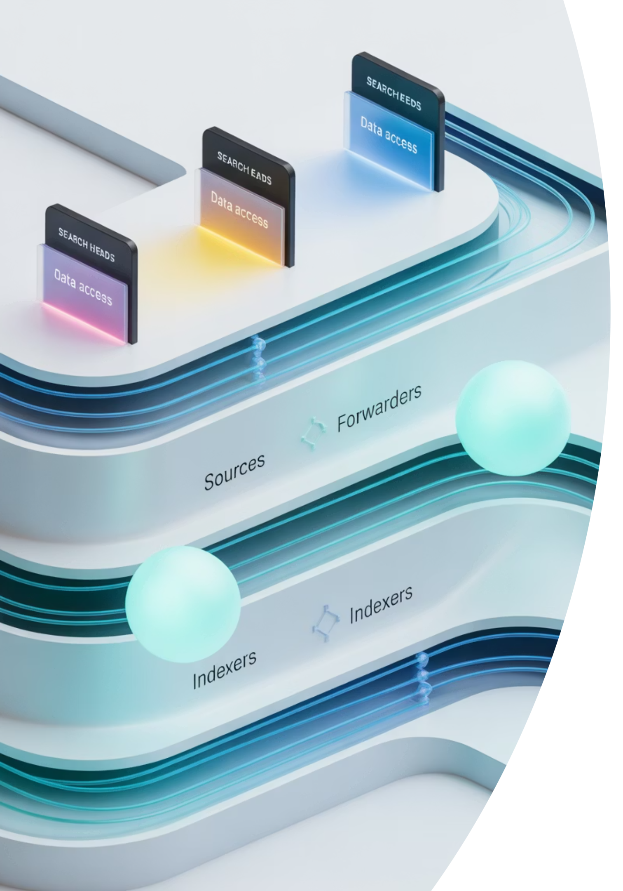
Splunk Architecture Overview
Data Input Layer
Forwarders (UF/HF) collect and send data from various sources
Indexing Layer
Indexers receive data, parse events, and store them in searchable indexes
Search & Reporting Layer
Search Heads allow users to run queries, create dashboards, and set up alerts
Optional components for enterprise-scale environments:
Deployment Server - Manages configurations across Splunk instances
License Master - Controls licensing across the deployment
Cluster Master - Manages indexer clusters for high availability

Slide 8




Data Flow in Splunk
Data Ingestion
Forwarders send raw log data to Indexers from various sources
Parsing & Indexing
Data parsed into events
Timestamp and metadata applied
Events stored in indexes
Searching & Reporting
Search Head runs SPL queries
Results visualized in dashboards/reports

Slide 9


Indexing Process
How Splunk Indexes Data
Index Structure
Breaks incoming data into discrete events
Indexes are organized into time-based buckets:
Identifies timestamps and extracts fields
Hot: Active, newest data (read/write)
Creates indexes (organized buckets of data)
Warm: Recent data (read-only)
Stores both raw data and searchable metadata
Cold: Older data (compressed)
Optimizes for fast searching and retrieval
Frozen: Archived data

Slide 10










Searching Process
Search Distribution
Query Creation
Search Head distributes query to Indexers
User enters SPL query in Search Head
Parallel Processing
Indexers scan data in parallel and return results
Visualization
Results displayed in GUI or dashboard
Result Aggregation
Search Head aggregates results from all Indexers
Splunk's distributed architecture allows it to efficiently search through massive volumes of data by leveraging parallel processing across multiple indexers.

