Slide 1
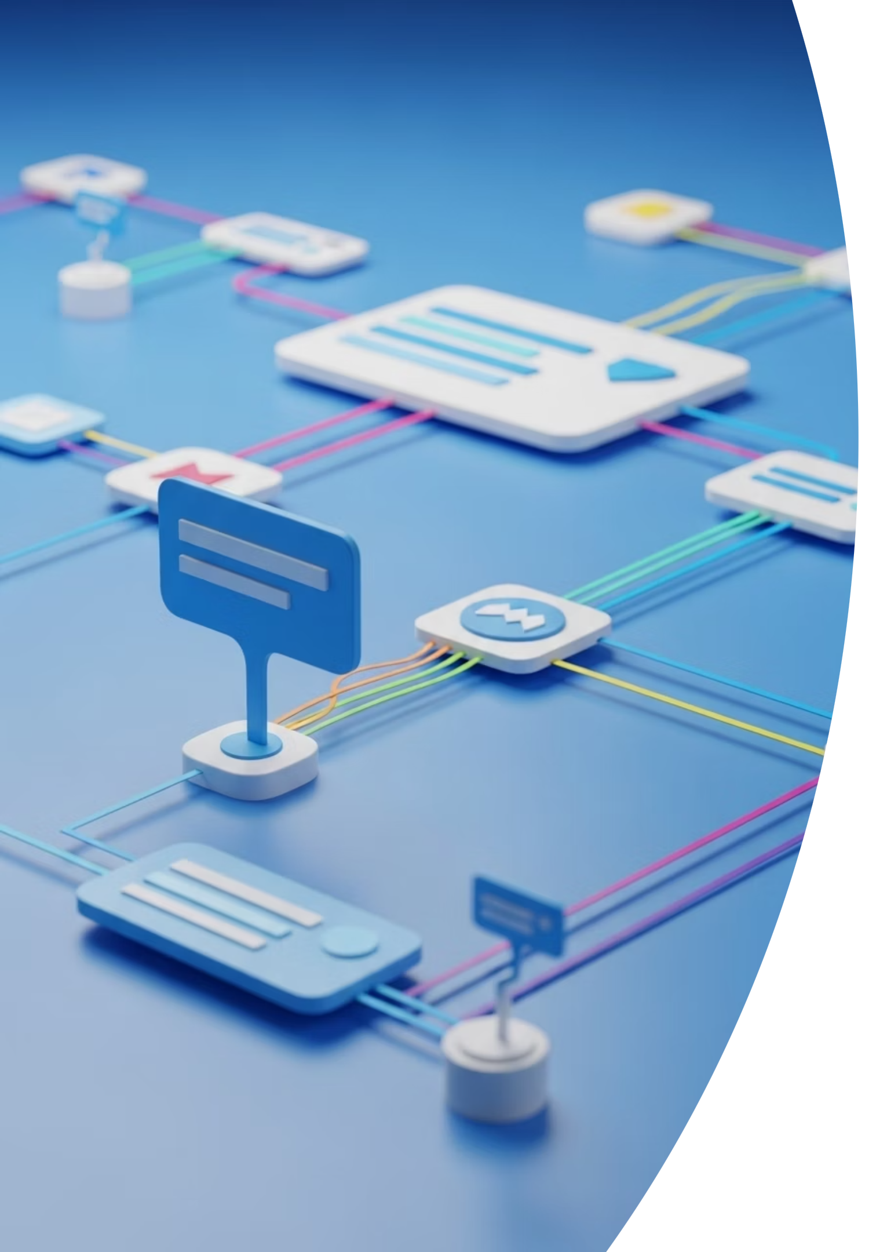
Networking Fundamentals & Security Technologies
In the digital world, devices must communicate with each other to share information, provide services, and enable connectivity across the internet. This interaction forms the basis of networking. Understanding how networks work is fundamental to cybersecurity because most cyber attacks involve exploiting a network pathway to reach a target.

Slide 2

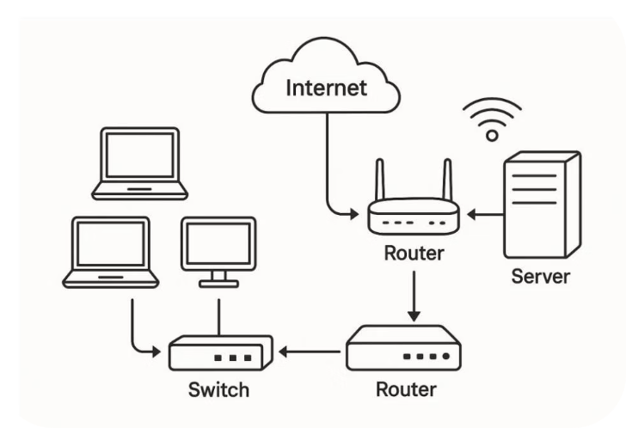
Understanding Networking in Cybersecurity
A network is simply a collection of interconnected devices—computers, phones, servers—that exchange information. These connections can happen over physical wires, like Ethernet cables, or wirelessly using Wi-Fi.
When you send a message from your phone to a friend across the globe, that message travels through routers, switches, servers, and cables. Networking defines the rules and technologies that make such communication possible.

Slide 3
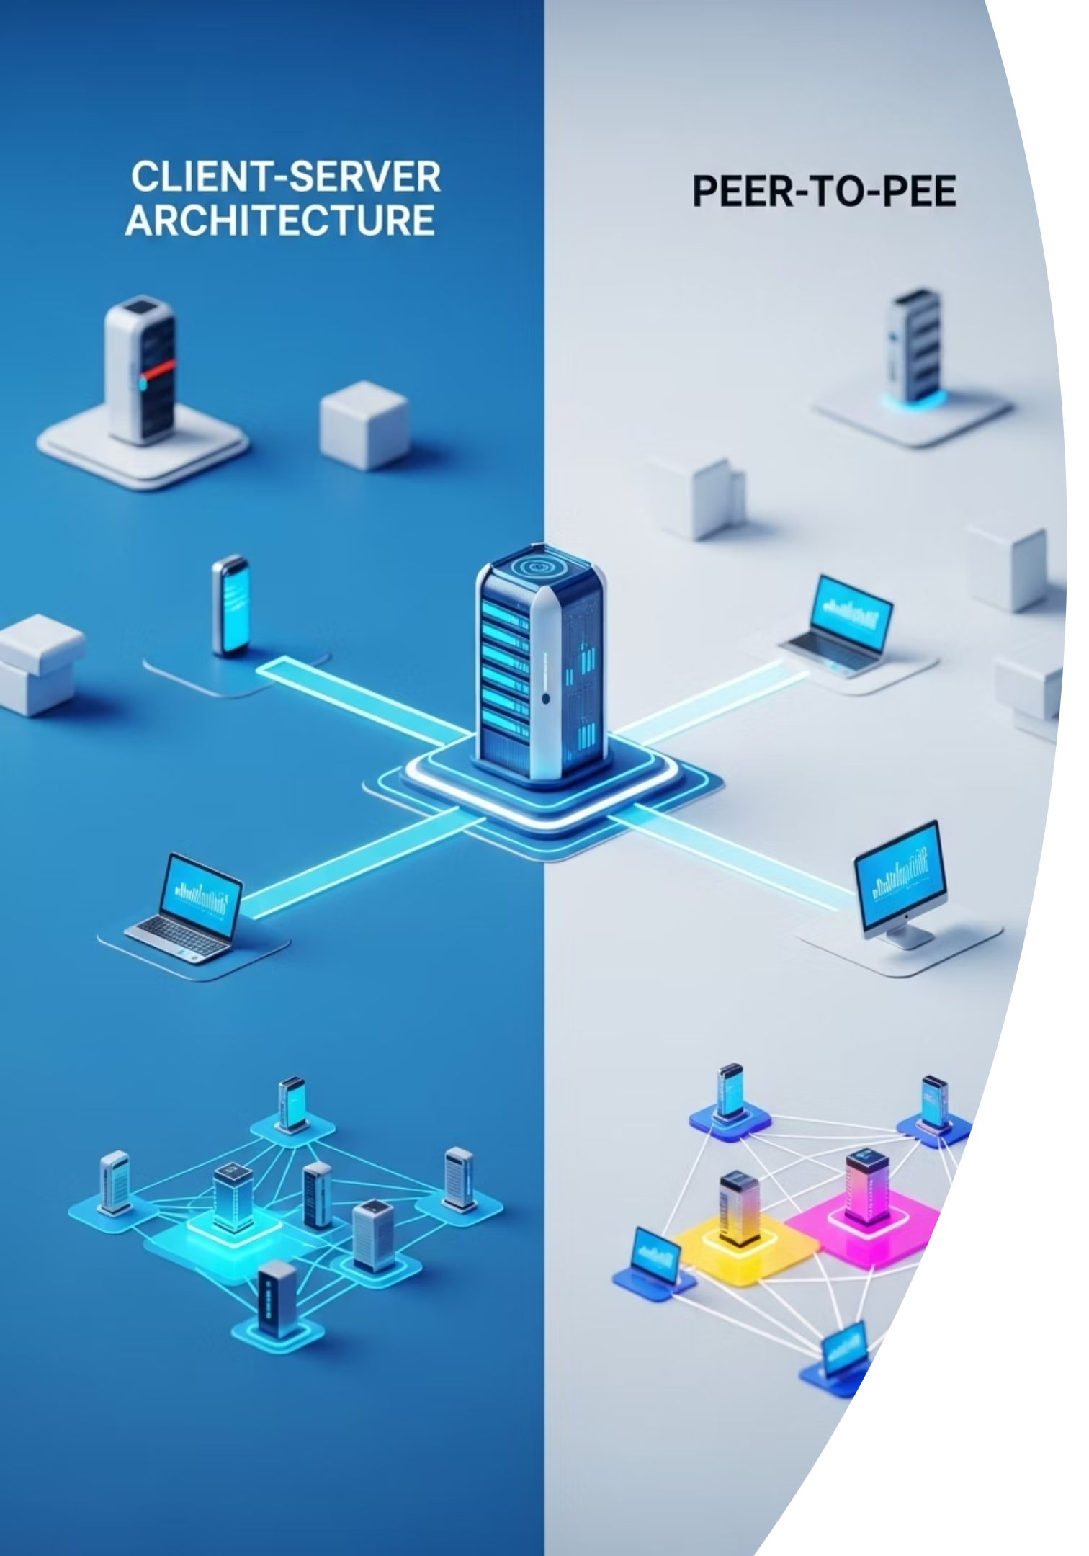
Core Network Architectures
Client-Server Model
One device (the client) requests information or services, and another device (the server) responds. This is how websites work—your browser (client) requests a page, and the web server sends it.
Peer-to-Peer (P2P) Model
Devices communicate directly with each other without a central server. Common in file-sharing systems or local networks like Bluetooth file transfers.
Each model has its own strengths and weaknesses. While client-server offers centralized control and security, P2P can be faster and more resilient—but also harder to secure.

Slide 4
Key Networking Protocols
Protocols are the language of the internet. They are sets of rules that devices follow to exchange information.
1
2
3
TCP/IP
DNS
DHCP
The backbone of the internet. TCP ensures reliable delivery by checking for errors and confirming receipt, while IP handles addressing and routing—deciding where data should go.
Think of it as the internet's phone book. It translates user-friendly website names like "example.com" into IP addresses like "192.0.2.1" so that computers can locate each other.
This protocol automatically assigns IP addresses to devices on a network, making it easier to scale and manage.
TCP: Used for services where accuracy matters, like web browsing, email, and file transfers.
UDP: A faster but less reliable protocol used for real-time activities like video calls, gaming, and DNS queries.
These protocols make the modern internet possible—but they also create opportunities for attackers, who can exploit vulnerabilities in the way these protocols work.

Slide 5

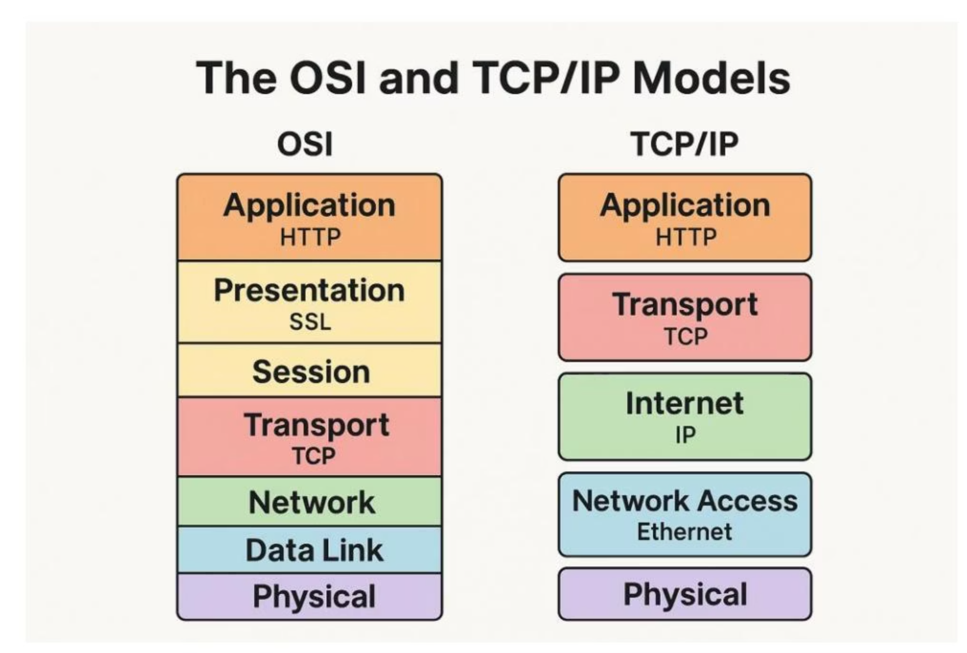
The OSI and TCP/IP Models
OSI Model
TCP/IP Model
A theoretical framework with seven layers, from the physical wires (Layer 1) up to user-facing applications (Layer 7). Each layer performs a specific role.
A simplified, four-layer model used in real-world networking. It combines some OSI layers for practical use.
Understanding these layers helps in diagnosing issues and understanding where attacks might occur. For instance, a firewall may operate at the network layer (blocking IP addresses), while encryption happens at the presentation or transport layer.

Slide 6
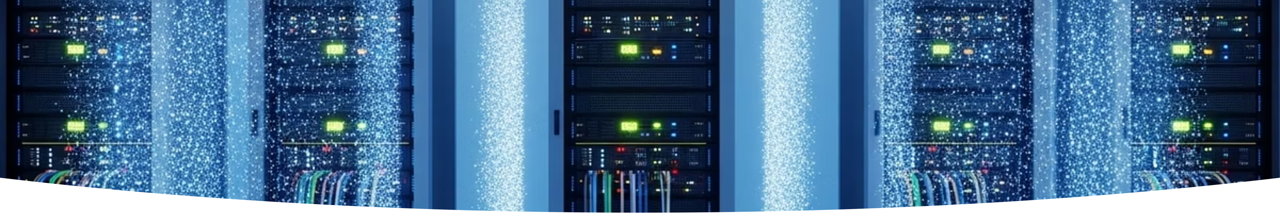
Network Segmentation and VLANs
In cybersecurity, segmentation is a strategy used to divide networks into smaller parts. This helps limit the damage if a breach occurs.
What are VLANs?
Security Benefits
Virtual Local Area Networks allow administrators to group devices logically, even if they are not physically close.
Placing HR and Finance departments on separate VLANs prevents unauthorized access between departments. If an attacker breaches the HR network, they can't automatically access Finance.
Segmentation is like building walls within a building. Even if someone gets through the front door, they still need to get through locked internal doors to reach sensitive areas.

Slide 7


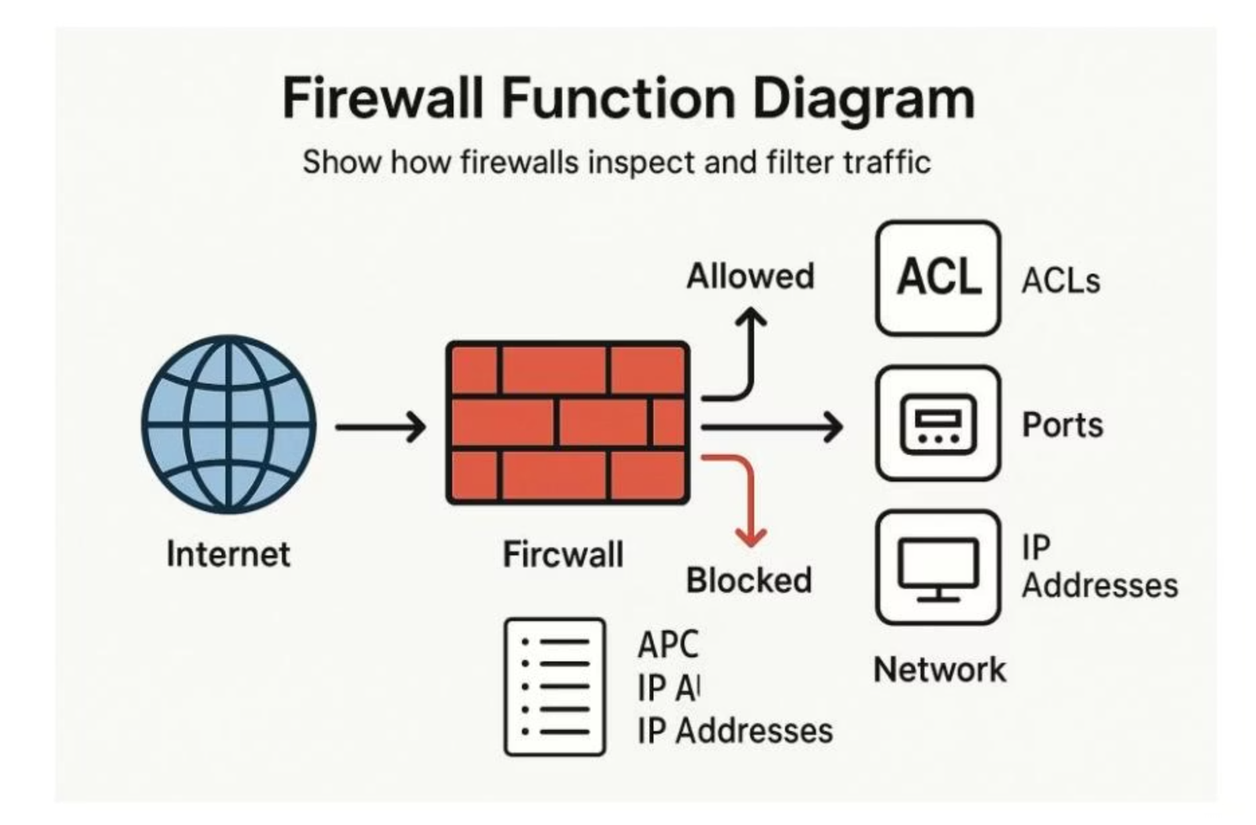


Firewalls and Access Control
A firewall acts as a gatekeeper between networks, filtering traffic based on predefined rules.
Stateless Firewalls
Simple and fast, checking packets against rules without remembering previous traffic.
Stateful Firewalls
More advanced, remembering connections and ensuring that traffic is part of a valid session.
Next-Generation Firewalls
Include deep packet inspection, intrusion prevention, antivirus, and application awareness.
Firewalls often use Access Control Lists (ACLs) to allow or deny traffic based on IP addresses, ports, or protocols. Configuring firewalls correctly is essential—one misconfiguration could allow unauthorized access or block legitimate users.

Slide 8

Common Network Attacks
Network attacks often target weaknesses in protocols or configurations. Understanding these attacks is crucial for effective defense.
1
Man-in-the-Middle (MITM) Attacks
2
ARP Spoofing
3
DNS Spoofing (Poisoning)
Attackers send fake ARP messages to associate their device's MAC address with the IP address of another device. This tricks the network into sending traffic to the attacker.
By injecting false DNS information, attackers redirect users to malicious websites. This can lead to credential theft, phishing, or malware infections.
Attackers secretly intercept communication between two devices. They may eavesdrop or modify messages. A common technique is SSL stripping, where encrypted traffic is downgraded to an insecure format.

Slide 9

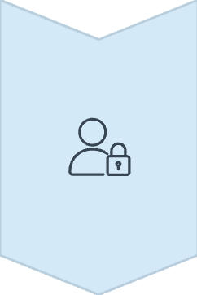
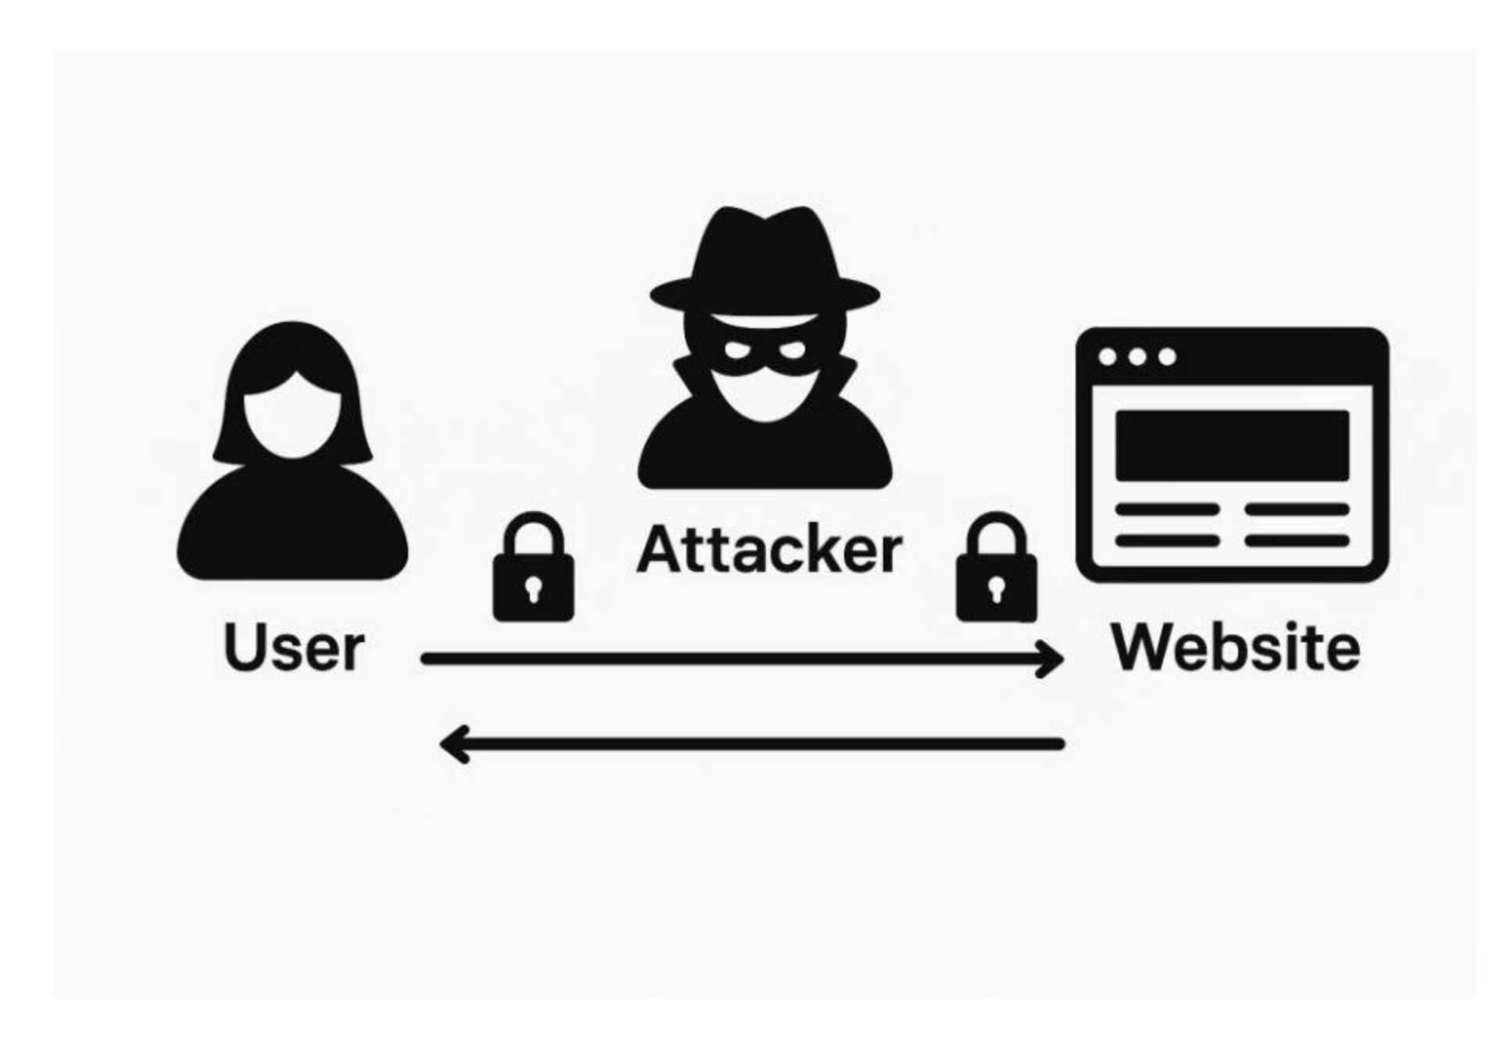

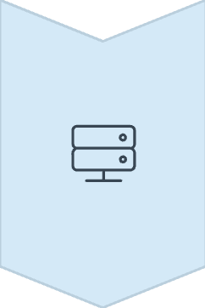
Man-in-the-Middle (MITM) Attacks
In a Man-in-the-Middle attack, an attacker positions themselves between two communicating parties, intercepting and potentially altering the communication without either party knowing.
Victim sends data
User believes they're communicating directly with a legitimate website or service
Attacker intercepts
Captures sensitive information like passwords, credit card details, or personal data
Forwards to destination
Communication continues to legitimate destination, making the attack difficult to detect
These attacks exploit the very systems that allow the internet to function. Protecting against them requires layered defenses such as encryption (HTTPS), monitoring tools, and secure configurations.

Slide 10

Real-World Case Study: The 2013 Target Breach
1
Initial Access
Attackers gained access through an HVAC vendor connected to Target's internal network
2
Lateral Movement
Once inside, they moved laterally to the payment processing network
3
Data Theft
Stole 40 million credit card numbers
Key Lesson: Network segmentation could have limited this breach by preventing the attackers from moving from the vendor network to the payment processing network.

Slide 11
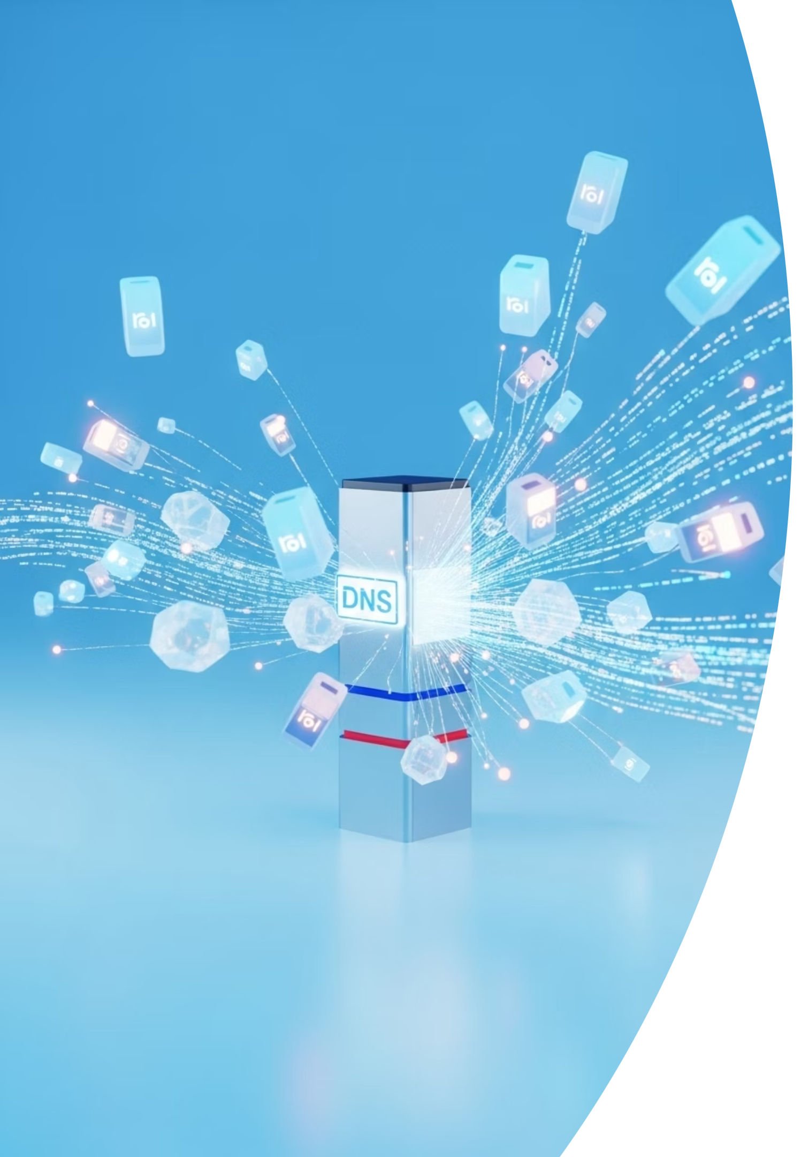
Real-World Case Study: The Dyn DNS Attack (2016)
A massive DDoS (Distributed Denial of Service) attack on DNS provider Dyn caused outages for major sites like Twitter, Netflix, and Reddit.
Attack Vector
The attackers used IoT devices infected with the Mirai malware
Attack Method
Infected devices flooded Dyn's servers with requests
Impact
Major internet platforms became inaccessible for hours
Key Lesson: This demonstrated the dangers of unsecured IoT devices and the importance of resilient network infrastructure.

Slide 12
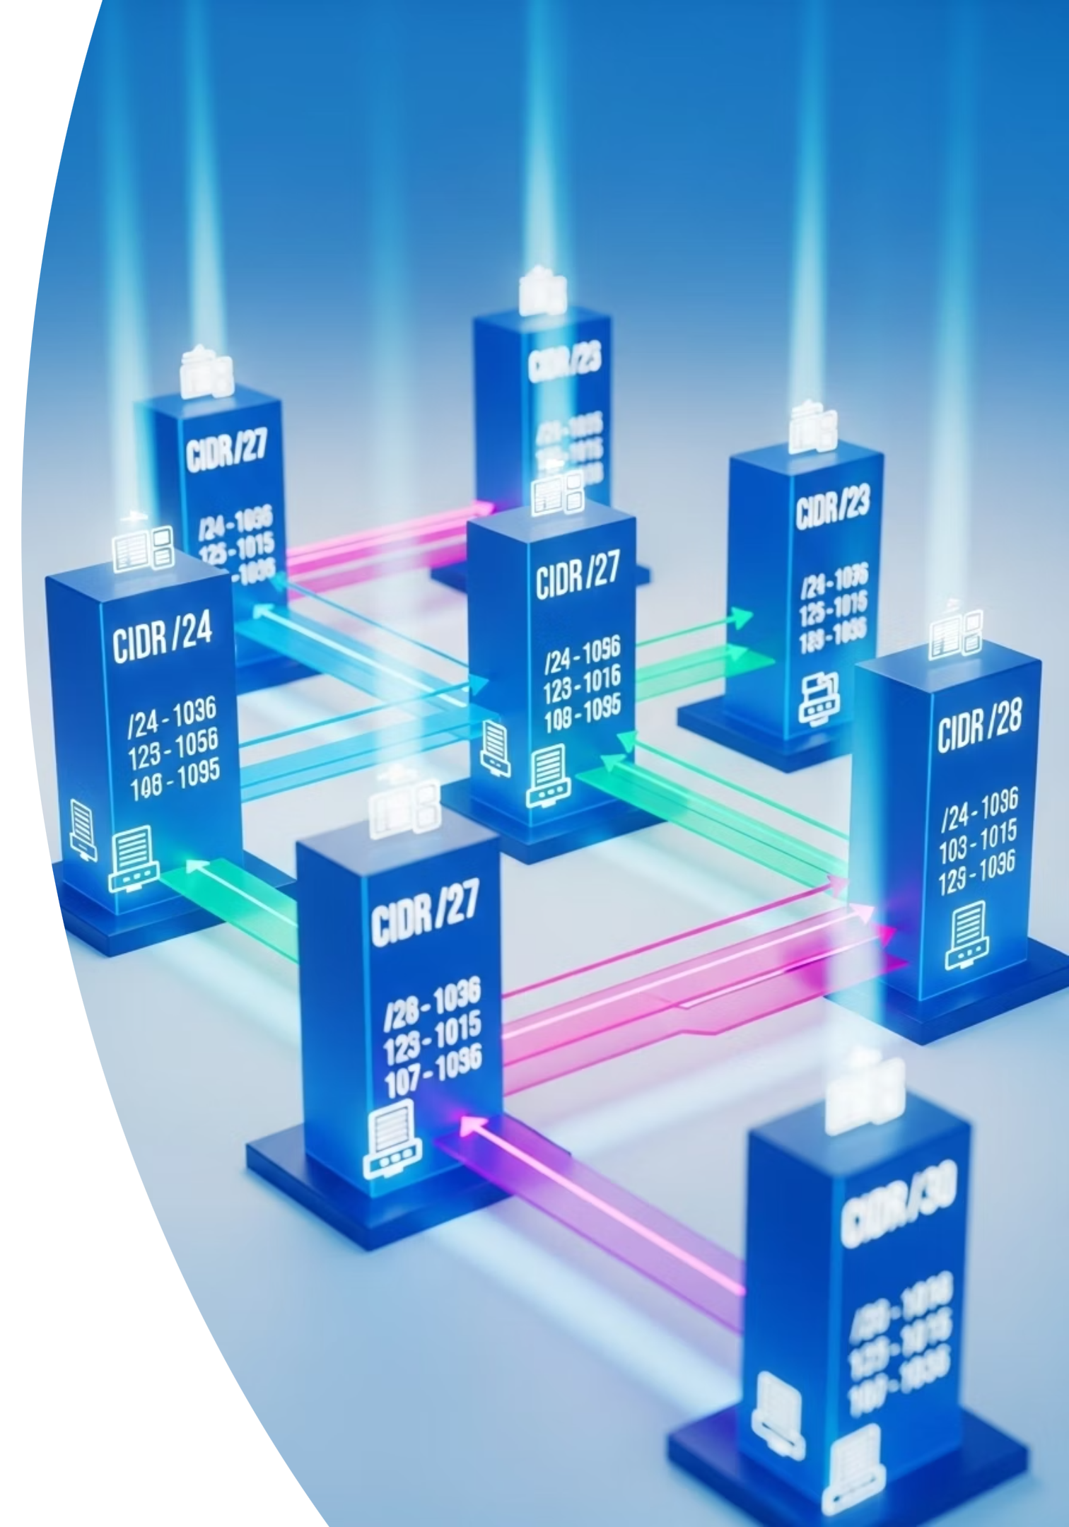
IP Addressing and Subnetting
Every device on a network has an IP address. These addresses come in two main types:
IPv4
IPv6
32-bit format, e.g., 192.168.1.1
128-bit format, e.g., 2001:0db8:85a3::8a2e:0370:7334
Limited address space (4.3 billion addresses)
Virtually unlimited address space
Subnetting divides large networks into smaller, efficient sub-networks. This improves performance and security by isolating groups of devices.
/24 Subnet
256 addresses (common for small networks)
/30 Subnet
4 addresses (ideal for point-to-point connections)

Slide 13
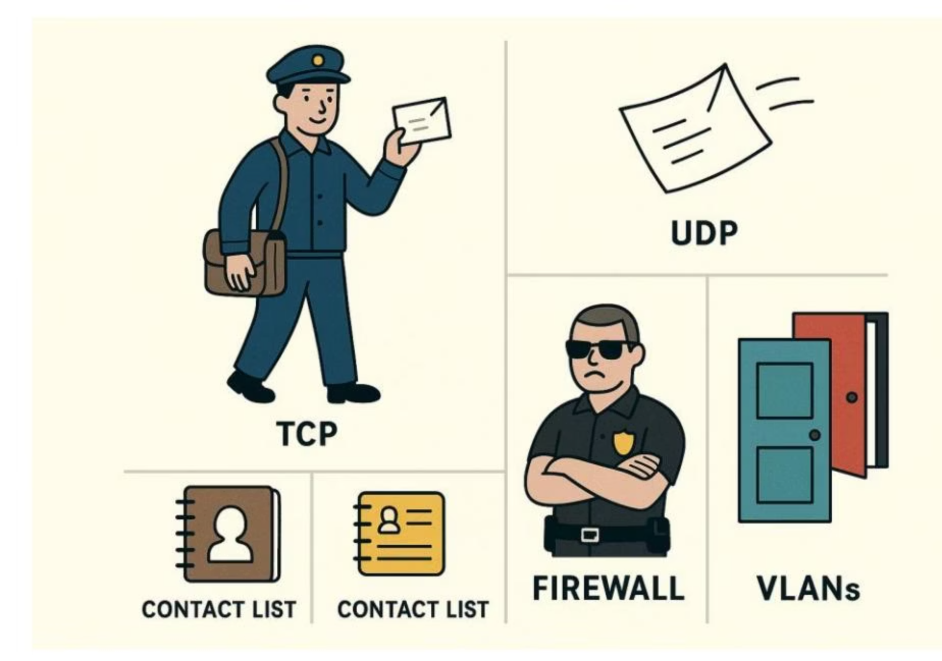





Visualizing Networking Concepts
TCP
UDP
DNS
A reliable mail carrier who checks that each letter was delivered
Like tossing a note across the room—faster but riskier
Your phone's contact list, translating names into numbers
Firewalls
VLANs
Security guards checking ID before letting someone in
Private rooms within a building, restricting who can enter where
These mental images help make technical concepts more relatable for beginners.

Slide 14
Careers in Networking and Security Technologies
If you're interested in defending digital infrastructure, networking knowledge is essential. Many cybersecurity roles are deeply tied to networking:
Network Security Analyst
Firewall Administrator
Infrastructure Security Engineer
Monitors and defends network activity
Designs and manages firewall rules
Builds secure network environments
SOC Analyst
Penetration Tester
Investigates suspicious activity on enterprise networks
Tests networks for vulnerabilities using ethical hacking

Slide 15
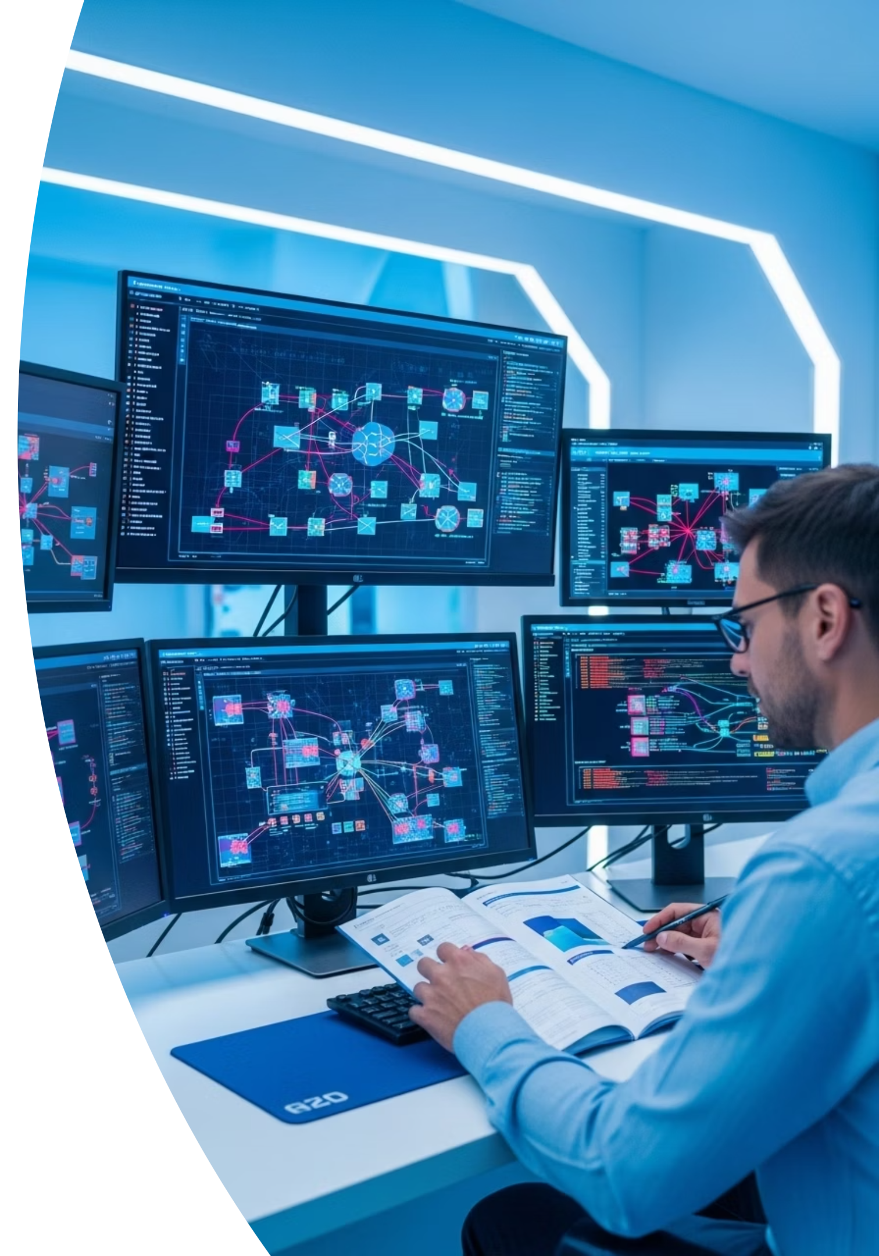





Recommended Certifications
These certifications provide a strong foundation in networking and security:
CompTIA Network+
Cisco CCNA
Covers networking fundamentals, implementation, and operations
Focuses on Cisco networking technologies and implementation
ISC2 CC
Entry-level cybersecurity certification with networking components
These certifications validate your knowledge and can help advance your career in cybersecurity.

Slide 16
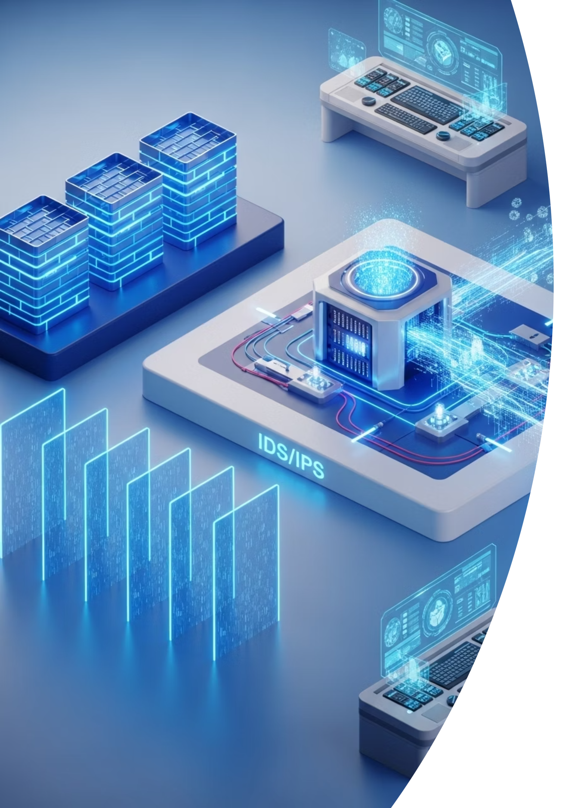
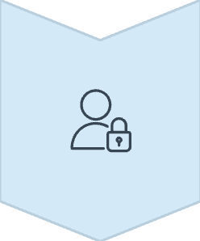



Network Security Best Practices
Implement Defense in Depth
Use multiple layers of security controls to protect your network
Segment Your Network
Divide networks into zones to contain breaches and limit lateral movement
Keep Systems Updated
Regularly patch and update network devices to address vulnerabilities
Monitor Network Traffic
Implement tools to detect and alert on suspicious network activity
Following these practices can significantly reduce your network's attack surface and improve your security posture.

Slide 17

The Importance of Encryption in Networking
Encryption transforms readable data into a coded format that can only be decoded with the correct key, protecting information as it travels across networks.
Transport Layer Security (TLS)
Virtual Private Networks (VPNs)
Wireless Security (WPA3)
Secures web browsing, email, and other communications
Creates encrypted tunnels for secure remote access
Protects Wi-Fi networks from eavesdropping and unauthorized access
Without encryption, sensitive data transmitted over networks would be vulnerable to interception and theft. Modern encryption standards make it computationally infeasible for attackers to decrypt protected information.

Slide 18
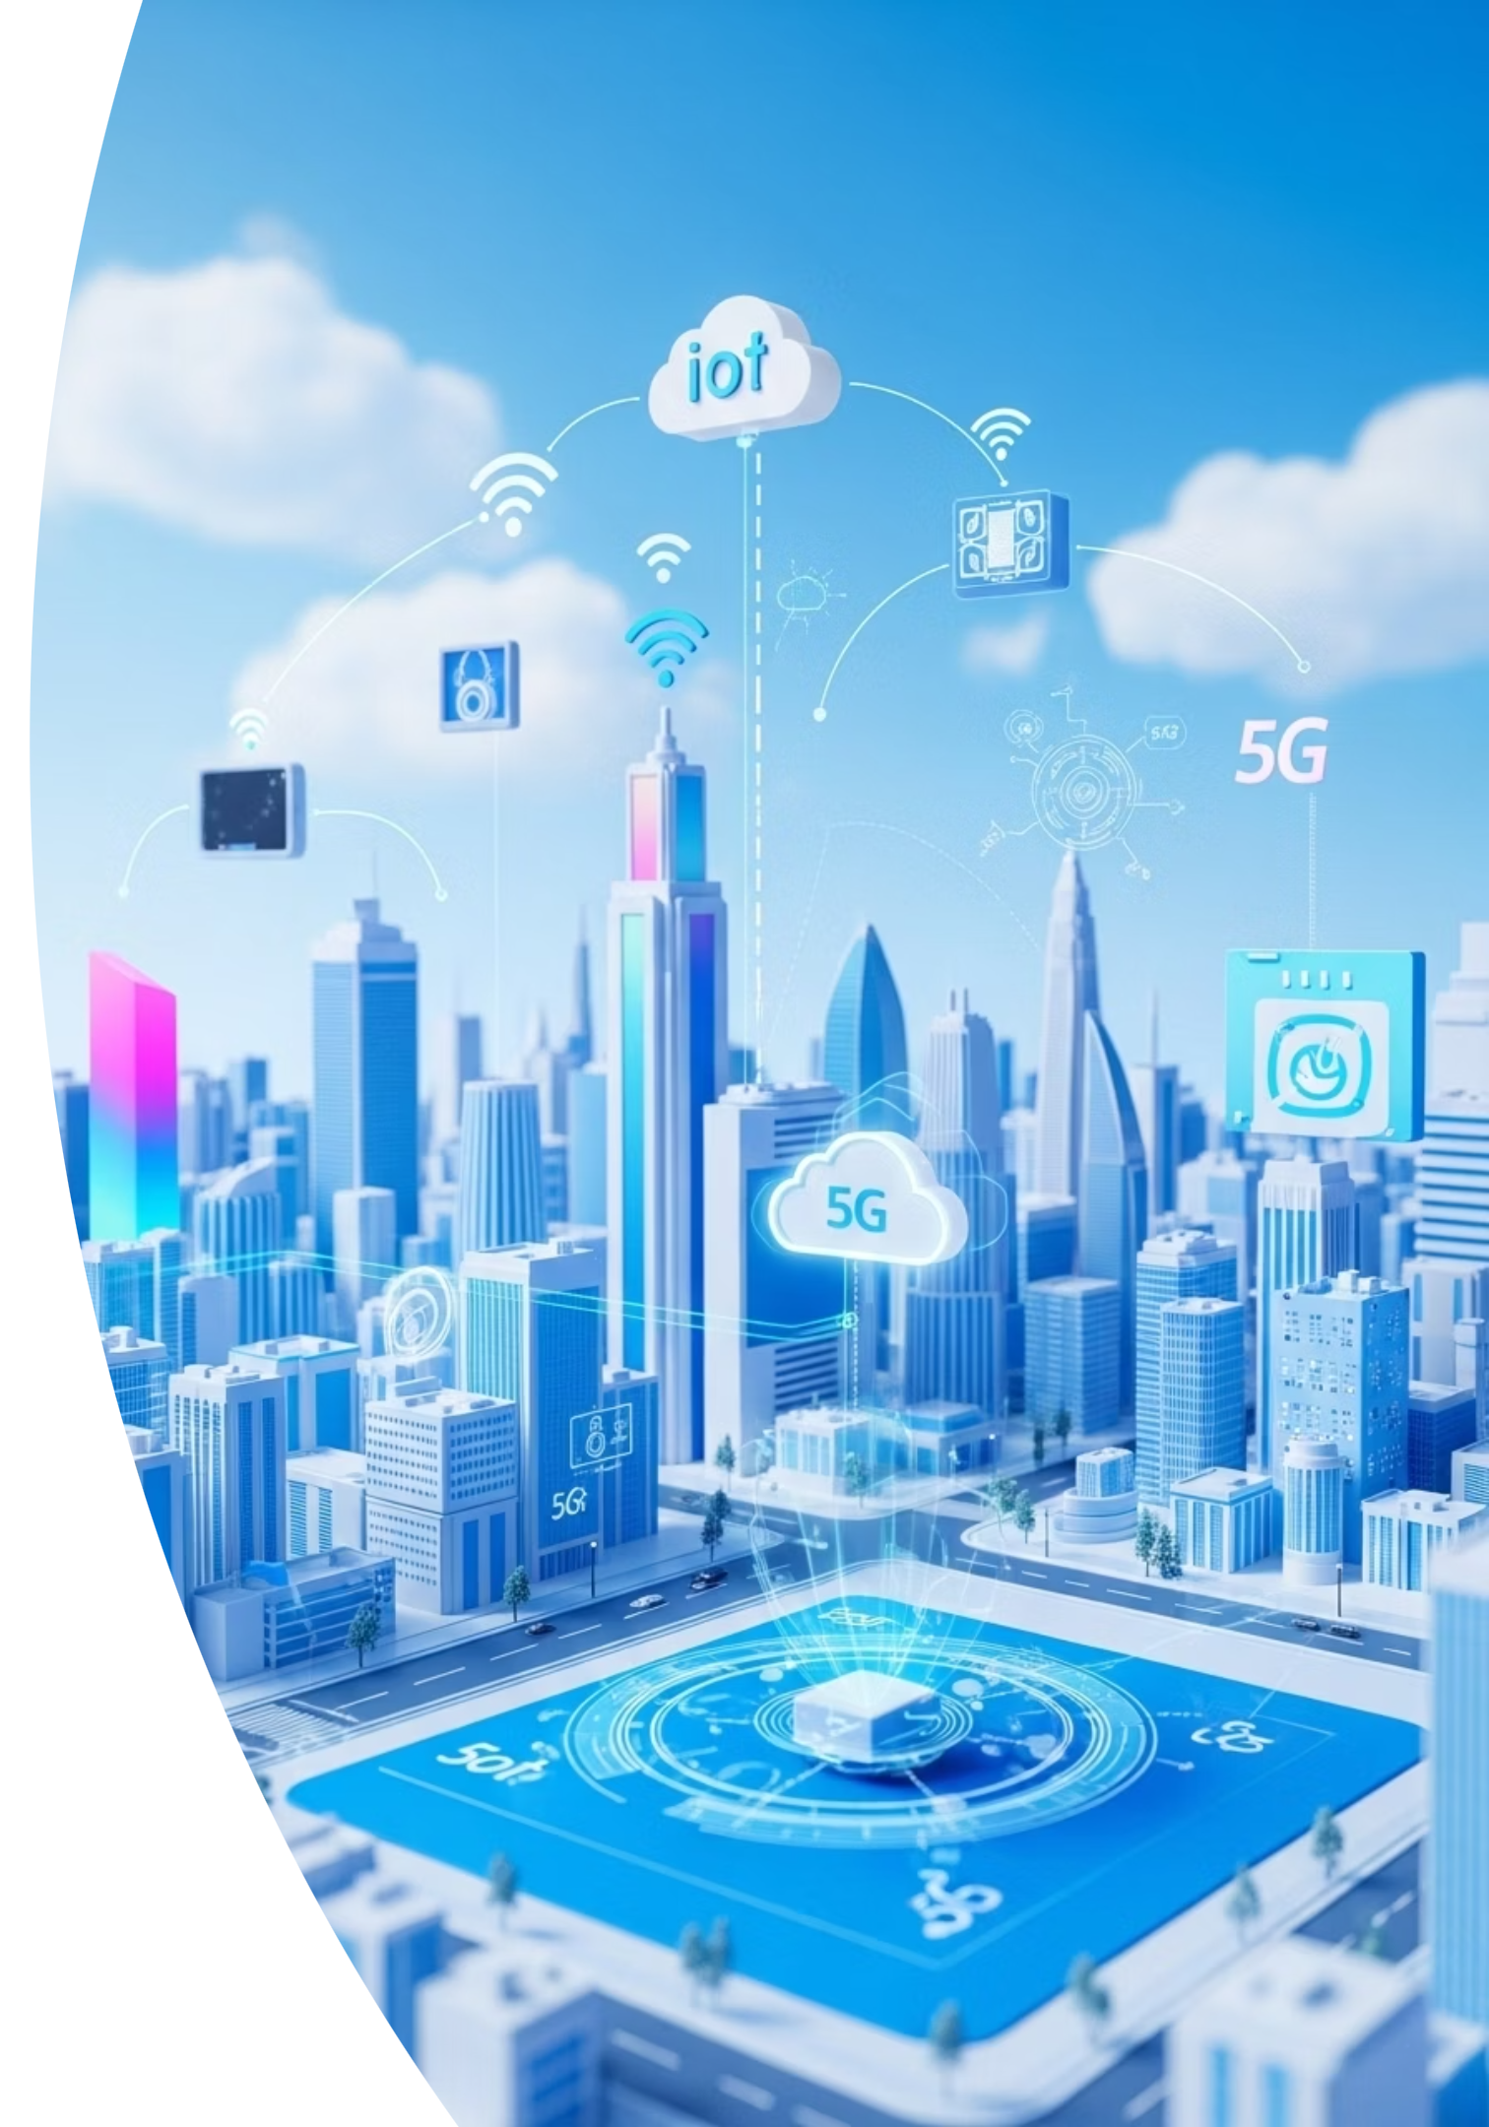
Emerging Network Security Challenges
Cloud Networking
5G Networks
As organizations migrate to cloud environments, traditional network boundaries disappear, requiring new security approaches.
Higher speeds and lower latency enable new applications but also introduce new security considerations.
IoT Security
Zero Trust Architecture
The proliferation of Internet of Things devices creates new attack vectors and challenges for network security.
Moving from perimeter-based security to a model that verifies every access request, regardless of source.
The evolution of networking technologies continues to reshape the cybersecurity landscape, requiring security professionals to constantly adapt their strategies and skills.

Slide 19


Practical Network Security Tools
1
Wireshark
Network protocol analyzer for monitoring and troubleshooting network traffic
2
Ettercap
Simulating ARP Spoofing (Man-in-the-Middle Attack)
3
VLAN
Understand how VLANs logically segment network traffic to improve security.
Proficiency with these tools is valuable for both defensive security operations and offensive security testing. They provide visibility into network activity and help identify potential security issues.

Slide 20

Final Thoughts: The Heartbeat of Cybersecurity
Networking is the invisible thread that ties every system together, and knowing how it works is the first step in protecting it.
Whether you're just starting out or aiming for a cybersecurity career, these networking fundamentals give you the map to navigate and secure the digital landscape.
In the next chapters, we will explore how to apply this knowledge to detect threats, respond to incidents, and build resilient systems capable of withstanding real-world attacks.
Understanding networking is not just about connectivity—it's about building the foundation for effective cybersecurity.

