Slide 1
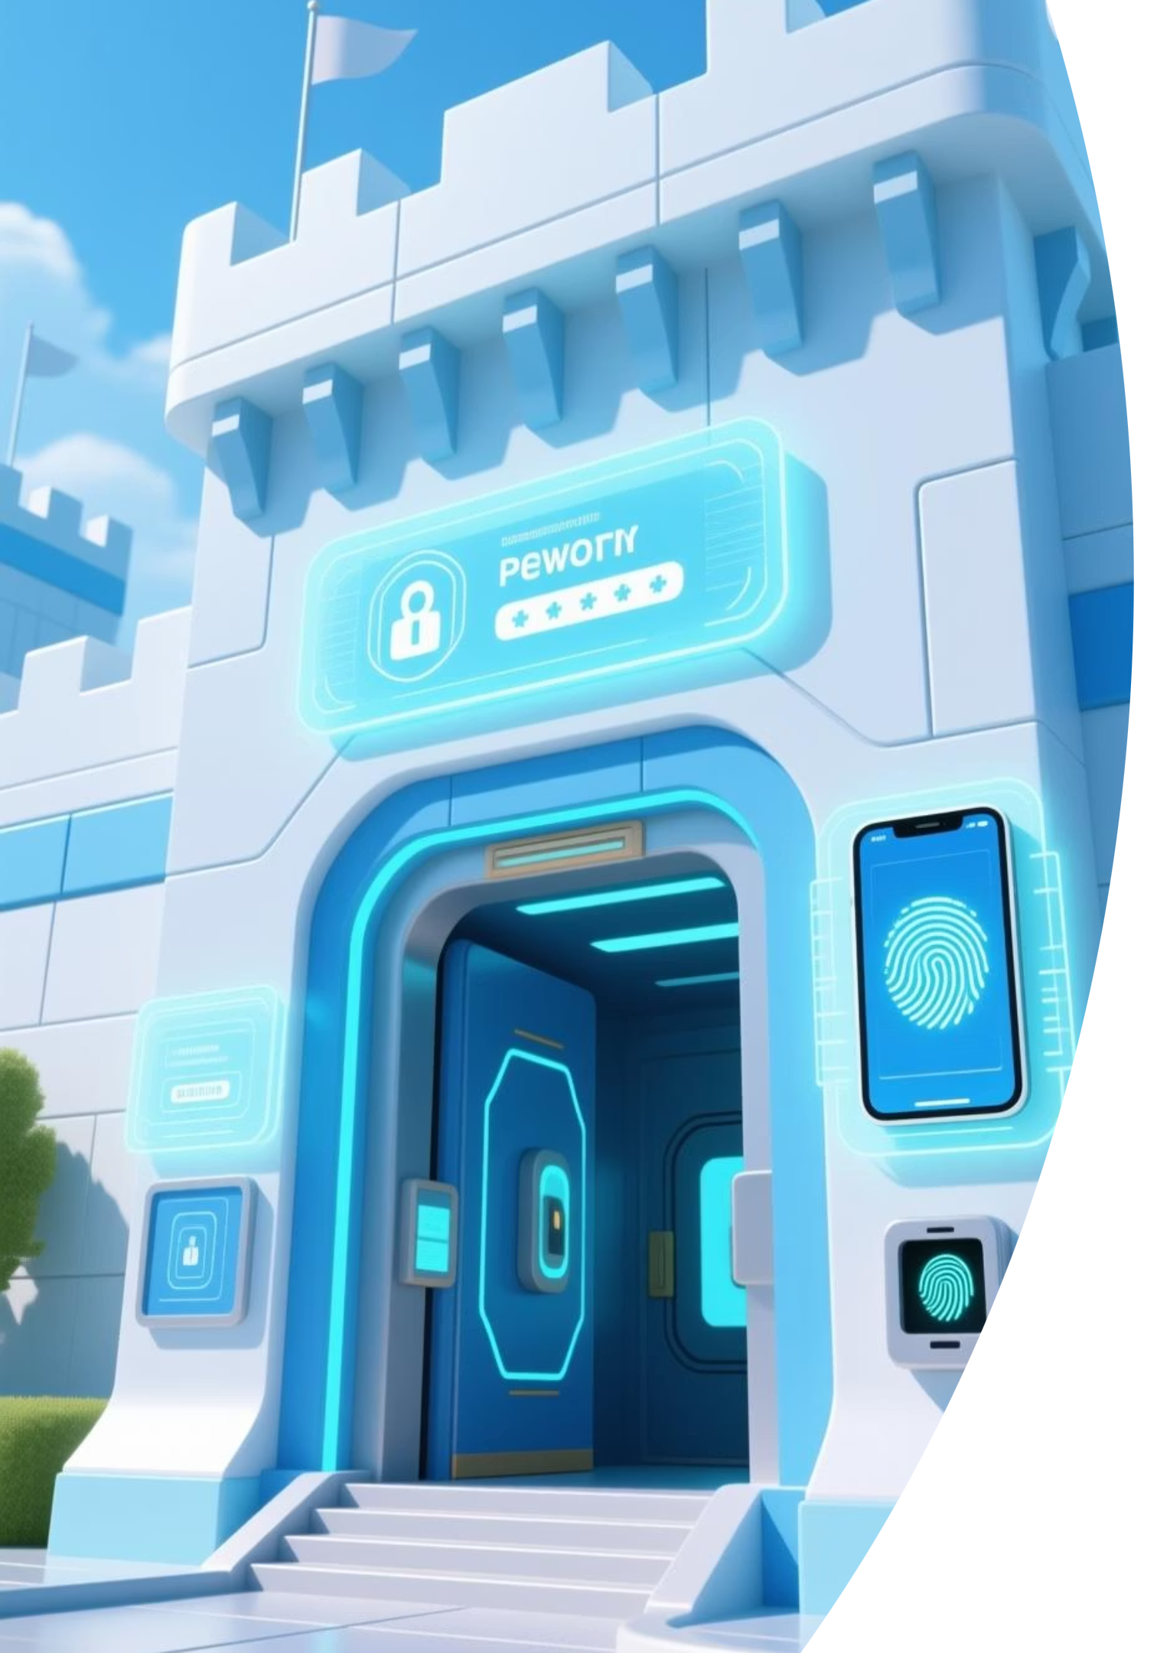
Password Policies, Multi-Factor Authentication (MFA), and Biometrics
Strong authentication is the cornerstone of cybersecurity. It prevents unauthorized access, protects sensitive data, and supports regulatory compliance. These concepts not only enhance digital trust but also form a key part of the ISC2 Certified in Cybersecurity (CC) exam.

Slide 2
Chapter Agenda
Password Policies
Multi-Factor Authentication
Understanding the power and pitfalls of passwords and how to create strong password policies
Exploring MFA as an essential second layer of protection beyond passwords
Biometric Security
Combined Approaches
Examining how physical characteristics can serve as authentication factors
Implementing defense in depth with layered authentication methods

Slide 3
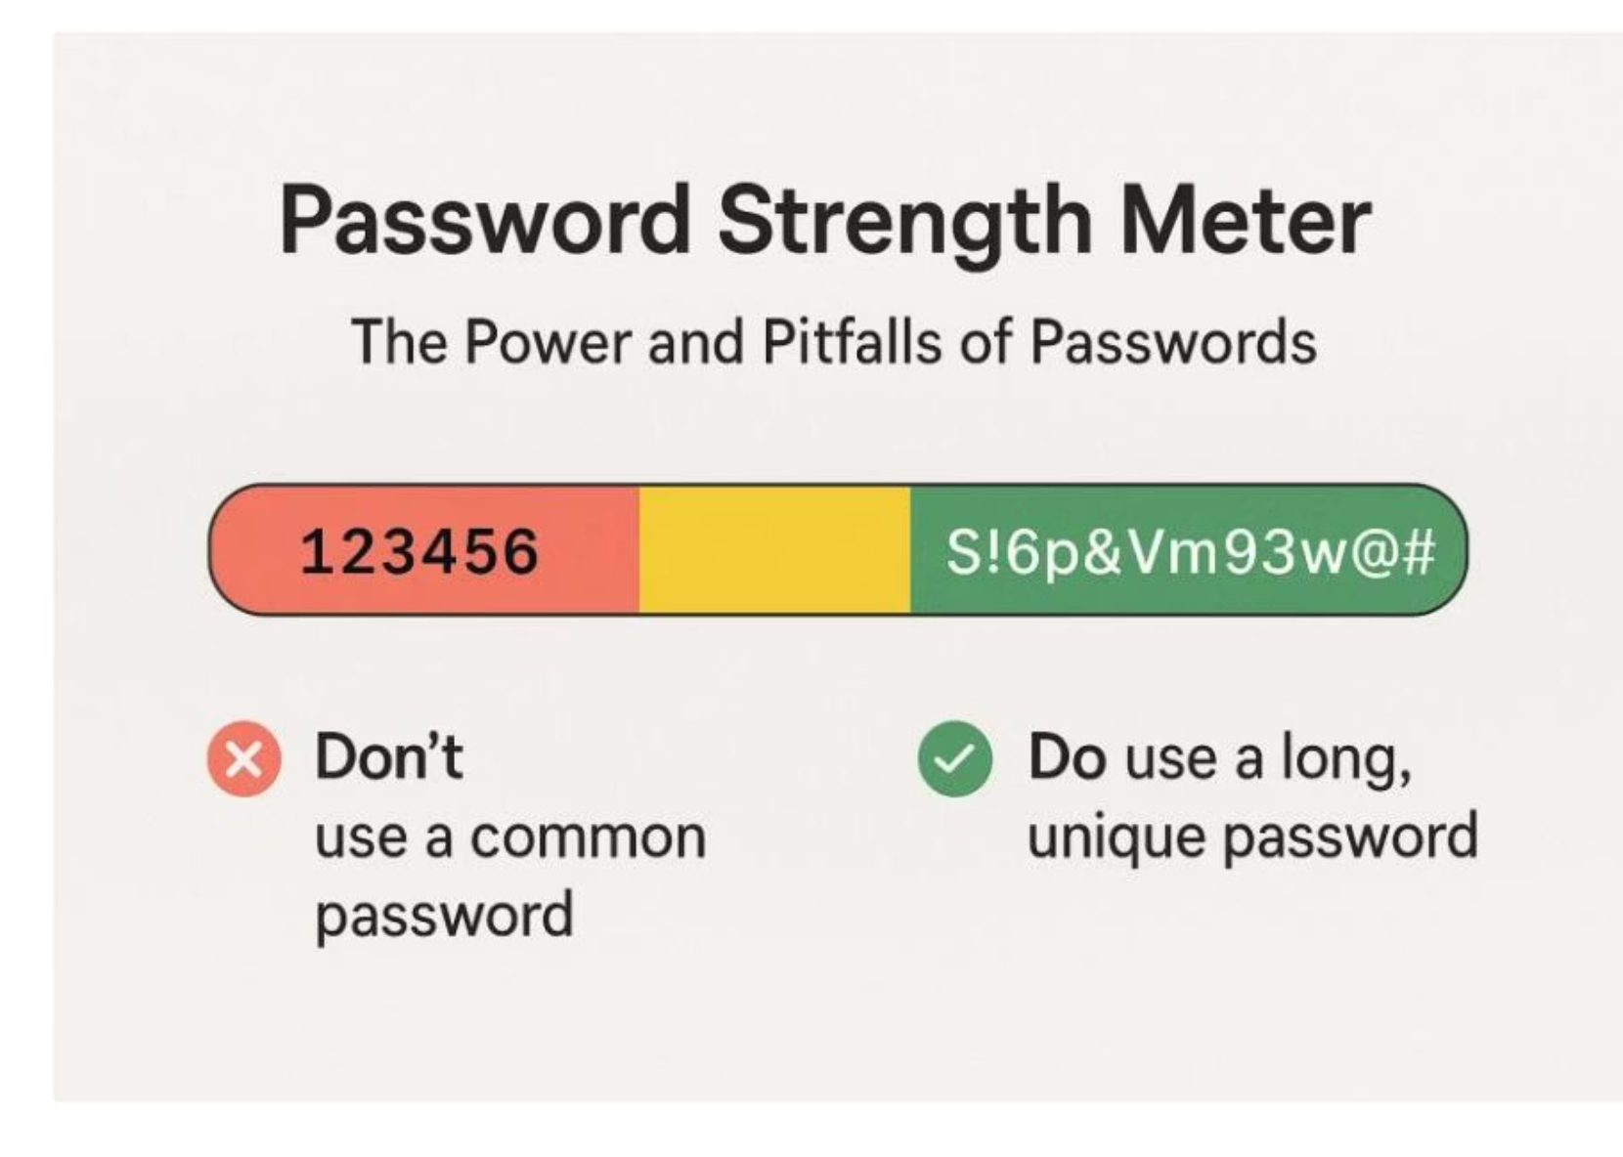
The Power and Pitfalls of Passwords
Passwords are the most common form of authentication, but they are also the most frequently exploited. In many breaches, attackers didn't have to hack anything—they simply logged in with stolen or weak credentials.
When poorly managed, passwords become the weakest link in an organization's security chain, making a strong password policy essential, not just recommended.
Figure 3.1: Weak vs. strong passwords

Slide 4
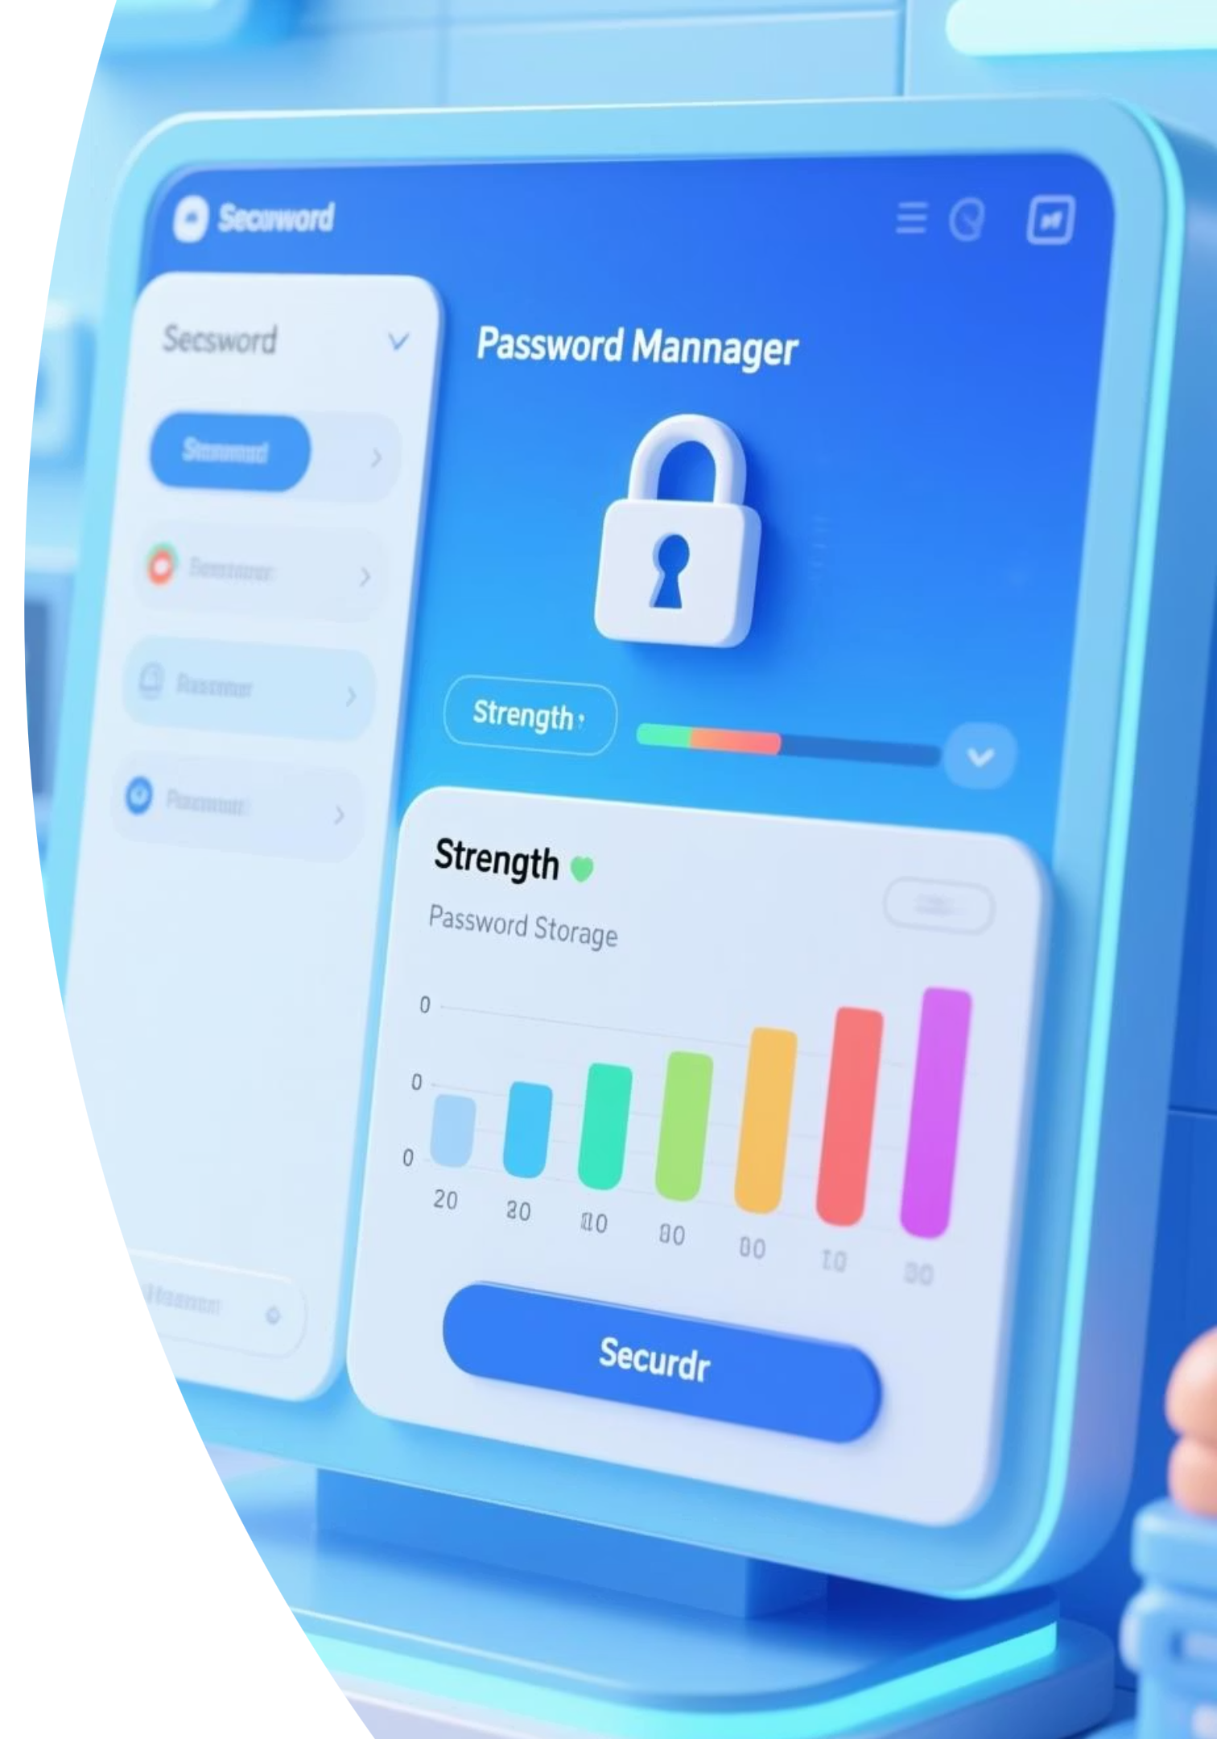
Creating a Strong Password Policy
Password Complexity
Passwords should be 12-16 characters long and combine uppercase letters, lowercase letters, numbers, and symbols.
Users should avoid predictable sequences, dictionary words, or personal information.
Password Hygiene Rules
Enforce regular password changes (e.g., every 90 days)
Lock accounts after repeated failed login attempts
Prevent password reuse
Encourage the use of password managers

Slide 5
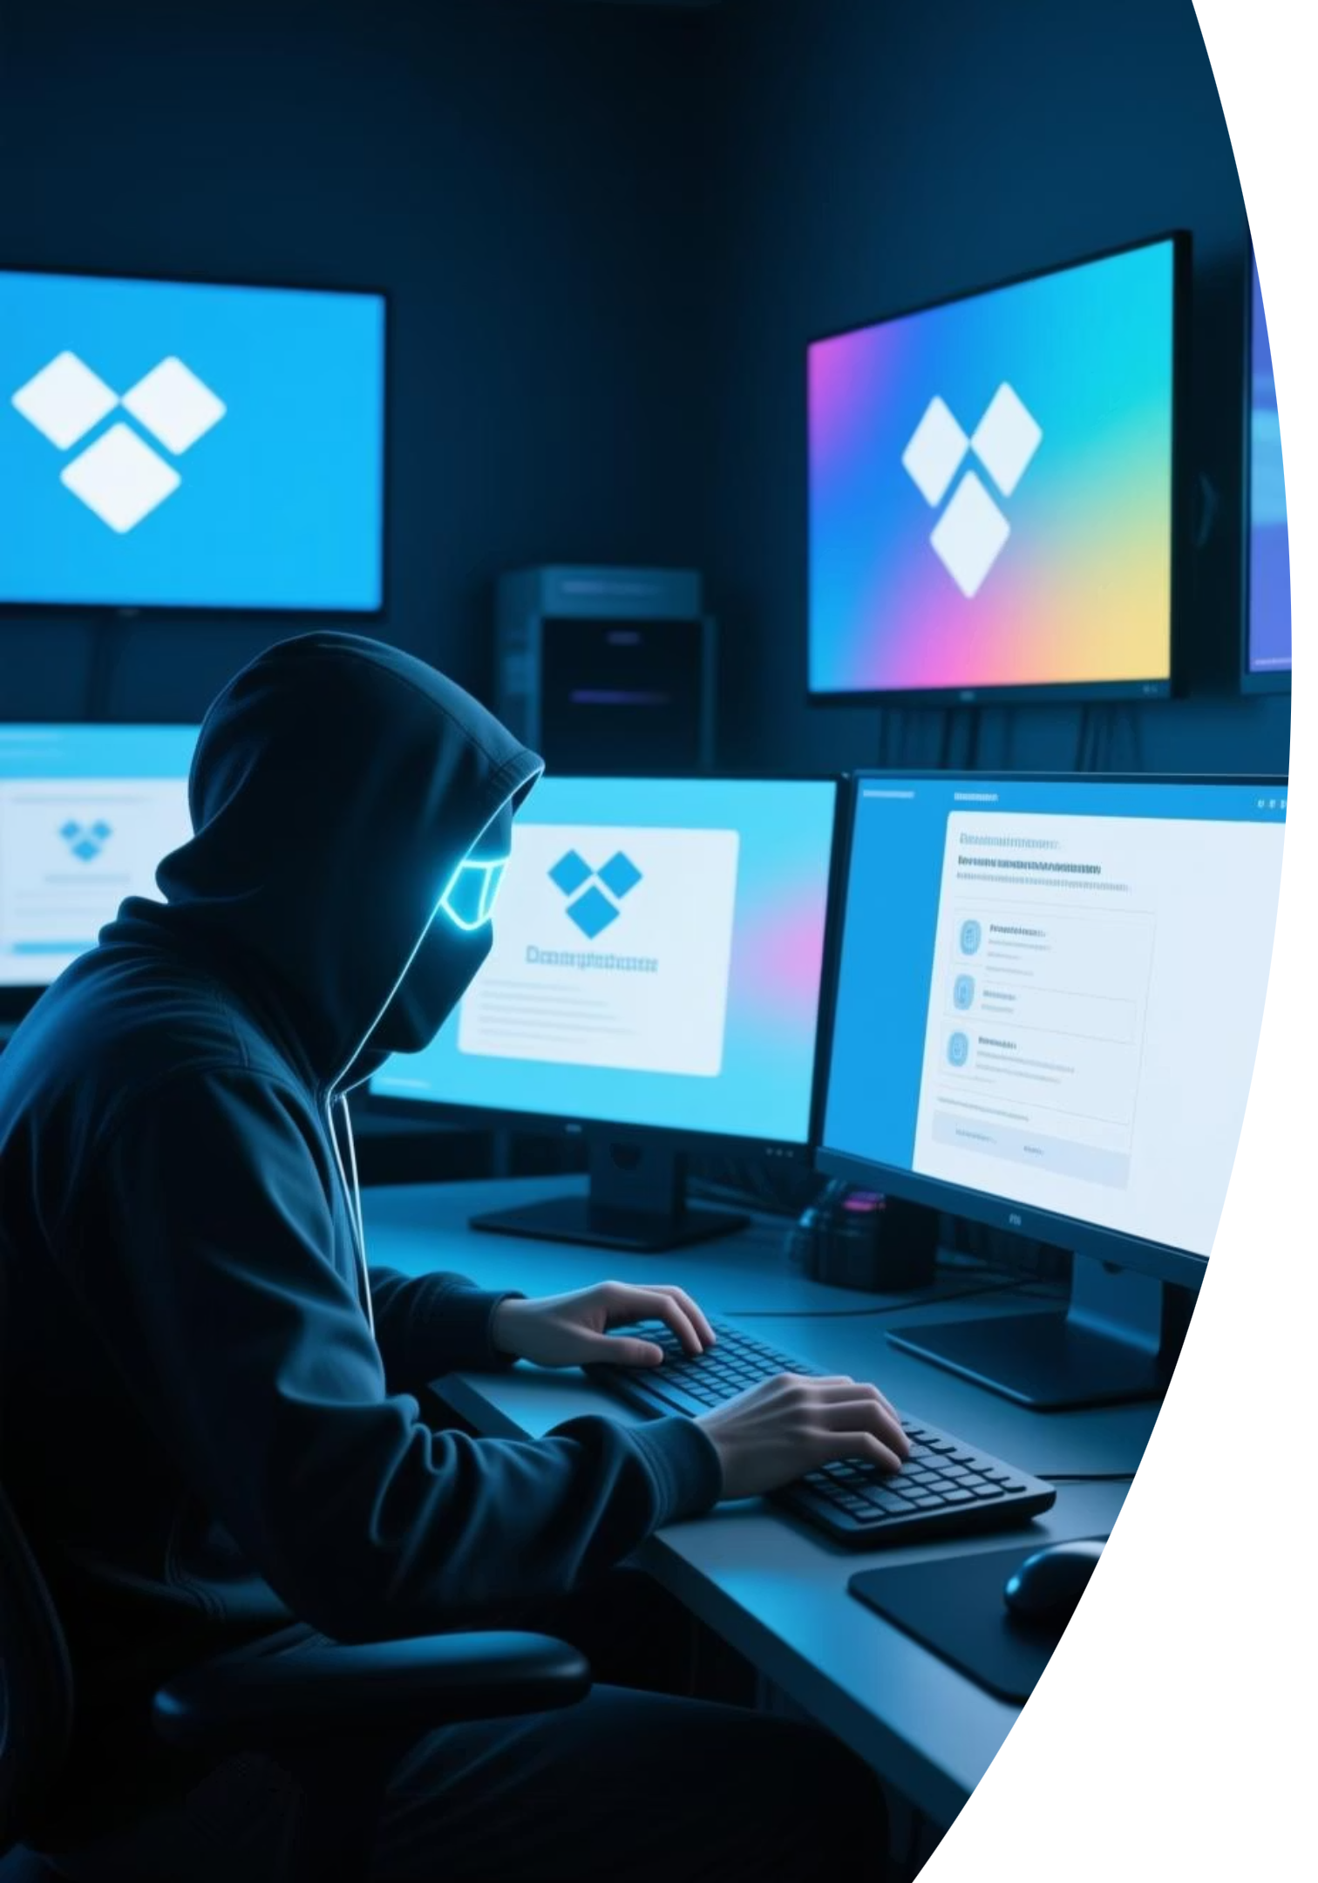
Case Study: The Dropbox Incident
In 2012, Dropbox suffered a breach that exposed over 68 million accounts.
The root cause? Password reuse. An employee reused their corporate password on another site that got hacked. Once attackers obtained those credentials, they used them to log in to Dropbox systems.
This breach highlighted the danger of relying solely on passwords and the critical need for multi-layered authentication.

Slide 6
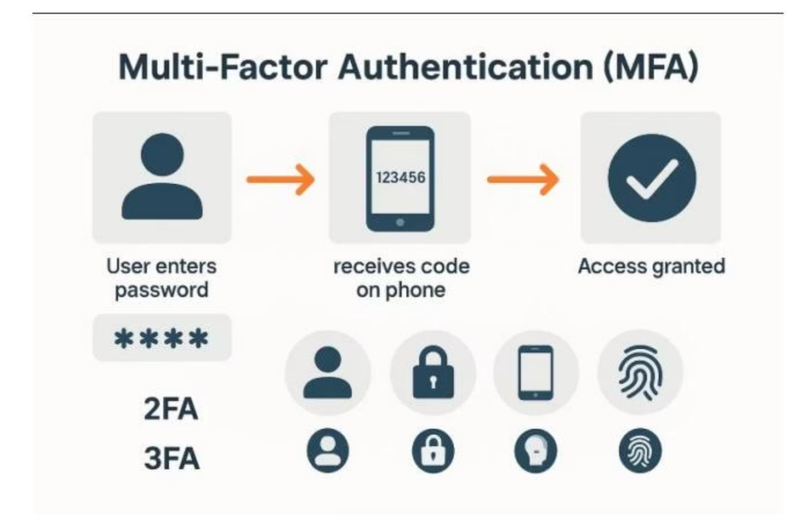
Multi-Factor Authentication (MFA)
Multi-Factor Authentication (MFA) adds an extra layer of protection beyond just a username and password. Even if an attacker steals a user's password, they still can't gain access without the second factor.
MFA works by combining two or more authentication factors from different categories.
Figure 3.2: How MFA works

Slide 7



The Three Authentication Factors
Something You Know
Something You Have
Something You Are
Information only the user should know, such as a password, PIN, or the answer to a security question.
A physical item the user possesses, such as a smartphone, security token, smartcard, or USB key.
Biometric data unique to the user, like a fingerprint, facial recognition, retina scan, or voice pattern.
Common MFA implementations include receiving a code on your phone after entering your password or using an authenticator app like Google Authenticator or Microsoft Authenticator.

Slide 8
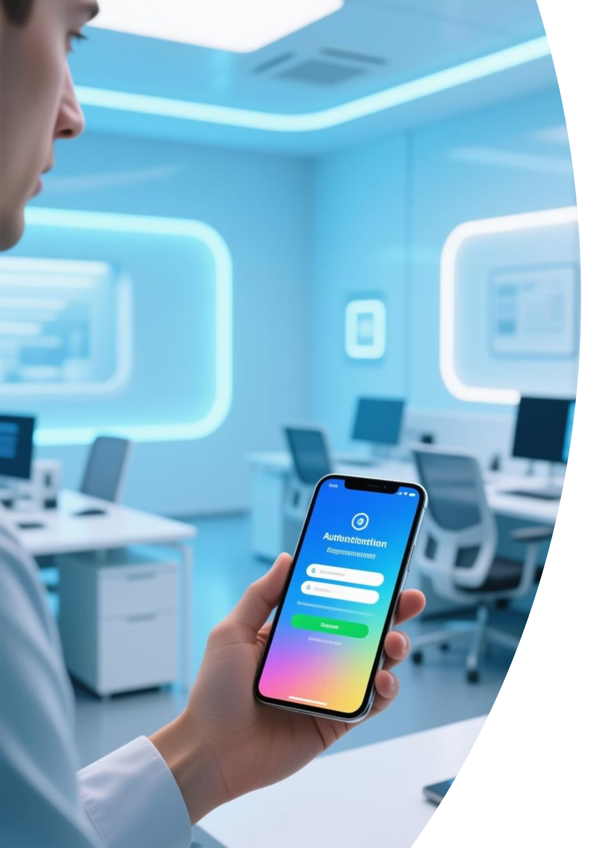

Real-World Example: Google's Mandatory MFA
Google reported in 2021 that enabling MFA via security keys blocked 100% of automated bot attacks and 96% of phishing attempts.
As a result, Google made MFA mandatory for over 150 million users. The result was a dramatic drop in account hijackings.
Why MFA Matters:
MFA is particularly effective against phishing, password spraying, and credential stuffing attacks. It's a low-cost, high-impact defense that every organization—regardless of size—should adopt.

Slide 9

Biometrics: Your Body as a Password
Biometric authentication uses unique physical or behavioral characteristics to verify identity. Unlike passwords, biometrics can't be forgotten. And unlike MFA devices, they can't be lost or left behind.
Common Biometric Methods:
Fingerprint scanning
Facial recognition
Retina and iris scans
Voice recognition
Behavioral biometrics (typing rhythm, walking gait)

Slide 10
Pros and Cons of Biometrics
Advantages
Disadvantages
Harder to steal or replicate than passwords
Privacy concerns (storing biometric data)
Convenient for users - nothing to remember
Once compromised, cannot be changed
Often faster than typing passwords
High accuracy systems can be expensive
The permanence of biometric data creates unique security challenges - you can change a password, but you can't change your fingerprints.

Slide 11
Case Study: Biometric Hacking
In 2014, German hackers from the Chaos Computer Club recreated the fingerprint of a German politician using high-resolution photos and wood glue.
Figure 3.4: Biometric spoofing from photos
The incident sparked debate on whether biometrics should be used as primary or secondary authentication, especially since biometrics are not secret—your face and fingerprints are everywhere.

Slide 12
Combining Authentication Methods
No single method is perfect on its own. Strong security requires layers. This approach, known as defense in depth, drastically reduces the chances of unauthorized access.
Biometric Verification
Approve Push Notification
User provides something they are (fingerprint)
Enter Password
User confirms on something they have (smartphone)
User provides something they know (password)
This multi-layered process makes it significantly harder for attackers to bypass authentication—even if they succeed in one area.

Slide 13
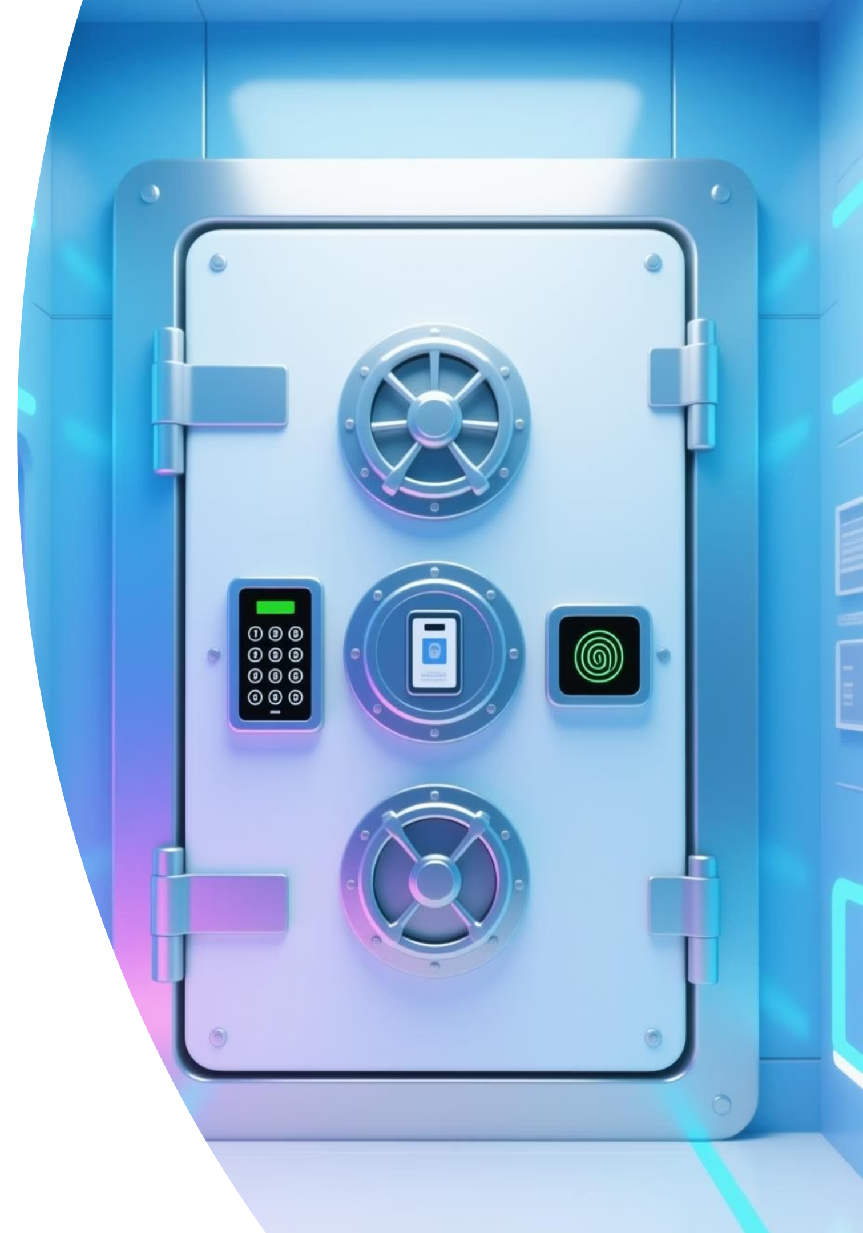
Visual Learning Aid: The Secure Vault
The Keypad
The Security Badge
Represents the password (something you know)
Represents a smart device or token (something you have)
The Retina Scanner
Represents biometrics (something you are)
Each layer adds another obstacle for attackers, significantly increasing security.

Slide 14
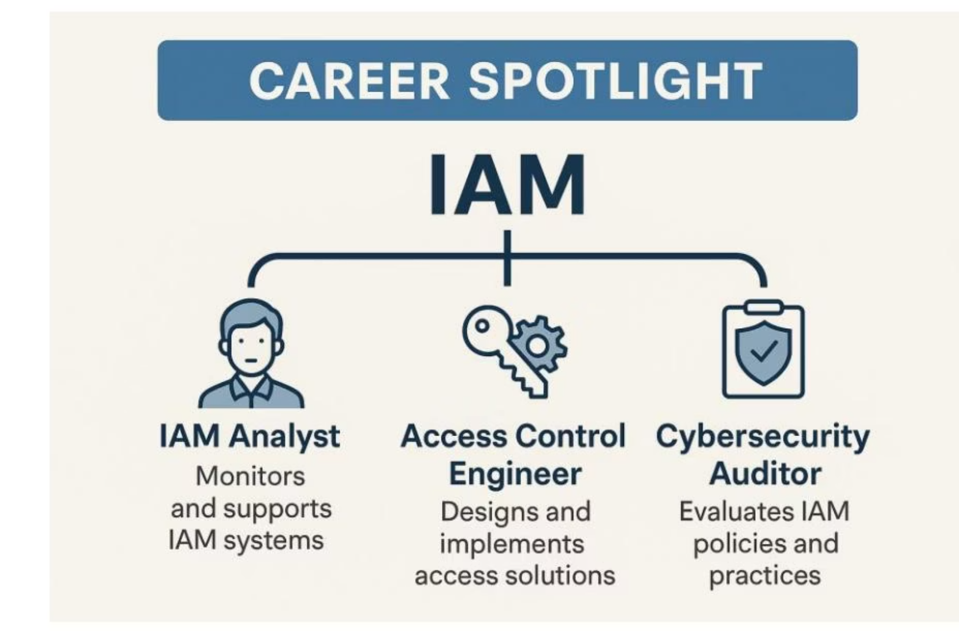
Career Spotlight: Identity and Access Management
Professionals who specialize in authentication and access control play a critical role in cybersecurity teams. These roles are foundational and often serve as entry points for aspiring cybersecurity professionals.
Understanding authentication methods is essential for these career paths and for the ISC2 Certified in Cybersecurity (CC) exam.
Figure 3.5: IAM roles

Slide 15

In-Demand IAM Roles
1
2
3
IAM Analyst
Access Control Engineer
Cybersecurity Auditor
Focuses on user provisioning, access reviews, and implementing IAM tools.
Designs and maintains access systems like Active Directory, Azure AD, and AWS IAM.
Reviews password policies, MFA configurations, and access logs for compliance.
Ensures the right people have the right access at the right time.
Builds the technical infrastructure that enforces authentication policies.
Ensures authentication practices meet regulatory requirements and industry standards.

Slide 16




Authentication in Practice: Enterprise VPN
Let's examine how layered authentication works in a real-world scenario: logging in to an enterprise VPN.
Step 1
Step 2
Step 3
Enter your username and password (something you know)
Approve a push notification on your smartphone (something you have)
Use a fingerprint scan for final access (something you are)

Slide 17
Authentication Factor Comparison
Factor Type
Examples
Strengths
Weaknesses
Something you know
Password, PIN
Easy to implement
Can be forgotten or stolen
Something you have
Token, smartphone
Hard to duplicate
Can be lost or stolen
Something you are
Fingerprint, face
Unique to individual
Cannot be changed if compromised
The most secure authentication systems combine factors from at least two different categories, compensating for the weaknesses of each individual method.

Slide 18

The Cybersecurity Mindset
The next time you log in, ask yourself: What would happen if this one step failed?
That's the mindset that separates casual users from cybersecurity professionals.
Password policies, MFA, and biometrics are more than just technical topics—they're real-world tools for defending organizations against daily cyber threats. Understanding how they work together helps build a solid cybersecurity foundation.
As threats grow more sophisticated, layered authentication isn't a luxury—it's a necessity.

Slide 19
Key Takeaways
1
Password policies are essential but insufficient alone
2
MFA provides critical additional protection
Combining factors from different categories (know/have/are) dramatically increases security, as demonstrated by Google's 100% success against bot attacks.
Strong passwords should be 12-16 characters with mixed character types, but even the strongest passwords can be compromised.
3
Biometrics offer convenience with unique challenges
4
Defense in depth is the gold standard
Layering multiple authentication methods creates the strongest possible security posture.
While biometrics can't be forgotten, they also can't be changed if compromised, as shown by the Chaos Computer Club case.

Slide 20
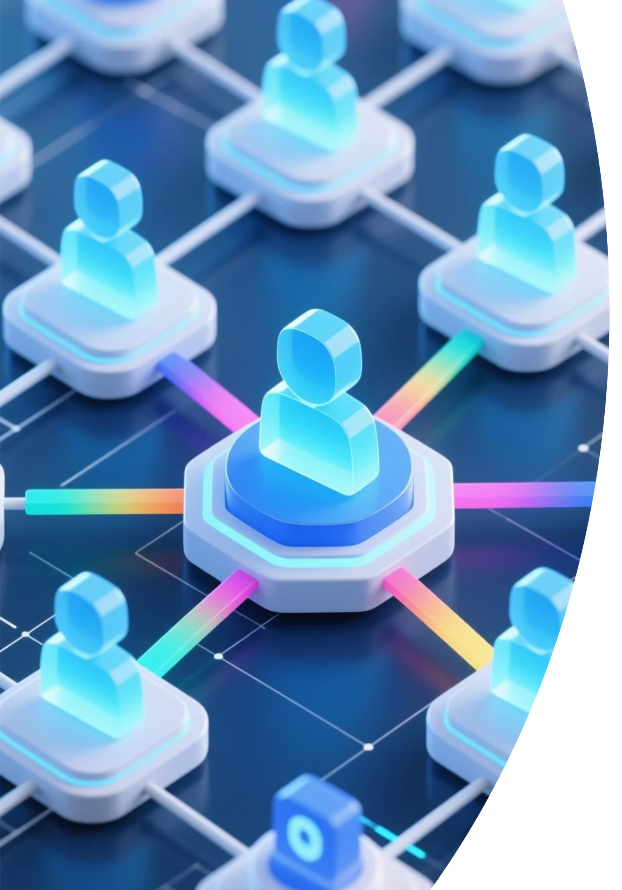






Coming Up Next
In the lab session, we'll look at how organizations simplify and secure access by assigning permissions based on roles rather than individuals, in our discussion of Role-Based Access Control (RBAC).
Role-Based Access Control
Principle of Least Privilege
Learn how RBAC simplifies permissions management and enhances security
Understand how to minimize attack surface through proper access limitations
Access Review Processes
Explore best practices for ongoing access management and compliance

